Slide 1
Alabama:
Our Beautiful Home
Chapter 5: Settlement of a Territory
STUDY PRESENTATION
© 2013 Clairmont Press

Slide 2
Section 1: Pioneers
Section 2: Frontiers Open to Settlement
Section 3: Different Cultures Move to the Alabama Frontier
Section 4: Slavery in Alabama

Slide 3
Section 1: Pioneers
Essential Question: How did settlers move around in the Alabama territory?

Slide 4
Section 1: Pioneers
What terms do I need to know?
navigable
frontier

Slide 5
Introduction
Good land, good climate, and navigable rivers attracted settlers to Alabama.
Some settlers were wealthy and brought their own slave workers.
Most were poor and had to fish, hunt, or grow their own food to live.
Most settlers were from Virginia, the Carolinas, or Georgia travelling on paths made by Indians or soldiers.

Slide 6
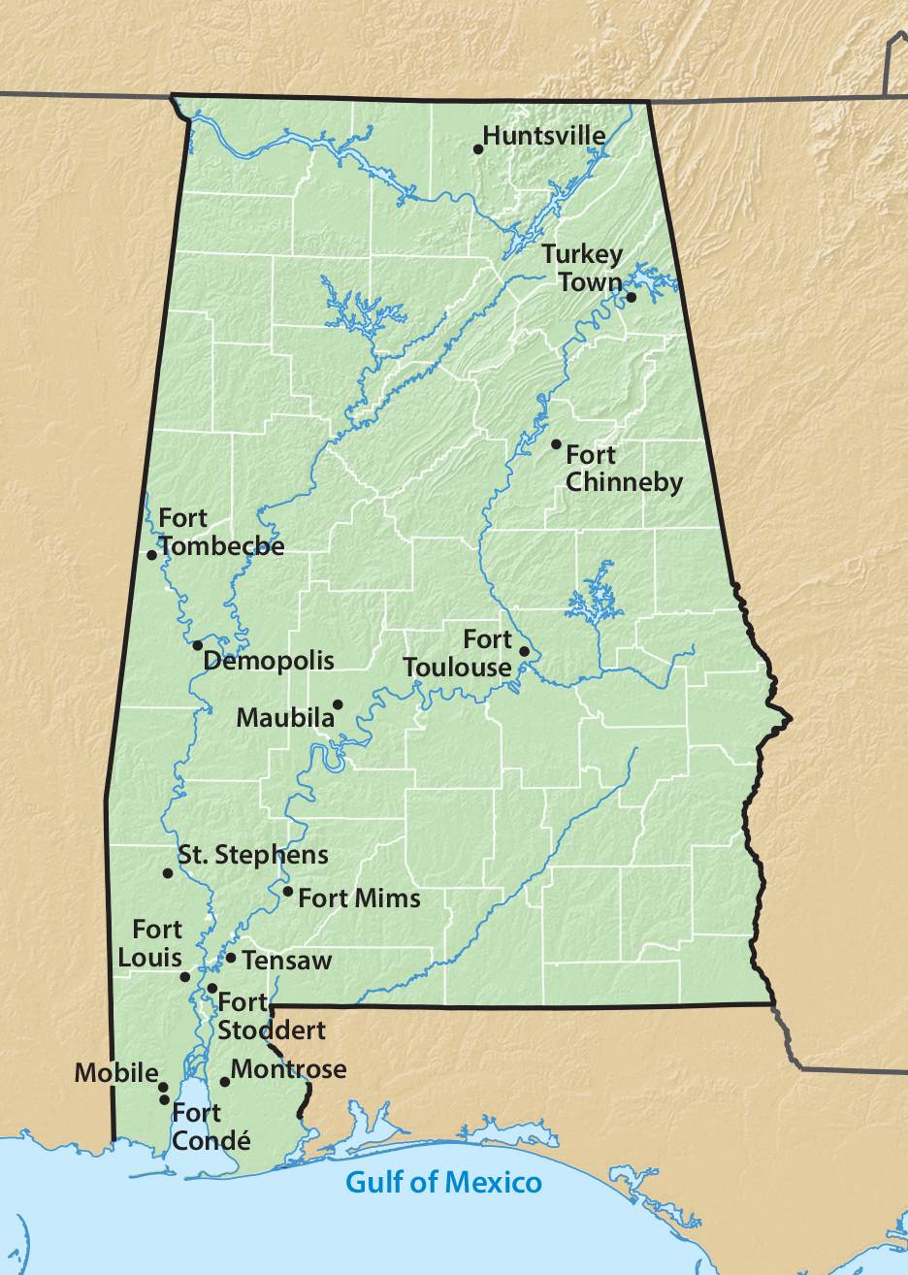
Early Settlements in Alabama

Slide 7
Pioneer Roads
The Federal Road and Natchez Trace (1806) were the first real roads into Alabama.
They connected Washington, D.C. to New Orleans, Louisiana.
Settlers traveled in groups for protection.
Roads were rough and had no bridges.
The Huntsville Road connected St. Stephens, Alabama’s capital, with Philadelphia, Pennsylvania.

Slide 8
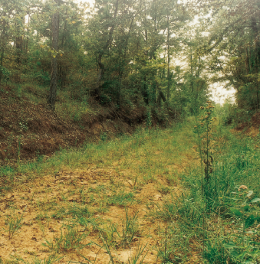
Traveling the Roads
Poor settlers pulled their own carts with all their belongings. Wealthier settlers had horses or oxen to pull wagons.
Some roads were simply a path.
Well-traveled roads might have a tavern, fort, or food stand along the way, but prices were high.

Slide 9
Section 2: Frontiers Open to Settlement
Essential Question: How did settlers survive on the frontier?

Slide 10
Section 2: Frontiers Open to Settlement
What terms do I need to know?
squatter
speculator
yeoman

Slide 11
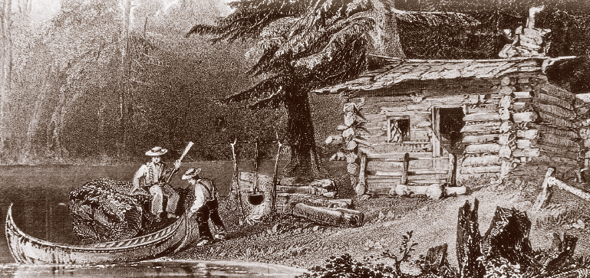
Introduction
Some settlers called squatters did not wait to buy land; they just came, cleared land, and built a cabin.
Lands were surveyed and then sold in 40 or 80 acres sizes.
Land investors (speculators) bought large amounts of land with plans to sell it for a profit.

Slide 12
The Life of Yeoman Farmers
Most of the pioneers were yeoman farmers (small farms).
They grew their own vegetables and hunted animals for food.
Their cattle roamed the woods for food.

Slide 13
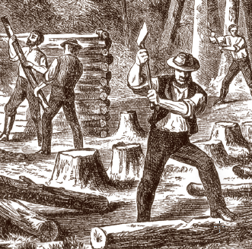
Building Log Cabins
Most settlers built log cabins for shelter.
Tree trunks were cut and stacked to build walls. Roofs were made of thick boards.
Chinking was the process of filling the gaps in the wall with mud, rocks, and sticks to keep out the winds and rain.

Slide 14
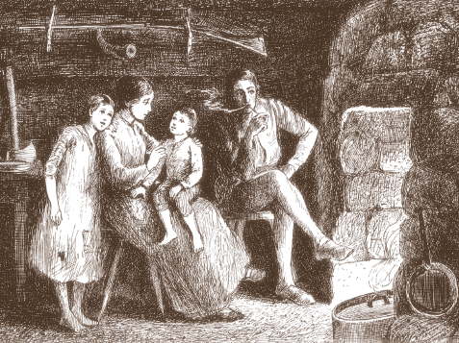
Living in the Cabin
A fireplace kept the cabin warm and was used for cooking.
Streams were used for water.
Most cabins had one room and maybe a loft for the children.
Mattresses were made of hay, grass, cornhusks, Spanish moss, etc. and deer or bear hides were blankets.
Most settlers built their own furniture.

Slide 15
Farming
Forests covered Alabama, so farmers had to clear areas to make farmland which might take a year!
Farm families grew peas, corn, beans, potatoes, sugarcane, and melons. They had to store enough food for the winter.
Tobacco and cotton might be grown to sell for money.

Slide 16
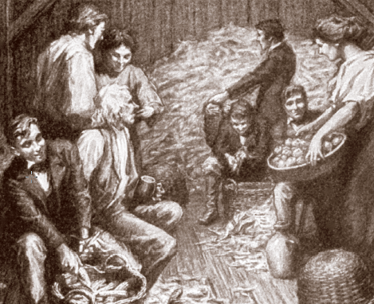
Fun on the Frontier
Settlers often lived lonely lives, but neighboring families helped each other.
They might work together to build a barn or to make quilts.
Storytellers and musicians helped others have a fun evening.
Corn shuckin’s were events to take the husks off corn. Contests, music, and games made the event fun.

Slide 17
Education on the Frontier
Survival on the frontier was hard so there was little time for education of children.
The first school opened in 1799 and others slowly followed – usually in one-room log cabins.
Schools had no paper, pencils, or books. Some students wrote with chalk on slate.
A single teacher taught all grades.

Slide 18
Section 3: Different Cultures Move to Alabama
Essential Question: How did people with different cultures live together in Alabama?

Slide 19
Section 3: Different Cultures Move to Alabama
What terms do I need to know?
freedmen
plantation
planter

Slide 20
The Vine and Olive Company
In 1817, French settlers came to the Tombigbee River area to grove grapes and olives.
The group had many problems and failed to grow the crops they wanted.
They moved to the Gulf Coast but left behind some French names such as Marengo, Bon Secour, and Bayou La Batre.

Slide 21
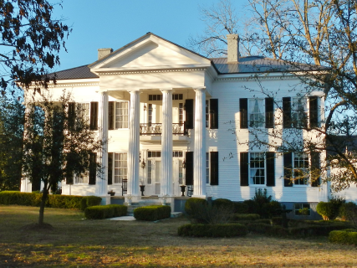
Planters
A few people, called planters, had large farms called plantations.
Slaves were used as workers.
Plantations usually grew or made everything that they needed to survive.
Extra money was used to buy goods from Europe brought through ports at New Orleans and Mobile.
Plantation home in Lowndesboro

Slide 22
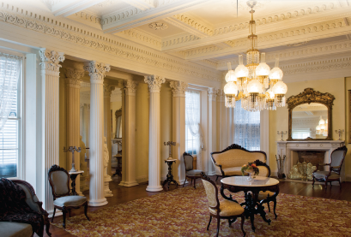
Plantation Homes
Planters often had very large, beautiful homes.
High ceilings in the homes kept them cooler in summer but hard to heat in winter.
Artists would visit to paint portraits of the family.
The kitchen was a separate building in order to protect the main house from accidental fires.

Slide 23
Social Life of Planters
Families visited other planter families traveling by horse or carriage.
Men might travel to a nearby town for supplies and news.
Women sewed or embroidered while they talked to each other. Some painted or played music.
Outdoor parties, foxhunts, weddings, and church services filled the social life of planters’ families.
Click to see Alabama plantations

Slide 24
Plantation Children
Planters hired teachers for their sons to teach them Latin, English, history, literature, and mathematics.
Some attended east coast universities and others the University of Alabama.
Boys were allowed the freedom to roam the fields and forests, learn to use a gun, hunt, and swim.
Some daughters of planters were allowed to attend special girls’ schools. Girls studied French, music, geography, and literature. At home they learned to sew and entertain.
The girls also learned to direct the people who worked in the house and yard.

Slide 25
Section 4: Slavery in Alabama
Essential Question: How did slaves contribute to the growth of Alabama?

Slide 26
Section 4: Slavery in Alabama
What terms do I need to know?
cotton gin
economy
mill

Slide 27
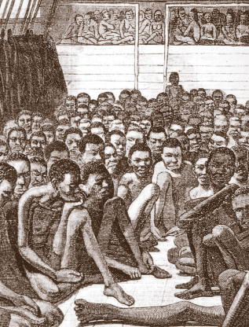
Slavery
Black slaves had been a part of the Spanish and French settlements.
The British started bringing Africans to America in 1619 to work as slaves on Virginia plantations.
The first slaves to come to Mobile arrived in 1721.
Slaves were forced to work and could not quit their jobs or leave the area.

Slide 28
The Last Slave Ship
A law was passed in 1808 to stop slaves from coming into the United States.
The Clotilda arrived in Mobile in 1860 with a load of slaves to sneak in and sell. Descendents of this group later started a settlement near Mobile called AfricaTown, USA.
In 1860, about 1/3 of Alabama families owned slaves. Most owned less than five slaves.
The Black Belt and Tennessee River Valley were good for growing cotton and so had the most slaves.

Slide 29
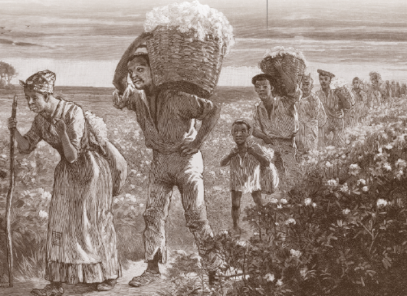
The Life of Slaves
Field slaves worked outdoors on the farm from sunrise to sunset.
House slaves worked as servants for the family in the house. Slaves lived in cabins, often with dirt floors.
Masters (owners) gave food and clothing to the slaves. Wives would often serve as nurses to sick slaves.

Slide 30
Beliefs and Customs of Slaves
Slaves had to ask permission to marry.
Slaves sang songs of heaven where life seemed better than their earthly life.
African traditions of singing and preaching blended with the traditions of southern churches.
Slaves could attend church with their white masters but sat in the back or in the balcony.

Slide 31
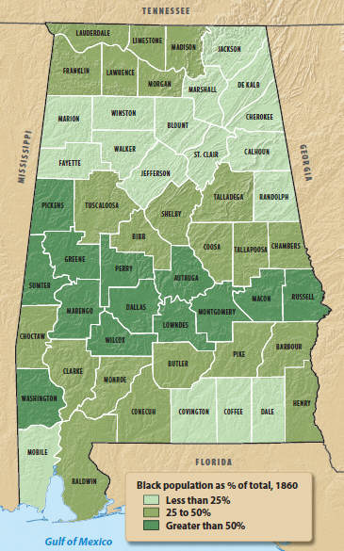
Slave Population 1860

Slide 32
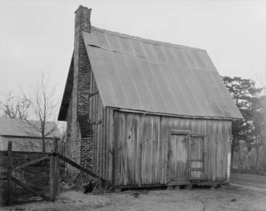
Slave Codes
Slave Codes were laws meant to control the lives of the slaves.
One law made it illegal to teach slaves to read or write.
Slaves could not carry weapons, own land or animals, or speak against a a white man in court.
Slaves who broke a law could be whipped or worse!
Slaves could be sold which might break up their families.
Slave cabin, Hale County, AL

Slide 33
Free Blacks
There were some free blacks in Alabama – some even owned slaves!
Slaves might buy their freedom or have it given to them by their masters.
Most free blacks moved to towns where they could work as carpenters, cooks, barbers, or factory workers.
Free blacks had to carry passes to prove they were free, but they could not vote. Most could not get an education.

Slide 34
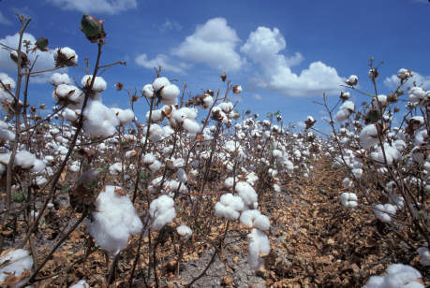
Cotton Gin Increases Amount of Cotton Grown
The dark soil of the Black Belt was good for growing cotton.
The state’s long growing season was good for the crop, too.

Slide 35
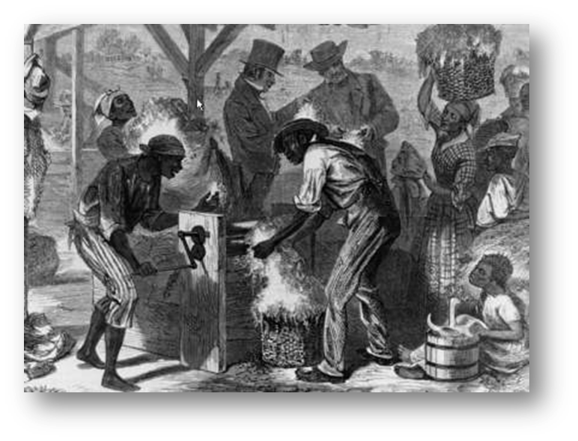
Eli Whitney’s Invention
Cotton bolls are filled with small seeds that must be removed.
Pulling these out by hand was a slow process.
Eli Whitney invented a cotton gin (1793) to pull the seeds from the cotton.
The invention, first powered by a man, was later powered by water or horse power.

Slide 36
Cotton Kingdom
The invention of the cotton gin encouraged farmers to grow cotton.
Alabama moved from growing 4% of America’s cotton to 23%.
Growing more cotton required more slave workers and made many people wealthy.
Alabama’s cotton was shipped to mills in Europe through the ports of Mobile and New Orleans.
This trade made Alabama a “cotton kingdom.”

Slide 37
Image Credits
Title slide: Alabama Capitol by National Park Service: National Register of Historic Places; Slide 2: Desoto Falls by JS Fouche Public Domain Wikimedia Commons; Slide 21: Rivers Langley on Wikimedia Commons; Slide 32, 35: Library of Congress; Slide 34: USDA; End slide: Coosa River by Mike Cline
Return to Main Menu

