Slide 1
Alabama:
Our Beautiful Home
Chapter 11: From Prosperity to Poverty and Back Again
STUDY PRESENTATION
© 2013 Clairmont Press

Slide 2
Section 1: Alabama – 100 Years Old
Section 2: The New Deal
Section 3: World War II
Section 4: The Cold War Leads to the Korean Conflict

Slide 3
Section 1: Alabama – 100 Years Old
Essential Question: How did the Great Depression affect the lives of Alabamians?

Slide 4
Section 1: Alabama – 100 Years Old
What terms do I need to know?
suffrage
depression
stock
supply and demand
unemployment

Slide 5
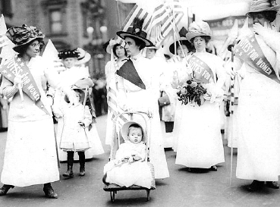
Women’s Suffrage
Women battled for a long time for suffrage.
Susan B. Anthony was a famous fighter for women’s right to vote.
Women marched, made speeches, and wrote articles.
The 19th Amendment was ratified by enough states to add it to the U.S. Constitution in 1920. Women now had the right to vote!
New York march to support women’s suffrage, 1912.

Slide 6
The “Roaring Twenties”
After World War I, people enjoyed good, high-paying jobs. This time in the 1920s was called the “Roaring Twenties.”
Most homes had electricity and people could afford new inventions like refrigerators, electric stoves, and radios. Movies became popular, too.
Improvements were made in schools, treatment of prisoners, and roads.

Slide 7
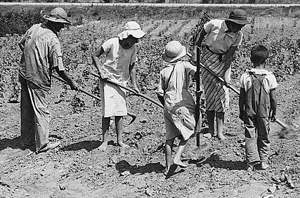
The Great Depression
Good times turned bad at the end of the 1920s.
The country fell into an economic depression. It is known now as the Great Depression.
Tenant farming family near Anniston, 1936

Slide 8
The Stock Market Crash of 1929
The Great Depression was connected to the stock market where people buy and sell ownership of businesses.
Too many people borrowed money to invest in these businesses hoping to get rich.
By October 1929, prices began to fall and investors panicked. They knew that if prices fell, they could not pay back their loans.
Many Americans lost their money, jobs, and homes.

Slide 9
How the Depression Happened
Another cause of the Great Depression had to do with supply and demand.
Factories and farmers were producing more goods than people could buy. Other countries did not need America’s goods either. This caused prices to fall.
Factories began to lay off workers or close. Without a good job, workers could not pay their bills.
Unemployment was very high, and Alabama’s was the highest in the South.
Many people did not have money to pay their loan payments, so banks ran out of money and closed. Even more people lost all their savings.

Slide 10
Alabamians Remember the Great Depression
Those who lived during the Great Depression will never forget it.
Many can tell stories of “hard times.”
People grew their own food and saved as much money as they could. They reused goods such as making clothing out of flour sacks.
Some stores swapped goods instead of using money.

Slide 11
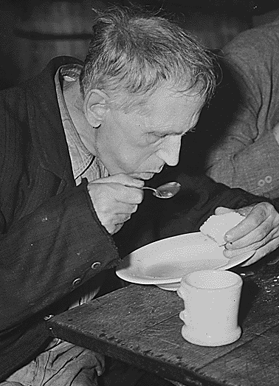
The Worst Year of the Depression
By the fall of 1932, conditions in the country were very bad.
Franklin D. Roosevelt was elected president. He promised to help get people back to work.
He said, “The only thing we have to fear is fear itself.”
Soup kitchens fed Americans who had no money (1936).

Slide 12
Section 2: The New Deal
Essential Question: How did the New Deal help Americans during the Great Depression?

Slide 13
Section 2: The New Deal
What terms do I need to know?
New Deal
civilian
Social Security Act

Slide 14
Introduction
President Roosevelt asked Congress to pass laws to help Americans in the hard times.
He called the programs a New Deal for America.
Some of the programs are still around today.

Slide 15
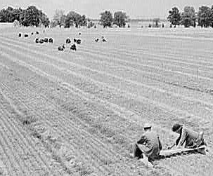
Programs to Create Jobs
The Civilian Conservation Corps (CCC) was the first work program of the New Deal. Young men aged 18 to 25 were given jobs like planting forests or building dams and state parks.
The Public Works Administration (PWA) and Works Progress Administration (WPA) gave jobs building schools, public buildings, highways, bridges, and the arts.
CCC workers planting trees in Alabama, 1942

Slide 16
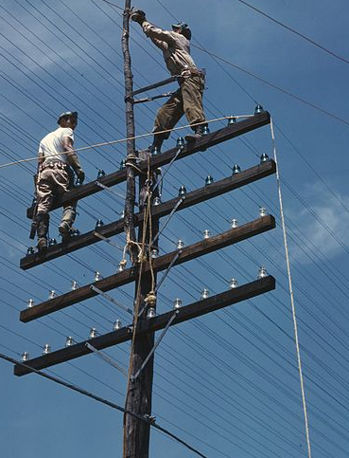
Programs to Improve Lives
The Rural Electrification Administration (REA) supplied electricity to farms and thousands of rural homes.
The Tennessee Valley Authority (TVA) build dams to generate electricity and control floodwaters.
The TVA still generates electricity for citizens of Alabama.
Workers install power lines for the TVA (1944).

Slide 17
Financial Safety Nets
The Social Security Act provided retirement money for older Americans.
It also provided money for unemployed Americans and helped needy children.
Disabled people could get money from Social Security, too.
The Federal Deposit Insurance Corporation (FDIC) was started to keep people’s money safe in their banks.

Slide 18
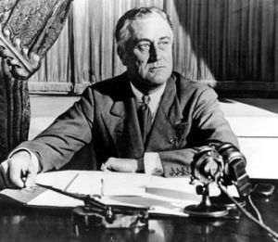
Effect of the New Deal
The New Deal’s programs helped people get through the hard times and made President Roosevelt very popular.
He was elected three more times as president!

Slide 19
Section 3: World War II
Essential Question: What role did Alabama play during World War II?

Slide 20
Section 3: World War II
What terms do I need to know?
Nazi
Holocaust
Allies
Axis Powers
combat
amphibious
posthumous
navigator
bombardier
ration
prisoner of war

Slide 21
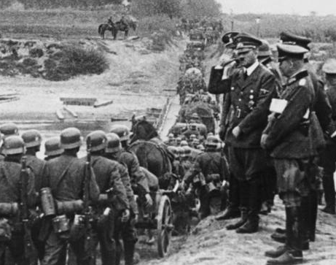
Introduction
In the 1930s, several countries invaded their neighbors.
Japan, Italy, and Germany began conflicts that helped to cause World War II.
German leader Adolf Hitler watches as his troops invade Poland (1939).

Slide 22
Europe at War
Adolf Hitler was leader of Germany. He led his country to take over Austria (1938) and Poland (1939).
He blamed the Jewish people for Germany’s problems, and started a political party called Nazis.
The Nazis put millions of Jews in prisons and killed over six million of them! This murder is called the Holocaust.

Slide 23
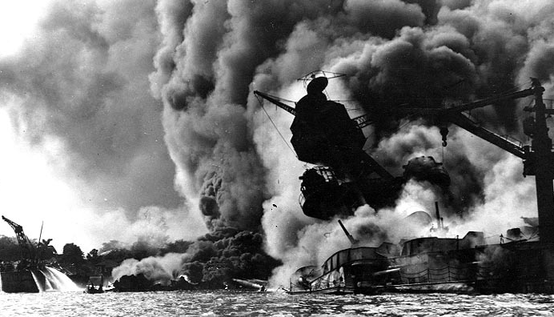
The United States Enters the War
France was taken over by Germany in 1940. England was Hitler’s next target.
However, the U.S. did not get into the war until Japan attacked its ships in Hawaii on December 7, 1941.
More than 2,000 Americans were killed and America’s Navy lost many ships and airplanes.
The president asked Congress to declare war against Japan. Days later Germany and Italy declared war on the U.S.
The USS Arizona burns after an attack by Japan on Pearl Harbor, HI (1941).

Slide 24
Countries of World War II
Allies | Axis
United States United Kingdom (England) France Soviet Union (now Russia) others | Germany Italy Japan others

Slide 25
Alabamians in the War
About 288,000 Alabamians served in the war, and over 6,000 died. Thirteen got the Medal of Honor for courage in combat.
One Alabama hero was General Holland Smith. He was an expert in amphibious warfare. His troops fought well on land and sea. He is known for helping to win the Battle of Iwo Jima in the Pacific Ocean.
Other famous Alabama heroes were General Franklin Hart and Private George Watson – the only African-American to receive a Medal of Honor for action in the Pacific.

Slide 26
Alabama’s Military Bases
More than 200,000 airmen were trained in Alabama at what became Maxwell-Gunter Air Force Base in Montgomery.
Training for navigators, bombardiers and pilots was at the Southeast Air Corps Training Center.
Other sites were added to train men for artillery, infantry, and chemical warfare.

Slide 27
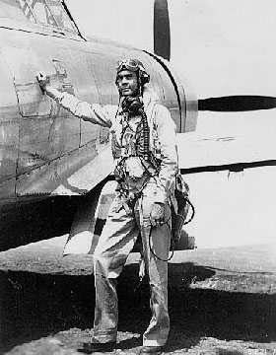
The Tuskegee Airmen
The Tuskegee Institute had a training program for black pilots.
These men proved they were worthy pilots and flew over 1,500 runs over Europe and North Africa.
Two of the airmen, Benjamin Davis and Daniel James became the first black generals in the U.S. Air Force.
Col. Benjamin Davis

Slide 28
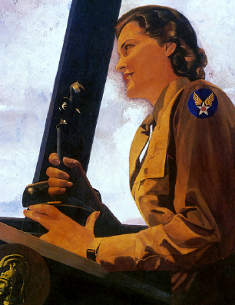
Women in the Armed Forces
Women served as regular members of the U.S. Army.
The Women’s Army Corps (WAC) served in many roles not involving combat.

Slide 29
Alabama Works and Sacrifices for the War
The climate and available electricity made Alabama a good training site.
Women worked in factory jobs left by men fighting the war.
So many people were working that the hard times of the Great Depression began to fade.

Slide 30
The War Means Growth for Mobile Area
Poor farmers moved to Mobile for jobs such as shipbuilding.
Docks handled millions of tons of goods during the war.
Many could not find homes and lived in tents or temporary shelters.

Slide 31
Huntsville and Childersburg Work for Victory
Manufacturing chemicals, artillery shells, smokeless gunpowder and explosives became more important to the economy of north Alabama than cotton.
Mill workers made cloth for tents, bags, and uniforms.

Slide 32
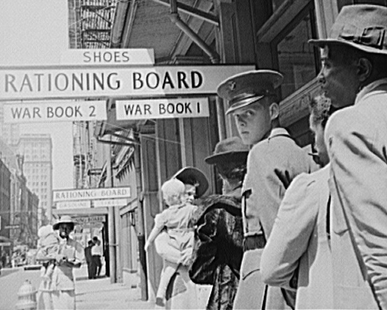
Rationing
Many products needed for the war became scarce. Many items were rationed (gasoline, tires, meat, coffee, sugar, etc.). Prices were controlled by the government to prevent price increases.
Other scarce goods were not rationed (for example, chewing gum and cigarettes).

Slide 33
Prisoners of War
Cotton and additional food were required from farmers to help with the war.
Timber was also needed for the war effort.
Prisoners of war (POWs) were sometimes used as labor. About 15,000 POWs were held in Alabama.

Slide 34
The Greatest Generation
The people who helped win the war are called “The Greatest Generation.”
Civilians watched the skies for surprise attack and participated in blackouts to hide buildings from bombings at night.
Lookouts watched the Gulf of Mexico for German ships and submarines who wanted to attack Alabama.
All people helped in ways big and small.

Slide 35
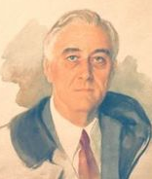
President Franklin D. Roosevelt Dies
President Roosevelt was elected a fourth time in 1944. He was loved and admired by most Americans.
He died in Warm Springs, GA in April 1945. Vice President Harry Truman became president just a few months before the war was won.

Slide 36
The War Ends
In 1945, Germany, Italy, and Japan surrendered.
Atomic bombs were dropped by the U.S. on Japan to force their surrender.
Over 400,000 Americans had died in the war.
After the war, women and blacks realized they could have more opportunities. Farmers began using more machines. Many of Alabama’s blacks moved to other parts of the U.S.

Slide 37
Section 4: The Cold War Leads to the Korean Conflict
Essential Question: How did countries’ beliefs and ideals lead to the Cold War?

Slide 38
Section 4: The Cold War Leads to the Korean Conflict
What terms do I need to know?
democratic
communist
Cold War
truce

Slide 39
Introduction
After World War II, the relationship between the United States and Soviet Union grew tense.
The beliefs in the U.S. were democratic and that people should have a lot of freedom and rights.
The Soviet Union’s beliefs were of a communist government. They believed that citizens should have fewer rights and freedoms. China became an ally of the Soviet Union.

Slide 40
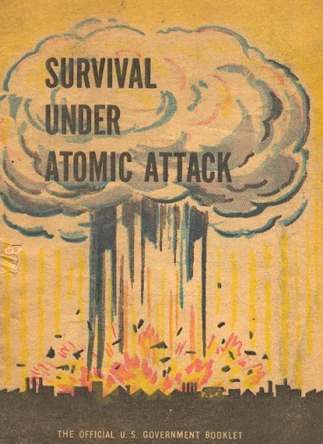
The Cold War
Differences in the viewpoints of countries was a big problem. The Soviet Union worked to force other countries to communism.
The United States was against this, and a Cold War developed.
No actual fighting took place between the countries, there was fighting between other countries and nuclear weapons were used to threaten each other.
The Cold War made people worry about atomic attacks.

Slide 41
The Korean Conflict
Korea was divided into two parts after World War II. The United States protected the southern part, and the Soviet Union protected the north.
North Korea created a communist government, while South Korea had a democratic one.
In 1950, the North (secretly helped by the Soviet Union) attacked the South. China joined the war on the side of North Korea.
Troops from many countries including the U.S. came to aid the South. A truce was signed in 1953. Over 35,000 Americans died – 771 from Alabama.
Korea is divided into two countries even today.

Slide 42
Image Credits
Title slide: Alabama Capitol by National Park Service: National Register of Historic Places; Slide 2: Desoto Falls by JS Fouche Public Domain Wikimedia Commons; End slide: Coosa River by Mike Cline; all others public domain on Wikimedia Commons
Return to Main Menu

