Slide 1
Alabama:
Our Beautiful Home
Chapter 2: The Land We Call Alabama
STUDY PRESENTATION
© 2013 Clairmont Press

Slide 2
Section 2: Mineral, Energy, and Water Resources

Slide 3
Section 2: Mineral, Energy, and Water Resources
Essential Question: Which natural resources attracted settlers to Alabama?

Slide 4
Section 2: Mineral, Energy, and Water Resources
What terms do I need to know?
swamp
fertile
aquifer
groundwater
surface water
wetland
waterway

Slide 5
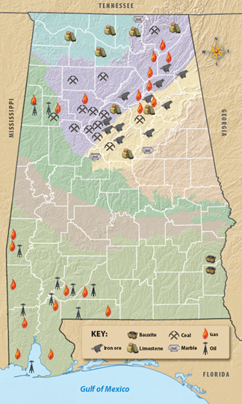
Mineral and Energy Resources

Slide 6
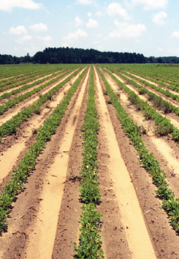
Soil
Soil is made from minerals from broken down rocks and decayed plant and animal material.
Some soil is very fertile, but some is not so good for growing plants.

Slide 7
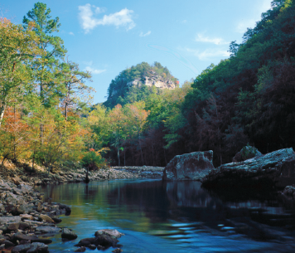
Water Resources
Fresh water was important to settlers.
Alabama’s fresh water is on the surface and under ground.

Slide 8
Aquifers
A great amount of water is stored beneath the earth’s surface.
Some rain soaks into the earth in layers called aquifers. Water stored here is called groundwater.
When groundwater seeps from the ground, it forms springs.
Settlers needed the water for themselves, their livestock, and their crops.
Water came from wells, springs, creeks, and rivers.

Slide 9
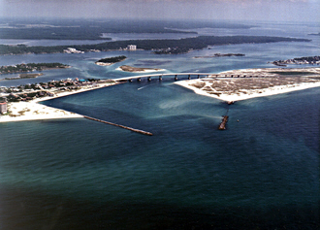
Surface Water
Surface water is found in rivers, streams, lakes, and wetlands.
Six of Alabama’s rivers can be used for large boats. These rivers are called waterways.
Indians, settlers, farmers, and traders used waterways to carry supplies and people.
Surface water slowed settlers’ movements, though, since there were no bridges.
The Tennessee, Chattahoochee, and Perdido Rivers form part of Alabama’s borders.
The mouth of the Perdido River at Orange Beach, AL

Slide 10
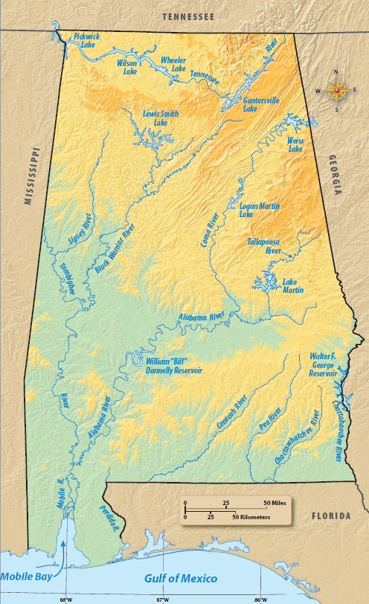
Surface Water Map

Slide 11
Section 3: Weather, Climate, and Natural Hazards
Essential Question: Why do people work to understand their climate?

Slide 12
Image Credits
Title slide: Alabama Capitol by National Park Service: National Register of Historic Places; Slide 2: Desoto Falls by JS Fouche Public Domain Wikimedia Commons; End slide: Coosa River by Mike Cline
Return to Main Menu

