Slide 1
Alabama:
Our Beautiful Home
Chapter 2: The Land We Call Alabama
STUDY PRESENTATION
© 2013 Clairmont Press

Slide 2
Section 3: Weather, Climate, and Natural Hazards

Slide 3
Section 3: Weather, Climate, and Natural Hazards
Essential Question: Why do people work to understand their climate?

Slide 4
Section 3: Weather, Climate, and Natural Hazards
What terms do I need to know?
subtropical
temperature
precipitation
natural hazard
drought
flash flood
lightning
tornado
hurricane
evacuate

Slide 5
Temperature and Precipitation
Alabama’s climate is called subtropical, or temperate. Summers have hot temperatures and winters are mild.
Mountain areas are usually cooler because of their altitude.
Precipitation is water in the form of rain, snow, sleet, or hail that falls from the sky to the earth.
Alabama gets 50-60 inches of precipitation per year; most of it is rain.

Slide 6
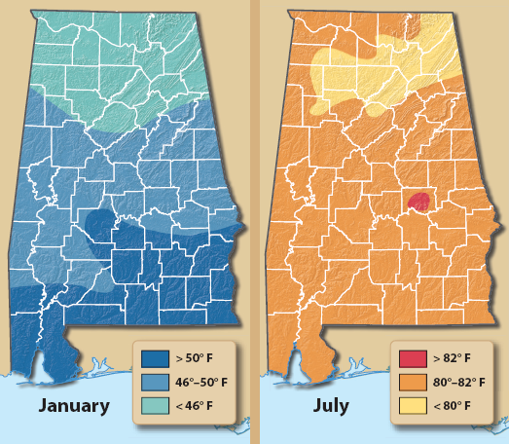
Alabama Temperature Maps

Slide 7
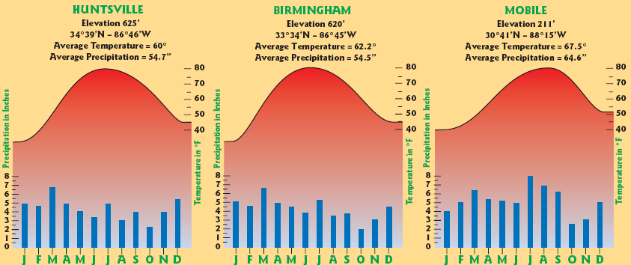
Temperature and Precipitation Graphs for Three Cities

Slide 8
Natural Hazards
Weather that can cause harm is a natural hazard.
Ice storms, heavy snows, droughts, flash floods, thunderstorms, tornadoes, and hurricanes can be natural hazards of Alabama.

Slide 9
Frozen Hazards
When drops of rain fall onto freezing surfaces, ice forms. Sheets of this ice on roads and bridges can cause accidents.
Snowstorms are large amounts of snow at one time.
Snow and ice have weight. When there is a lot of it, trees, power lines, and roofs can fall.

Slide 10
Water – Too Much or Not Enough
When too little rain falls for weeks or months, it’s called a drought.
Droughts can kill crops and forests. Results can be higher food prices and forest fires.
Water shortages can affect everyone at home, school, or work.
Too much rain at one time can cause a flash flood. Streams and ditches fill quickly and water spills onto the land.
Flash floods can cause accidents or drowning.

Slide 11
Thunderstorms
Thunderstorms can produce lightning which can kill or injure people.
These large storms can also produce small balls of ice called hail which can damage roofs or cars.

Slide 12
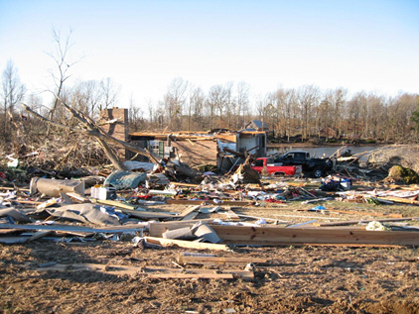
Tornadoes
Large thunderstorms can produce tornadoes. These powerful funnel-shaped clouds can do tremendous damage.
Tornadoes form quickly, and people must be on the lookout for them.
Radio, weather radios, and TV warn people when there is a danger of tornadoes.
When a tornado touches the ground, winds can be over 300 miles per hour. Everything in the tornadoes path can be destroyed.
In Alabama, most tornadoes happen between February and May. Sometimes these storms happen in late November and early December.
A home destroyed by a tornado in Jackson County, AL in 2008

Slide 13
Enhanced Fujita Intensity Scale for Tornadoes

Slide 14
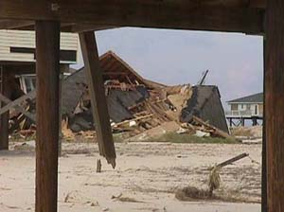
Hurricanes
Hurricanes form over warm ocean waters.
These storms can spread over 300 miles and have wind speeds over 200 miles per hour.
Buildings and highways near the coast may be flooded and destroyed.
Hurricanes usually occur between June and November.
The National Hurricane Center warns people when to evacuate.
Homes destroyed on the Alabama coast by Hurricane Georges in 1998
Click for Hurricane Photo

Slide 15
Image Credits
Title slide: Alabama Capitol by National Park Service: National Register of Historic Places; Slide 2: Desoto Falls by JS Fouche Public Domain Wikimedia Commons; End slide: Coosa River by Mike Cline
Return to Main Menu

