Slide 1
Alabama:
Our Beautiful Home
Chapter 2: The Land We Call Alabama
STUDY PRESENTATION
© 2013 Clairmont Press

Slide 2
Section 4: Natural Vegetation and Wildlife

Slide 3
Section 4: Natural Vegetation and Wildlife
Essential Question: What types of plants and animals live wild in Alabama?

Slide 4
Section 4: Natural Vegetation and Wildlife
What terms do I need to know?
natural vegetation
evergreen tree
deciduous tree
ecosystem

Slide 5
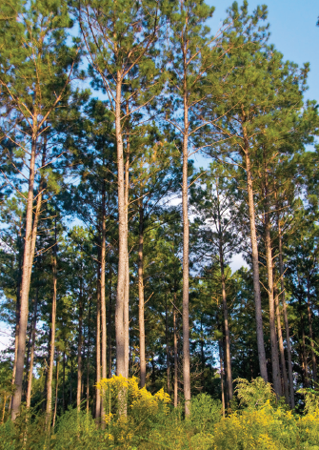
Types of Plants
Natural vegetation covered Alabama before settlers arrived.
Evergreen trees covered two-thirds of the southern part of the state. Most were different types of pine trees.
Deciduous trees covered most of the rest of the state’s hills and mountains.
Trees today support a timber industry.
The amount of water and sun in an area helps determine which plants will grow.

Slide 6
Ecosystems
An ecosystem is all the plants and animals living in an area along with the air, water, soil, and climate.
Our many ecosystems mean we have a variety of animals.
Fish, birds, insects, deer, snails, hawks, rodents, and snakes are some of our animals.
All living and nonliving parts of an ecosystem must work together to keep it going. Changing an ecosystem can kill the creatures in it.

Slide 7
Image Credits
Title slide: Alabama Capitol by National Park Service: National Register of Historic Places; Slide 2: Desoto Falls by JS Fouche Public Domain Wikimedia Commons; End slide: Coosa River by Mike Cline
Return to Main Menu

