Slide 1
Alabama:
Our Beautiful Home
Chapter 5: Settlement of a Territory
STUDY PRESENTATION
© 2013 Clairmont Press

Slide 2
Section 1: Pioneers

Slide 3
Section 1: Pioneers
Essential Question: How did settlers move around in the Alabama territory?

Slide 4
Section 1: Pioneers
What terms do I need to know?
navigable
frontier

Slide 5
Introduction
Good land, good climate, and navigable rivers attracted settlers to Alabama.
Some settlers were wealthy and brought their own slave workers.
Most were poor and had to fish, hunt, or grow their own food to live.
Most settlers were from Virginia, the Carolinas, or Georgia travelling on paths made by Indians or soldiers.

Slide 6
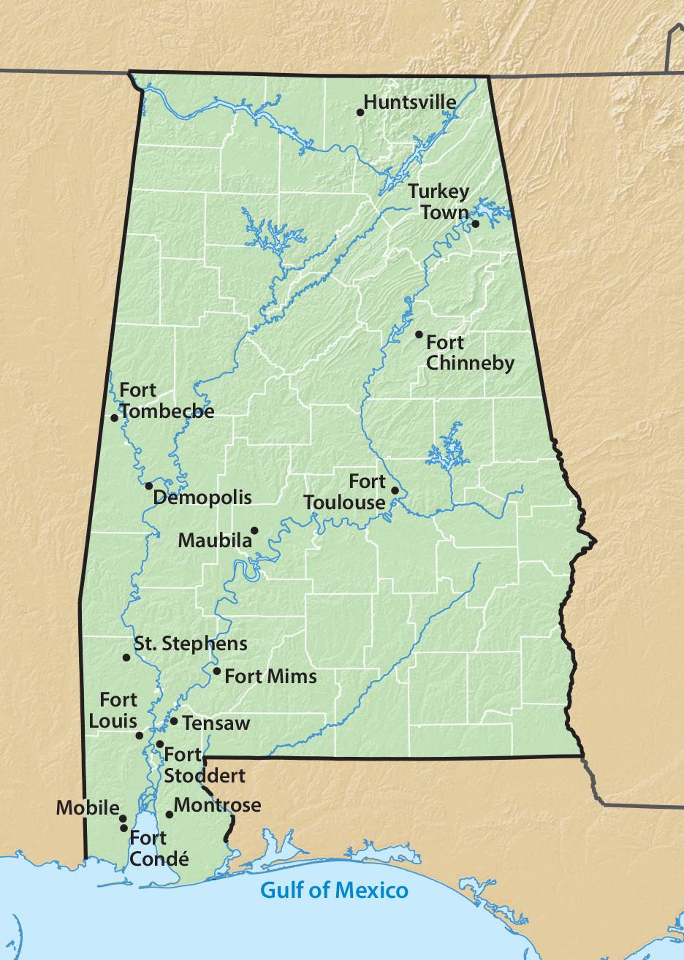
Early Settlements in Alabama

Slide 7
Pioneer Roads
The Federal Road and Natchez Trace (1806) were the first real roads into Alabama.
They connected Washington, D.C. to New Orleans, Louisiana.
Settlers traveled in groups for protection.
Roads were rough and had no bridges.
The Huntsville Road connected St. Stephens, Alabama’s capital, with Philadelphia, Pennsylvania.

Slide 8
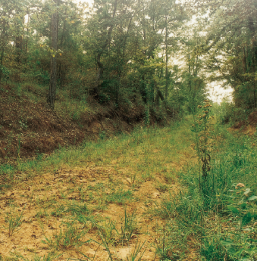
Traveling the Roads
Poor settlers pulled their own carts with all their belongings. Wealthier settlers had horses or oxen to pull wagons.
Some roads were simply a path.
Well-traveled roads might have a tavern, fort, or food stand along the way, but prices were high.

Slide 9
Image Credits
Title slide: Alabama Capitol by National Park Service: National Register of Historic Places; Slide 2: Desoto Falls by JS Fouche Public Domain Wikimedia Commons; Slide 21: Rivers Langley on Wikimedia Commons; Slide 32, 35: Library of Congress; Slide 34: USDA; End slide: Coosa River by Mike Cline
Return to Main Menu

