Slide 1
Alabama:
Our Beautiful Home
Chapter 5: Settlement of a Territory
STUDY PRESENTATION
© 2013 Clairmont Press

Slide 2
Section 3: Different Cultures Move to the Alabama Frontier

Slide 3
Section 3: Different Cultures Move to Alabama
Essential Question: How did people with different cultures live together in Alabama?

Slide 4
Section 3: Different Cultures Move to Alabama
What terms do I need to know?
freedmen
plantation
planter

Slide 5
The Vine and Olive Company
In 1817, French settlers came to the Tombigbee River area to grove grapes and olives.
The group had many problems and failed to grow the crops they wanted.
They moved to the Gulf Coast but left behind some French names such as Marengo, Bon Secour, and Bayou La Batre.

Slide 6
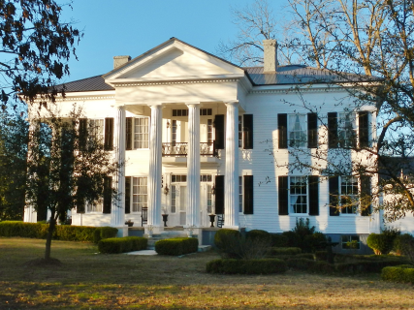
Planters
A few people, called planters, had large farms called plantations.
Slaves were used as workers.
Plantations usually grew or made everything that they needed to survive.
Extra money was used to buy goods from Europe brought through ports at New Orleans and Mobile.
Plantation home in Lowndesboro

Slide 7
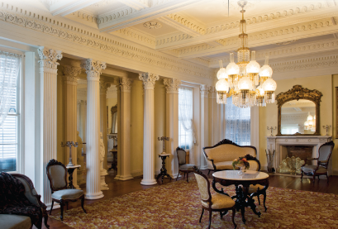
Plantation Homes
Planters often had very large, beautiful homes.
High ceilings in the homes kept them cooler in summer but hard to heat in winter.
Artists would visit to paint portraits of the family.
The kitchen was a separate building in order to protect the main house from accidental fires.

Slide 8
Social Life of Planters
Families visited other planter families traveling by horse or carriage.
Men might travel to a nearby town for supplies and news.
Women sewed or embroidered while they talked to each other. Some painted or played music.
Outdoor parties, foxhunts, weddings, and church services filled the social life of planters’ families.
Click to see Alabama plantations

Slide 9
Plantation Children
Planters hired teachers for their sons to teach them Latin, English, history, literature, and mathematics.
Some attended east coast universities and others the University of Alabama.
Boys were allowed the freedom to roam the fields and forests, learn to use a gun, hunt, and swim.
Some daughters of planters were allowed to attend special girls’ schools. Girls studied French, music, geography, and literature. At home they learned to sew and entertain.
The girls also learned to direct the people who worked in the house and yard.

Slide 10
Image Credits
Title slide: Alabama Capitol by National Park Service: National Register of Historic Places; Slide 2: Desoto Falls by JS Fouche Public Domain Wikimedia Commons; Slide 21: Rivers Langley on Wikimedia Commons; Slide 32, 35: Library of Congress; Slide 34: USDA; End slide: Coosa River by Mike Cline
Return to Main Menu

