Slide 1
Alabama:
Our Beautiful Home
Chapter 5: Settlement of a Territory
STUDY PRESENTATION
© 2013 Clairmont Press

Slide 2
Section 4: Slavery in Alabama

Slide 3
Section 4: Slavery in Alabama
Essential Question: How did slaves contribute to the growth of Alabama?

Slide 4
Section 4: Slavery in Alabama
What terms do I need to know?
cotton gin
economy
mill

Slide 5
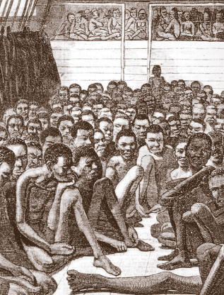
Slavery
Black slaves had been a part of the Spanish and French settlements.
The British started bringing Africans to America in 1619 to work as slaves on Virginia plantations.
The first slaves to come to Mobile arrived in 1721.
Slaves were forced to work and could not quit their jobs or leave the area.

Slide 6
The Last Slave Ship
A law was passed in 1808 to stop slaves from coming into the United States.
The Clotilda arrived in Mobile in 1860 with a load of slaves to sneak in and sell. Descendents of this group later started a settlement near Mobile called AfricaTown, USA.
In 1860, about 1/3 of Alabama families owned slaves. Most owned less than five slaves.
The Black Belt and Tennessee River Valley were good for growing cotton and so had the most slaves.

Slide 7
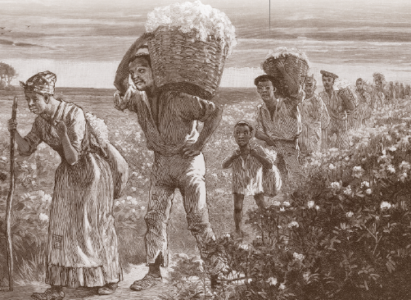
The Life of Slaves
Field slaves worked outdoors on the farm from sunrise to sunset.
House slaves worked as servants for the family in the house. Slaves lived in cabins, often with dirt floors.
Masters (owners) gave food and clothing to the slaves. Wives would often serve as nurses to sick slaves.

Slide 8
Beliefs and Customs of Slaves
Slaves had to ask permission to marry.
Slaves sang songs of heaven where life seemed better than their earthly life.
African traditions of singing and preaching blended with the traditions of southern churches.
Slaves could attend church with their white masters but sat in the back or in the balcony.

Slide 9
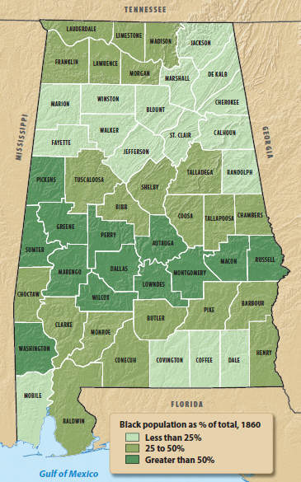
Slave Population 1860

Slide 10
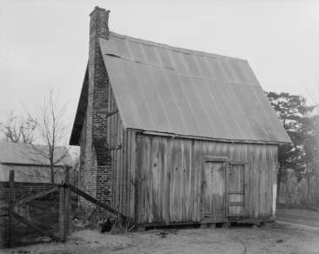
Slave Codes
Slave Codes were laws meant to control the lives of the slaves.
One law made it illegal to teach slaves to read or write.
Slaves could not carry weapons, own land or animals, or speak against a a white man in court.
Slaves who broke a law could be whipped or worse!
Slaves could be sold which might break up their families.
Slave cabin, Hale County, AL

Slide 11
Free Blacks
There were some free blacks in Alabama – some even owned slaves!
Slaves might buy their freedom or have it given to them by their masters.
Most free blacks moved to towns where they could work as carpenters, cooks, barbers, or factory workers.
Free blacks had to carry passes to prove they were free, but they could not vote. Most could not get an education.

Slide 12
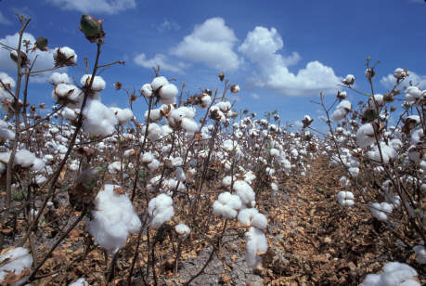
Cotton Gin Increases Amount of Cotton Grown
The dark soil of the Black Belt was good for growing cotton.
The state’s long growing season was good for the crop, too.

Slide 13
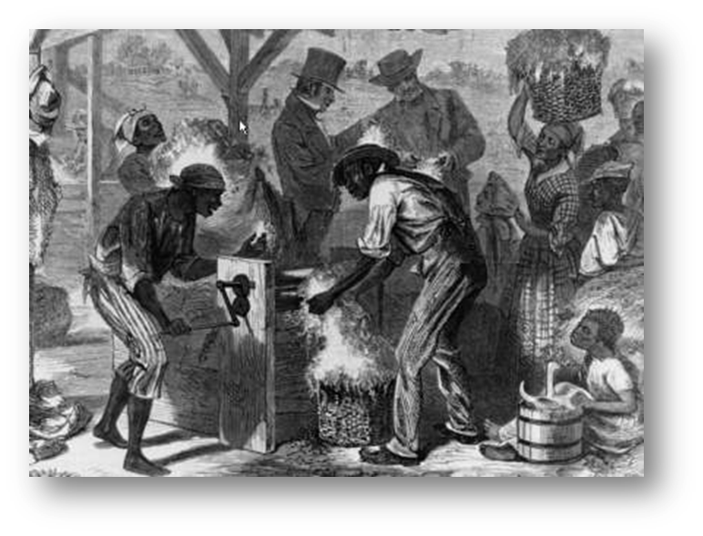
Eli Whitney’s Invention
Cotton bolls are filled with small seeds that must be removed.
Pulling these out by hand was a slow process.
Eli Whitney invented a cotton gin (1793) to pull the seeds from the cotton.
The invention, first powered by a man, was later powered by water or horse power.

Slide 14
Cotton Kingdom
The invention of the cotton gin encouraged farmers to grow cotton.
Alabama moved from growing 4% of America’s cotton to 23%.
Growing more cotton required more slave workers and made many people wealthy.
Alabama’s cotton was shipped to mills in Europe through the ports of Mobile and New Orleans.
This trade made Alabama a “cotton kingdom.”

Slide 15
Image Credits
Title slide: Alabama Capitol by National Park Service: National Register of Historic Places; Slide 2: Desoto Falls by JS Fouche Public Domain Wikimedia Commons; Slide 21: Rivers Langley on Wikimedia Commons; Slide 32, 35: Library of Congress; Slide 34: USDA; End slide: Coosa River by Mike Cline
Return to Main Menu

