Slide 1
Alabama:
Our Beautiful Home
Chapter 11: From Prosperity to Poverty and Back Again
STUDY PRESENTATION
© 2013 Clairmont Press

Slide 2
Section 1: Alabama – 100 Years Old
Section 2: The New Deal

Slide 3
Section 1: Alabama – 100 Years Old
Essential Question: How did the Great Depression affect the lives of Alabamians?

Slide 4
Section 1: Alabama – 100 Years Old
What terms do I need to know?
suffrage
depression
stock
supply and demand
unemployment

Slide 5
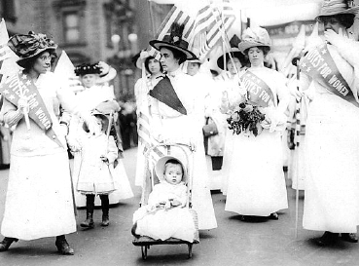
Women’s Suffrage
Women battled for a long time for suffrage.
Susan B. Anthony was a famous fighter for women’s right to vote.
Women marched, made speeches, and wrote articles.
The 19th Amendment was ratified by enough states to add it to the U.S. Constitution in 1920. Women now had the right to vote!
New York march to support women’s suffrage, 1912.

Slide 6
The “Roaring Twenties”
After World War I, people enjoyed good, high-paying jobs. This time in the 1920s was called the “Roaring Twenties.”
Most homes had electricity and people could afford new inventions like refrigerators, electric stoves, and radios. Movies became popular, too.
Improvements were made in schools, treatment of prisoners, and roads.

Slide 7
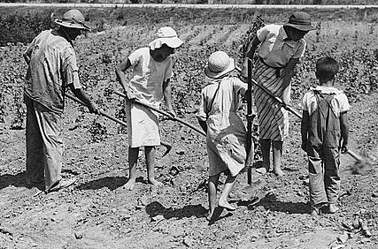
The Great Depression
Good times turned bad at the end of the 1920s.
The country fell into an economic depression. It is known now as the Great Depression.
Tenant farming family near Anniston, 1936

Slide 8
The Stock Market Crash of 1929
The Great Depression was connected to the stock market where people buy and sell ownership of businesses.
Too many people borrowed money to invest in these businesses hoping to get rich.
By October 1929, prices began to fall and investors panicked. They knew that if prices fell, they could not pay back their loans.
Many Americans lost their money, jobs, and homes.

Slide 9
How the Depression Happened
Another cause of the Great Depression had to do with supply and demand.
Factories and farmers were producing more goods than people could buy. Other countries did not need America’s goods either. This caused prices to fall.
Factories began to lay off workers or close. Without a good job, workers could not pay their bills.
Unemployment was very high, and Alabama’s was the highest in the South.
Many people did not have money to pay their loan payments, so banks ran out of money and closed. Even more people lost all their savings.

Slide 10
Alabamians Remember the Great Depression
Those who lived during the Great Depression will never forget it.
Many can tell stories of “hard times.”
People grew their own food and saved as much money as they could. They reused goods such as making clothing out of flour sacks.
Some stores swapped goods instead of using money.

Slide 11
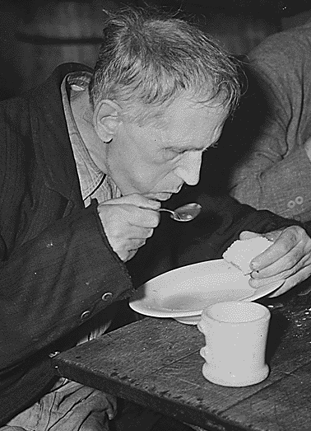
The Worst Year of the Depression
By the fall of 1932, conditions in the country were very bad.
Franklin D. Roosevelt was elected president. He promised to help get people back to work.
He said, “The only thing we have to fear is fear itself.”
Soup kitchens fed Americans who had no money (1936).

Slide 12
Image Credits
Title slide: Alabama Capitol by National Park Service: National Register of Historic Places; Slide 2: Desoto Falls by JS Fouche Public Domain Wikimedia Commons; End slide: Coosa River by Mike Cline; all others public domain on Wikimedia Commons
Return to Main Menu

