Slide 1
Alabama:
Our Beautiful Home
Chapter 11: From Prosperity to Poverty and Back Again
STUDY PRESENTATION
© 2013 Clairmont Press

Slide 2
Section 2: The New Deal

Slide 3
Section 2: The New Deal
Essential Question: How did the New Deal help Americans during the Great Depression?

Slide 4
Section 2: The New Deal
What terms do I need to know?
New Deal
civilian
Social Security Act

Slide 5
Introduction
President Roosevelt asked Congress to pass laws to help Americans in the hard times.
He called the programs a New Deal for America.
Some of the programs are still around today.

Slide 6
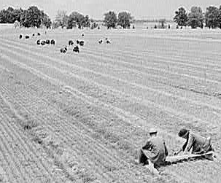
Programs to Create Jobs
The Civilian Conservation Corps (CCC) was the first work program of the New Deal. Young men aged 18 to 25 were given jobs like planting forests or building dams and state parks.
The Public Works Administration (PWA) and Works Progress Administration (WPA) gave jobs building schools, public buildings, highways, bridges, and the arts.
CCC workers planting trees in Alabama, 1942

Slide 7
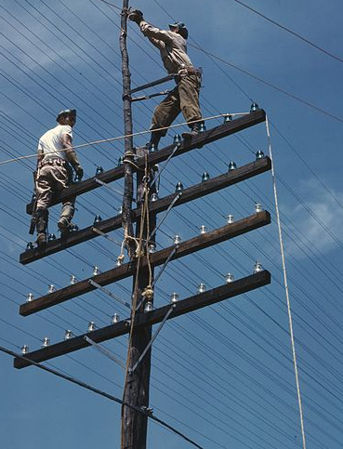
Programs to Improve Lives
The Rural Electrification Administration (REA) supplied electricity to farms and thousands of rural homes.
The Tennessee Valley Authority (TVA) build dams to generate electricity and control floodwaters.
The TVA still generates electricity for citizens of Alabama.
Workers install power lines for the TVA (1944).

Slide 8
Financial Safety Nets
The Social Security Act provided retirement money for older Americans.
It also provided money for unemployed Americans and helped needy children.
Disabled people could get money from Social Security, too.
The Federal Deposit Insurance Corporation (FDIC) was started to keep people’s money safe in their banks.

Slide 9
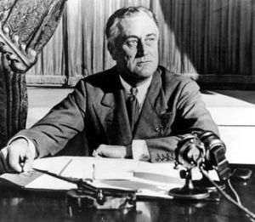
Effect of the New Deal
The New Deal’s programs helped people get through the hard times and made President Roosevelt very popular.
He was elected three more times as president!

Slide 10
Image Credits
Title slide: Alabama Capitol by National Park Service: National Register of Historic Places; Slide 2: Desoto Falls by JS Fouche Public Domain Wikimedia Commons; End slide: Coosa River by Mike Cline; all others public domain on Wikimedia Commons
Return to Main Menu

