Slide 1
Alabama:
Our Beautiful Home
Chapter 11: From Prosperity to Poverty and Back Again
STUDY PRESENTATION
© 2013 Clairmont Press

Slide 2
Section 3: World War II

Slide 3
Section 3: World War II
Essential Question: What role did Alabama play during World War II?

Slide 4
Section 3: World War II
What terms do I need to know?
Nazi
Holocaust
Allies
Axis Powers
combat
amphibious
posthumous
navigator
bombardier
ration
prisoner of war

Slide 5
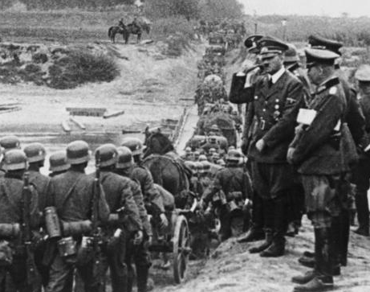
Introduction
In the 1930s, several countries invaded their neighbors.
Japan, Italy, and Germany began conflicts that helped to cause World War II.
German leader Adolf Hitler watches as his troops invade Poland (1939).

Slide 6
Europe at War
Adolf Hitler was leader of Germany. He led his country to take over Austria (1938) and Poland (1939).
He blamed the Jewish people for Germany’s problems, and started a political party called Nazis.
The Nazis put millions of Jews in prisons and killed over six million of them! This murder is called the Holocaust.

Slide 7
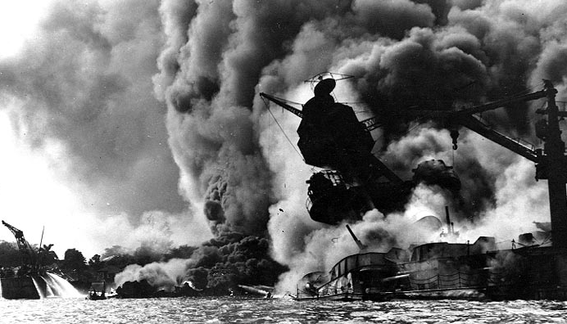
The United States Enters the War
France was taken over by Germany in 1940. England was Hitler’s next target.
However, the U.S. did not get into the war until Japan attacked its ships in Hawaii on December 7, 1941.
More than 2,000 Americans were killed and America’s Navy lost many ships and airplanes.
The president asked Congress to declare war against Japan. Days later Germany and Italy declared war on the U.S.
The USS Arizona burns after an attack by Japan on Pearl Harbor, HI (1941).

Slide 8
Countries of World War II
Allies | Axis
United States United Kingdom (England) France Soviet Union (now Russia) others | Germany Italy Japan others

Slide 9
Alabamians in the War
About 288,000 Alabamians served in the war, and over 6,000 died. Thirteen got the Medal of Honor for courage in combat.
One Alabama hero was General Holland Smith. He was an expert in amphibious warfare. His troops fought well on land and sea. He is known for helping to win the Battle of Iwo Jima in the Pacific Ocean.
Other famous Alabama heroes were General Franklin Hart and Private George Watson – the only African-American to receive a Medal of Honor for action in the Pacific.

Slide 10
Alabama’s Military Bases
More than 200,000 airmen were trained in Alabama at what became Maxwell-Gunter Air Force Base in Montgomery.
Training for navigators, bombardiers and pilots was at the Southeast Air Corps Training Center.
Other sites were added to train men for artillery, infantry, and chemical warfare.

Slide 11
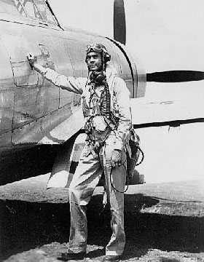
The Tuskegee Airmen
The Tuskegee Institute had a training program for black pilots.
These men proved they were worthy pilots and flew over 1,500 runs over Europe and North Africa.
Two of the airmen, Benjamin Davis and Daniel James became the first black generals in the U.S. Air Force.
Col. Benjamin Davis

Slide 12
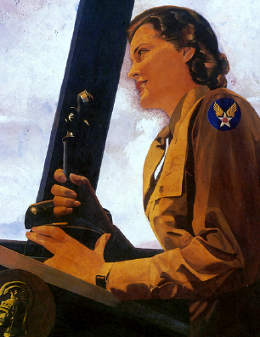
Women in the Armed Forces
Women served as regular members of the U.S. Army.
The Women’s Army Corps (WAC) served in many roles not involving combat.

Slide 13
Alabama Works and Sacrifices for the War
The climate and available electricity made Alabama a good training site.
Women worked in factory jobs left by men fighting the war.
So many people were working that the hard times of the Great Depression began to fade.

Slide 14
The War Means Growth for Mobile Area
Poor farmers moved to Mobile for jobs such as shipbuilding.
Docks handled millions of tons of goods during the war.
Many could not find homes and lived in tents or temporary shelters.

Slide 15
Huntsville and Childersburg Work for Victory
Manufacturing chemicals, artillery shells, smokeless gunpowder and explosives became more important to the economy of north Alabama than cotton.
Mill workers made cloth for tents, bags, and uniforms.

Slide 16
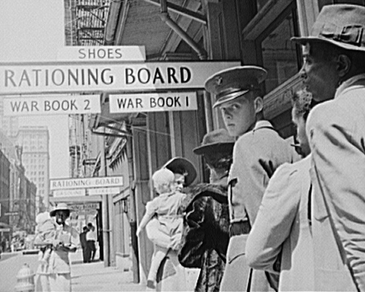
Rationing
Many products needed for the war became scarce. Many items were rationed (gasoline, tires, meat, coffee, sugar, etc.). Prices were controlled by the government to prevent price increases.
Other scarce goods were not rationed (for example, chewing gum and cigarettes).

Slide 17
Prisoners of War
Cotton and additional food were required from farmers to help with the war.
Timber was also needed for the war effort.
Prisoners of war (POWs) were sometimes used as labor. About 15,000 POWs were held in Alabama.

Slide 18
The Greatest Generation
The people who helped win the war are called “The Greatest Generation.”
Civilians watched the skies for surprise attack and participated in blackouts to hide buildings from bombings at night.
Lookouts watched the Gulf of Mexico for German ships and submarines who wanted to attack Alabama.
All people helped in ways big and small.

Slide 19
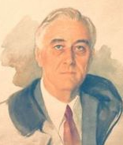
President Franklin D. Roosevelt Dies
President Roosevelt was elected a fourth time in 1944. He was loved and admired by most Americans.
He died in Warm Springs, GA in April 1945. Vice President Harry Truman became president just a few months before the war was won.

Slide 20
The War Ends
In 1945, Germany, Italy, and Japan surrendered.
Atomic bombs were dropped by the U.S. on Japan to force their surrender.
Over 400,000 Americans had died in the war.
After the war, women and blacks realized they could have more opportunities. Farmers began using more machines. Many of Alabama’s blacks moved to other parts of the U.S.

Slide 21
Image Credits
Title slide: Alabama Capitol by National Park Service: National Register of Historic Places; Slide 2: Desoto Falls by JS Fouche Public Domain Wikimedia Commons; End slide: Coosa River by Mike Cline; all others public domain on Wikimedia Commons
Return to Main Menu

