Slide 1
Alabama:
Our Beautiful Home
Chapter 11: From Prosperity to Poverty and Back Again
STUDY PRESENTATION
© 2013 Clairmont Press

Slide 2
Section 4: The Cold War Leads to the Korean Conflict

Slide 3
Section 4: The Cold War Leads to the Korean Conflict
Essential Question: How did countries’ beliefs and ideals lead to the Cold War?

Slide 4
Section 4: The Cold War Leads to the Korean Conflict
What terms do I need to know?
democratic
communist
Cold War
truce

Slide 5
Introduction
After World War II, the relationship between the United States and Soviet Union grew tense.
The beliefs in the U.S. were democratic and that people should have a lot of freedom and rights.
The Soviet Union’s beliefs were of a communist government. They believed that citizens should have fewer rights and freedoms. China became an ally of the Soviet Union.

Slide 6
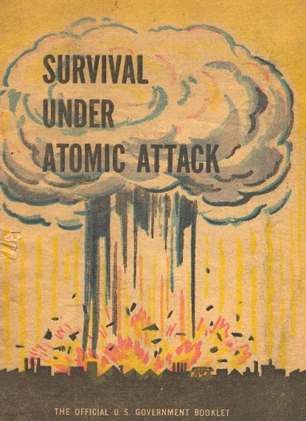
The Cold War
Differences in the viewpoints of countries was a big problem. The Soviet Union worked to force other countries to communism.
The United States was against this, and a Cold War developed.
No actual fighting took place between the countries, there was fighting between other countries and nuclear weapons were used to threaten each other.
The Cold War made people worry about atomic attacks.

Slide 7
The Korean Conflict
Korea was divided into two parts after World War II. The United States protected the southern part, and the Soviet Union protected the north.
North Korea created a communist government, while South Korea had a democratic one.
In 1950, the North (secretly helped by the Soviet Union) attacked the South. China joined the war on the side of North Korea.
Troops from many countries including the U.S. came to aid the South. A truce was signed in 1953. Over 35,000 Americans died – 771 from Alabama.
Korea is divided into two countries even today.

Slide 8
Image Credits
Title slide: Alabama Capitol by National Park Service: National Register of Historic Places; Slide 2: Desoto Falls by JS Fouche Public Domain Wikimedia Commons; End slide: Coosa River by Mike Cline; all others public domain on Wikimedia Commons
Return to Main Menu

