Slide 1
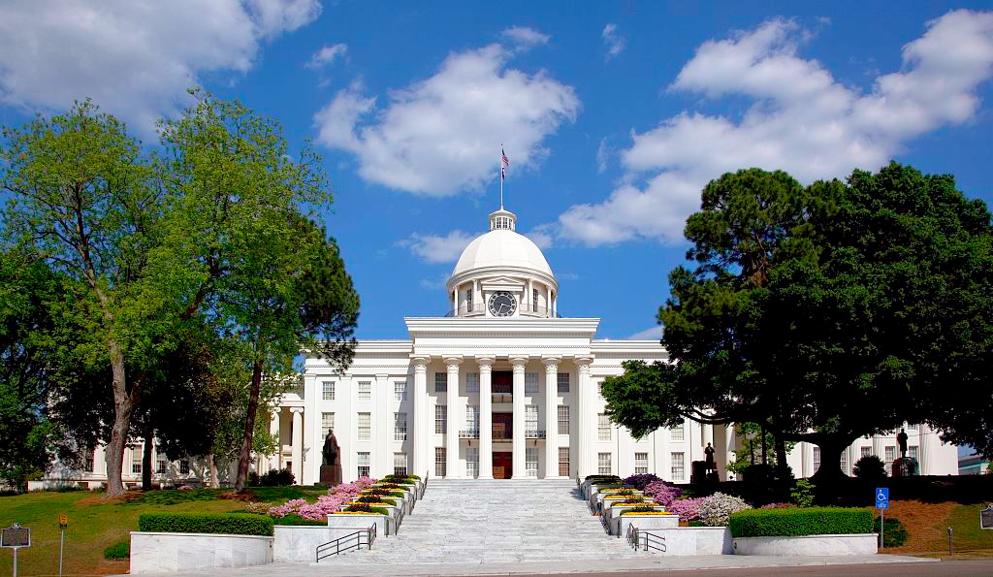
Alabama:
Our Beautiful Home
Chapter 16: Alabama’s Sons and Daughters
STUDY PRESENTATION
© 2013 Clairmont Press

Slide 2
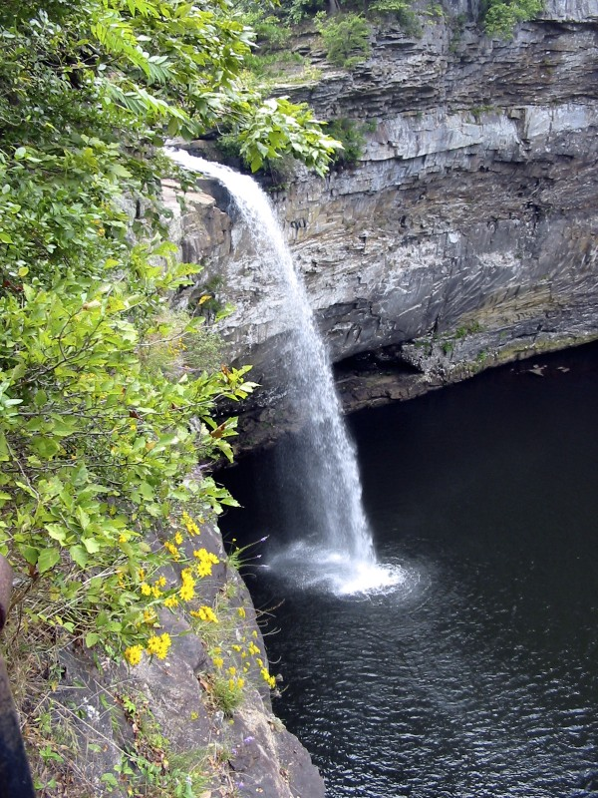
Section 1: Political Leaders, Lawmakers, and Jurists

Slide 3
Section 1: Political Leaders, Lawmakers, and Jurists
Essential Question: What has made some people from Alabama good leaders?

Slide 4
Section 1: Political Leaders, Lawmakers, and Jurists
What terms do I need to know?
  convict-leasing
  provost
  cabinet
  paraplegic
  prosecutor

Slide 5
Introduction
Alabama has many men and women who are respected lawmakers, political leaders, and jurists (judges).
They have been important to our state and nation.

Slide 6
Political Leaders
James Elisha Folsom: a.k.a. “Big Jim” was elected governor twice. Known for paving rural roads, increasing the school year, and improving schools.
Pattie Ruffner Jacobs: women’s suffrage leader and worked to end convict-leasing.
Thomas Erby Kilby: Worked to pay state debts and improve schools and prisons.

Slide 7
Political Leaders
Condoleeza Rice: served as national security advisor and U.S. Secretary of State.
George C. Wallace: served as governor four times and also ran for president. He was shot and became a paraplegic.
Lurleen Burns Wallace: first female governor of Alabama.

Slide 8
Lawmakers
The Bankheads-three in the same family who served in Congress:
John Hollis; John Hollis II; William B.
Tom Bevill: congressman for 30 years and led the drive to build the Tenn-Tom Waterway and I-22.
J. Lister Hill: long-time congressman and senator, known for improving hospitals and expanding electric use, telephones, housing, and education.

Slide 9
Lawmakers
John J. Sparkman: congressman who fought for the building of the Redstone Arsenal and making laws to support military service people and veterans.

Slide 10
Jurists
Oscar W. Adams: first black Alabama Supreme Court justice.
Hugo L. Black: U.S. Supreme Court justice.
Howell T. Heflin: Alabama Supreme Court chief justice and U.S. senator known for supporting civil rights.

Slide 11
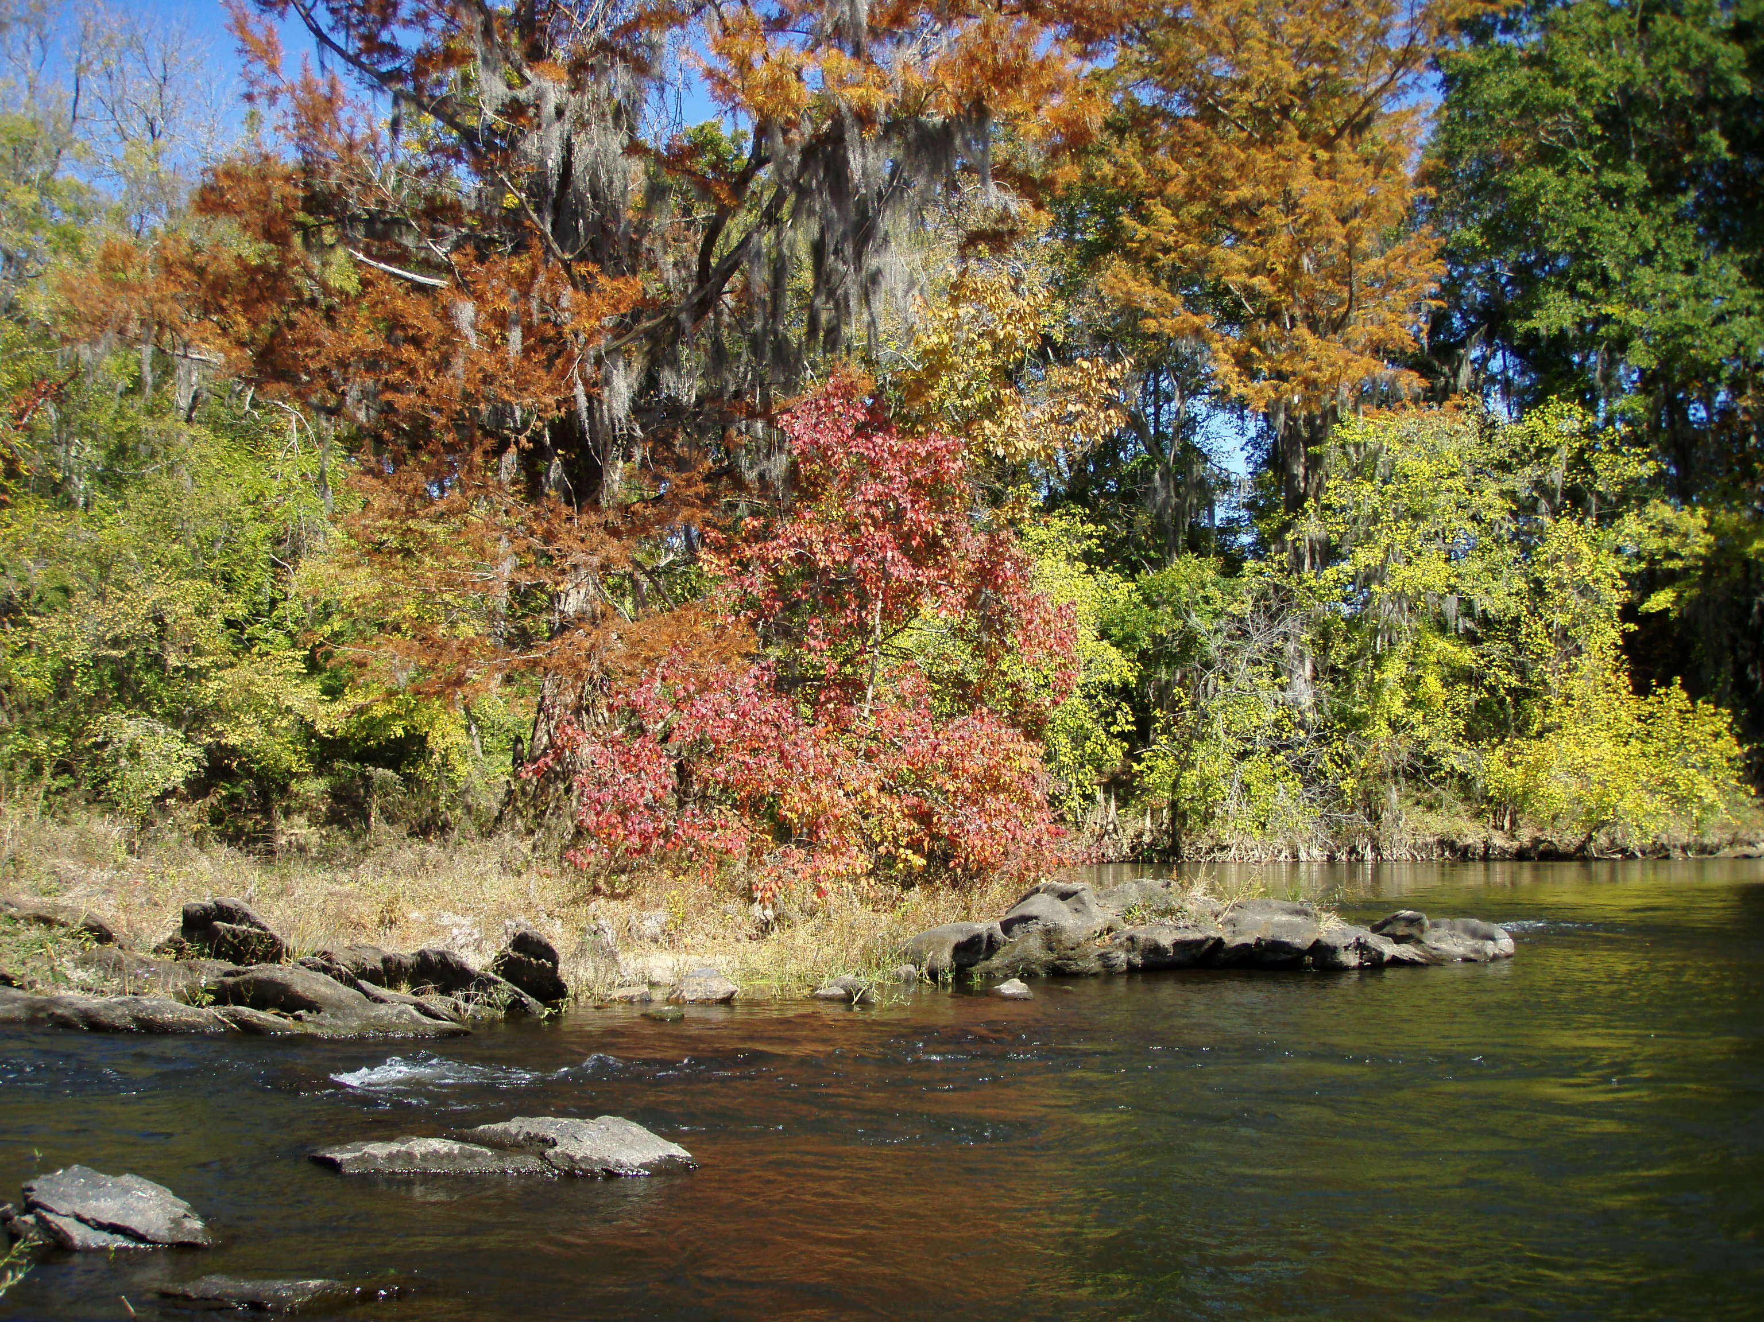
Image Credits
Title slide: Alabama Capitol by National Park Service: National Register of Historic Places; Slide 2: Desoto Falls by JS Fouche Public Domain Wikimedia Commons; Slide 21: Jylie Dupuis; End slide: Coosa River by Mike Cline
Return to Main Menu

