Slide 1
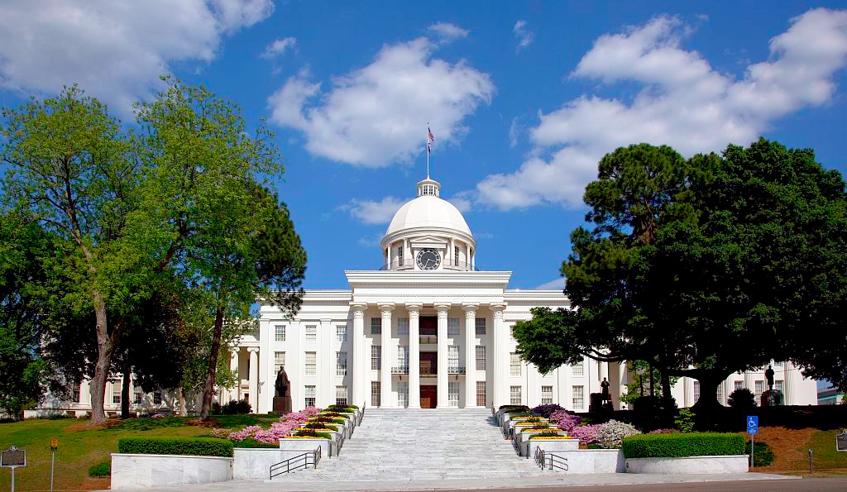
Alabama:
Our Beautiful Home
Chapter 16: Alabama’s Sons and Daughters
STUDY PRESENTATION
© 2013 Clairmont Press

Slide 2
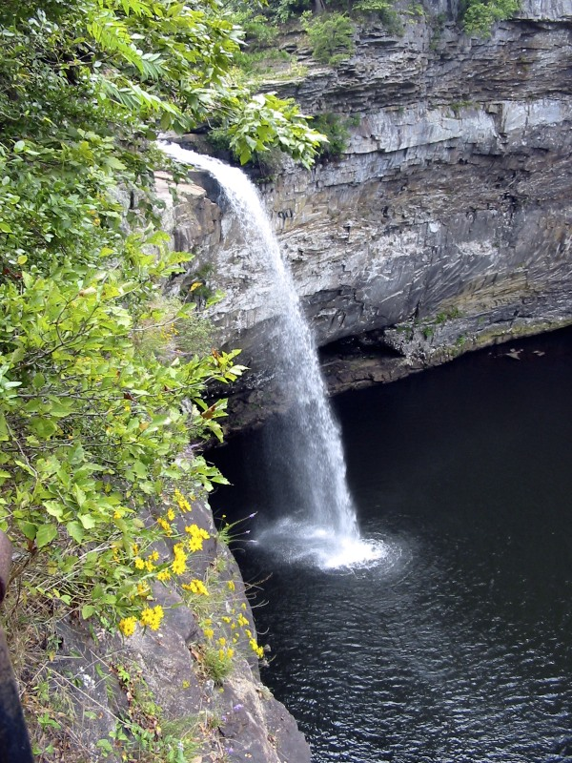
Section 2: Businesspeople, Educators, and Scientists

Slide 3
Section 2: Businesspeople, Educators, and Scientists
Essential Question: How have people earned fame by improving the lives of others in Alabama?

Slide 4
Section 2: Businesspeople, Educators, and Scientists
What terms do I need to know?
  entrepreneur
  profession
  arthritis
  sociobiology

Slide 5
Businesspeople
Many Alabamians have become successful entrepreneurs.
Winton “Red” Blount: built a large construction company and donated millions of dollars to charities in Alabama.
Emory O. Cunningham: publisher of magazines and cookbooks.
John H. “Red” Dove: built a family-owned trucking business.

Slide 6
Businesspeople
Arthur G. Gaston: black man who built insurance, broadcasting, and banking businesses.
Reverend William R. Pettiford: built largest African American-owned bank.
Mark C. Smith: founder of technology companies.
E. B. Stephens: founded the large EBSCO company.
Diane Weston: her company does technology research for NASA.

Slide 7
Educators
Alabama has many wonderful educators who make a difference in people’s lives.
Marva Collins: opened her own school in Chicago to help students who had trouble learning.
Julia Strudwick Tutwiler: worked to educate women and prisoners who lacked job skills.
Dr. George Washington Carver: did research on plants and scientific methods for farming; he became a famous teacher at the Tuskegee Institute.

Slide 8
Scientists
Scientists help improve people’s lives studying things like medicine, space, plants, animals, atoms, and more!
Dr. Percy Julian: created new products from soybeans and invented a drug to treat arthritis.
Dr. Robert Van de Graaff: built the world’s first atom smasher.
Dr. Edward O. Wilson: studied how ants and bees live and work together.
Dr. Werner von Braun: helped build America’s space program and supported education in his community.

Slide 9
Scientists
Several astronauts have come from Alabama. They have served as mission specialists and commanders of space missions.
Four surgeons general have been from Alabama. They have helped presidents improve the health of all Americans.

Slide 10
Dr. George Washington Carver,
Educator and Scientist
Dr. Carver was born a slave in Missouri around 1860 and grew up on the Missouri plantation of George and Susan Carver.
He worked hard to earn money for college expenses.
In 1896 Dr. Carver was invited by Booker T. Washington to work at the Tuskegee Institute which he did for the rest of his life.
Dr. Carver found dozens of uses for sweet potatoes and more than 300 products from peanuts.

Slide 11
Nick Saban
Nick Saban served for two seasons as head coach of the NFL Miami Dolphins.
After the 2006 season, he accepted the head coaching job at the University of Alabama.
Coach Saban has led the Crimson Tide to six national championships.
Saban and wife Terry founded Nick’s Kids Foundation to promote and support children, family, teacher, and student causes.

Slide 12
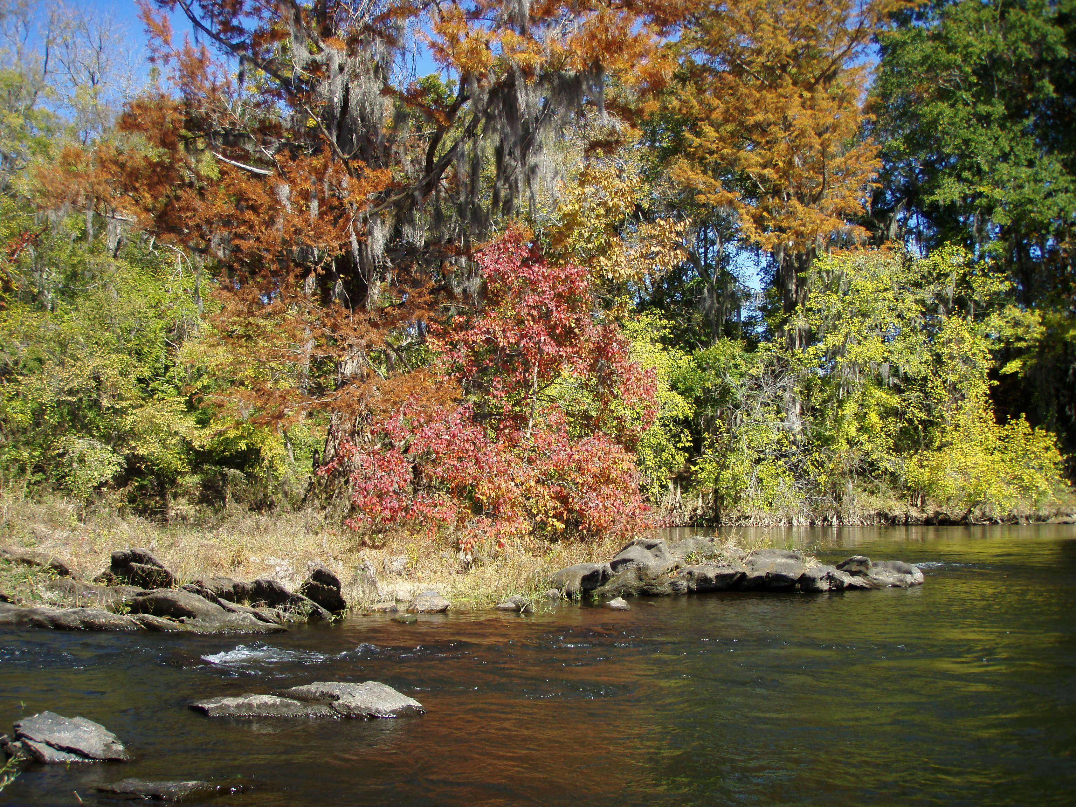
Image Credits
Title slide: Alabama Capitol by National Park Service: National Register of Historic Places; Slide 2: Desoto Falls by JS Fouche Public Domain Wikimedia Commons; Slide 21: Jylie Dupuis; End slide: Coosa River by Mike Cline
Return to Main Menu

