Slide 1
Alabama:
Our Beautiful Home
Chapter 16: Alabama’s Sons and Daughters
STUDY PRESENTATION
© 2013 Clairmont Press

Slide 2
Section 3: Entertainers, Sports Stars, and Writers

Slide 3
Section 3: Entertainers, Sports Stars, and Writers
Essential Question: How has Alabama contributed to the entertainment of Americans?

Slide 4
Section 3: Entertainers, Sports Stars, and Writers
What terms do I need to know?
record

Slide 5
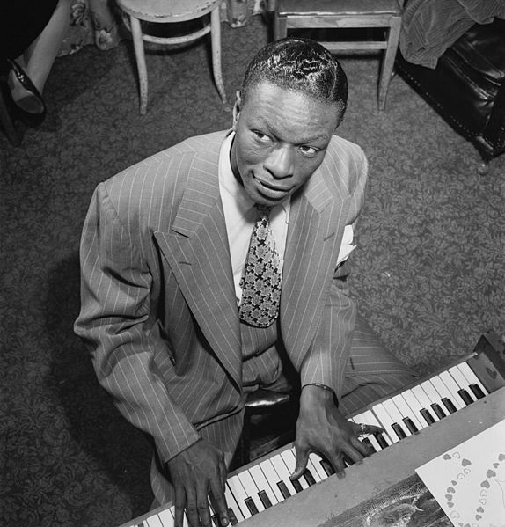
Entertainers
Many entertainers are from Alabama. One of the most famous is the country music group “Alabama.”
Jimmy Buffet: musician famous for his “parrothead” fans; also known for supporting the communities of the Gulf Coast.
Nat “King” Cole: famous jazz pianist who produced many records.
Taylor Hicks: famous musician and American Idol winner in 2006.

Slide 6
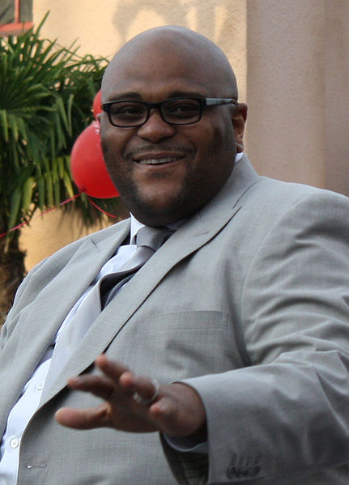
Entertainers
Lionel Richie: musician and singer who has won many awards.
Ruben Studdard: singer and American Idol winner in 2003.
Tammy Wynette: successful country music singer and musician.

Slide 7
Entertainers
Lionel Richie: musician and singer who has won many awards.
Octavia Spencer: actress who has earned an Academy Award and a Golden Globe.
Ruben Studdard: singer and American Idol winner in 2003.
Tammy Wynette: taught herself how to play the guitar and piano; became a country music star with 20 number one hit songs.

Slide 8
Entertainers
Lionel Richie: musician and singer who has won many awards.
Octavia Spencer: actress who has earned an Academy Award and a Golden Globe.
Ruben Studdard: singer and American Idol winner in 2003.

Slide 9
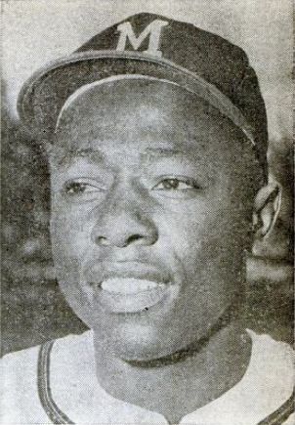
Sports Stars
Sports are popular in Alabama and the state has many famous athletes.
Henry “Hank” Aaron: professional baseball player who hit 755 home runs.
Charles Barkley: professional basketball player and Olympic gold medalist.
Paul “Bear” Bryant: famous coach of the University of Alabama Crimson Tide football team.

Slide 10
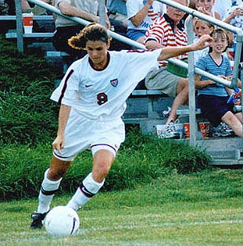
Sports Stars
Vonetta Jeffrey Flowers: first African American to win a gold medal at a Winter Olympics.
Mia Hamm: star soccer player and Olympic medalist.
Bo Jackson: has played professional basketball and football.
Joe Lewis: world boxing champion.
Willie Mays: record-setting professional baseball player.

Slide 11
Sports Stars
Vonetta Jeffrey Flowers: first African American to win a gold medal at a Winter Olympics.
Mia Hamm: star soccer player and Olympic medalist.
Bo Jackson: has played professional basketball and football.
A. J. McCarron: former quarterback for the University of Alabama; currently backup quarterback for the Atlanta Falcons
Joe Louis: world boxing champion.
Willie Mays: record-setting professional baseball player.

Slide 12
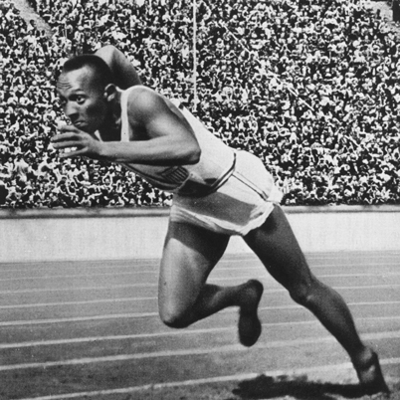
Sports Stars
Ozzie Newsome: star UA football player and later played and managed in professional football.
Jesse Owens: Olympic track and field star.
Catherine “Cat” Reddick Whitehill: Olympic medalist in soccer.

Slide 13
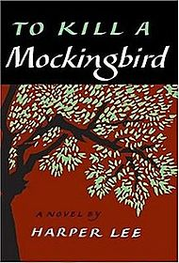
Writers
Many talented writers have come from Alabama.
Fannie Flagg: author of many books including Fried Green Tomatoes at the Whistle Stop Café; she is also an actress and TV personality.
Harper Lee: best known for the book To Kill a Mockingbird.

Slide 14
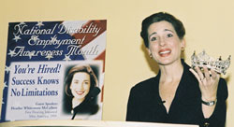
Writers
Heather Whitestone McCallum: author of Listening with My Heart; she lost her hearing as a child and later became Miss America.
Kathryn Tucker Windham: wrote Alabama, One Big Front Porch, and My Name is Julia; she is also a radio personality, journalist, and actor.

Slide 15
Image Credits
Title slide: Alabama Capitol by National Park Service: National Register of Historic Places; Slide 2: Desoto Falls by JS Fouche Public Domain Wikimedia Commons; Slide 21: Jylie Dupuis; End slide: Coosa River by Mike Cline
Return to Main Menu

