Slide 1
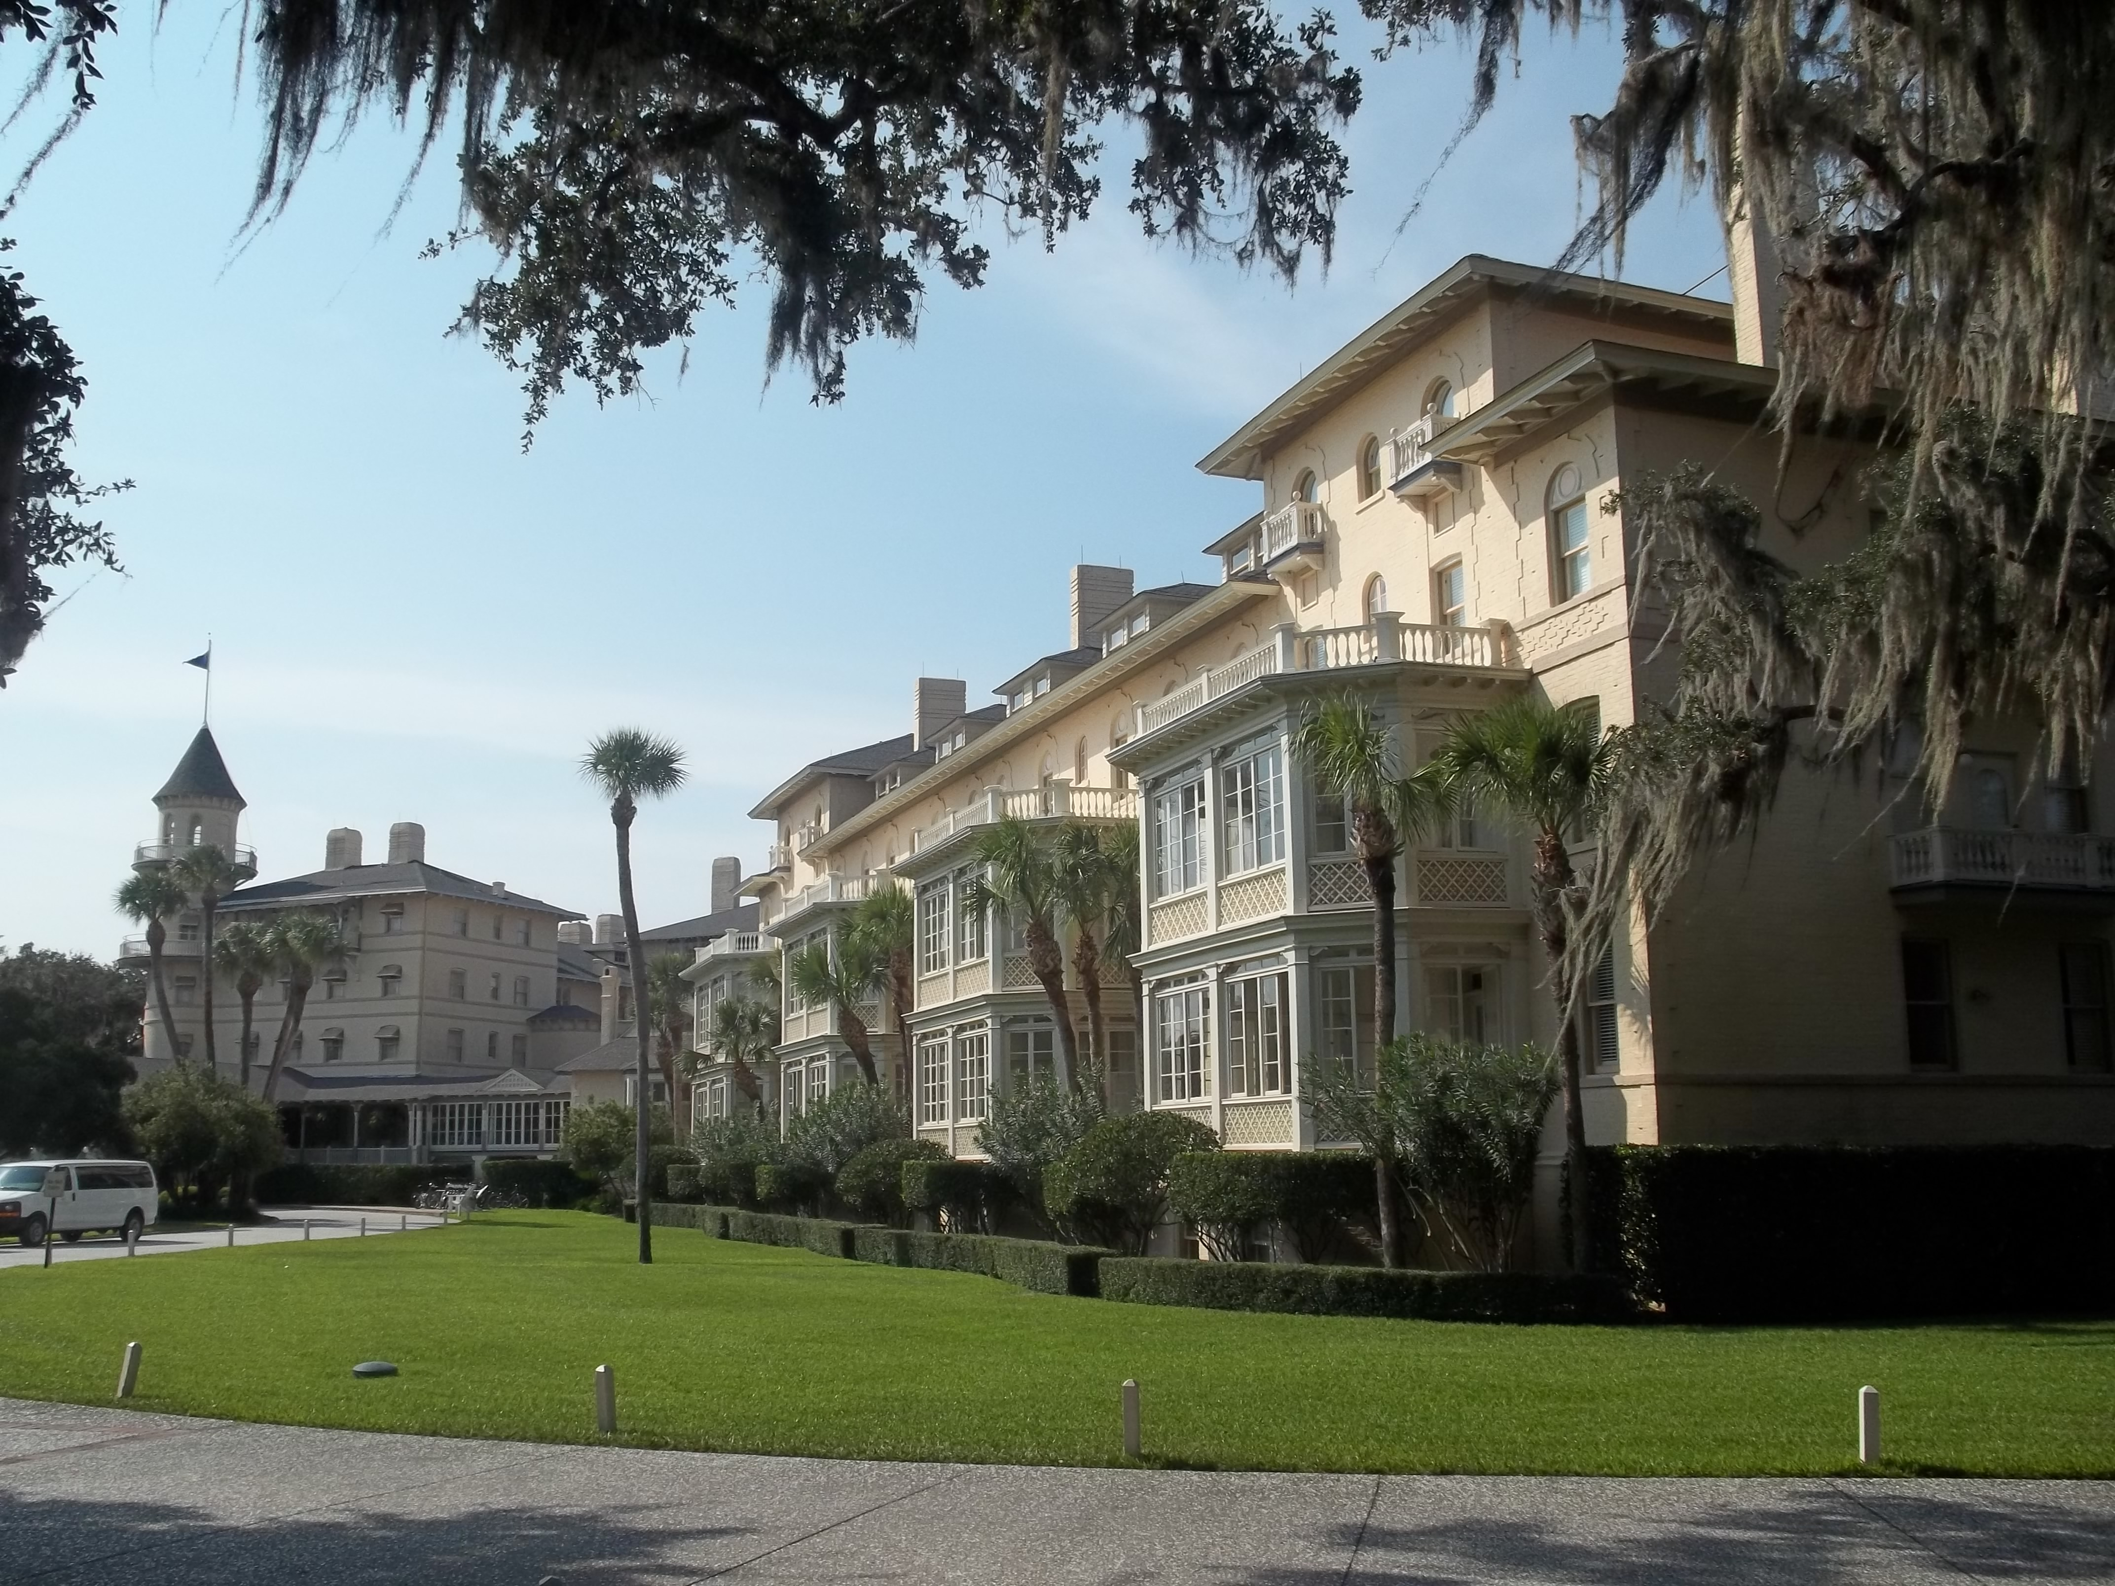

Chapter 1: Georgia’s Land and Location STUDY PRESENTATION
© 2025 Clairmont Press

Slide 2
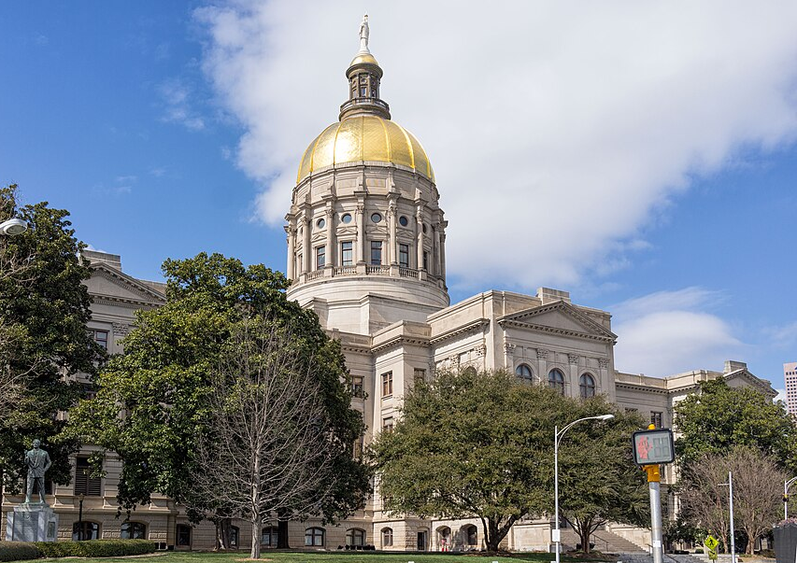
Section 1: Georgia’s Location
Section 2: Georgia’s Geographic Regions
Section 3: Georgia’s Physical Features

Slide 3
SECTION 1: GEORGIA’S LOCATION
Essential Question:
What is Georgia’s location in the world?

Slide 4
SECTION 1: GEORGIA’S LOCATION
What terms do I need to know?:
hemisphere
Equator
Prime Meridian
continent
nation
relative location

Slide 5
GEORGIA’S LOCATION
The state of Georgia covers nearly 60,000 square miles.
Located in the Northern and Western Hemispheres, Georgia is one of the fifty states that makes up the United States, which is in North America.
These types of statements help describe the location of a place.

Slide 6
LOCATING GEORGIA IN THE WORLD
A globe is a model of Earth, and globes are divided into two halves called hemispheres.
An imaginary line of latitude called the Equator divides the Northern and Southern Hemispheres.
An imaginary line of longitude called the Prime Meridian divides the Eastern and Western Hemispheres.
Seven continents (large continuous masses of land) exist on Earth, and many nations (a country with a common government and territory), exist on these continents.

Slide 7
LOCATING GEORGIA IN THE UNITED STATES
Relative location is where one location lies in relation to another location.
Georgia is in the Southeast region of the United States, and this region borders both the Atlantic Ocean and Gulf of Mexico.
Return to Main Menu

Slide 8
SECTION 2: GEORGIA’S GEOGRAPHIC REGIONS
Essential Question:
What are the five geographic regions of Georgia?

Slide 9
SECTION 2: GEORGIA’S GEOGRAPHIC REGIONS
What terms do I need to know?:
landforms
faults
elevation
Fall Line

Slide 10
GEORGIA’S GEOGRAPHIC REGIONS
Georgia is divided into 5 regions based on its landforms (natural features of a land surface):
Appalachian Plateau
Valley and Ridge
Blue Ridge
Piedmont
Coastal Plain
Each has various aspects that have affected how and where people live in the past and today.

Slide 11
APPALACHIAN PLATEAU REGION
Located in the northwest corner of the state, it is on the western edge od the Appalachian Mountains.
This region is where the borders of Tennessee, Georgia, and Alabama meet.
Due to erosion of the limestone-heavy land, the region has many caves, and coal and iron deposits made mining a major occupation here.
It has hot, humid summers and mild winters, and the region provides tourism and forestry for Georgia’s economy.

Slide 12
VALLEY AND RIDGE REGION
East of the Appalachian Plateau, this region is made up of long mountain ridges and long valleys in between.
These ridges and valleys run in straight lines from the southwest to northeast.
The valleys contain fertile farmland, and streams and roads run along the valleys.
A fault system (break in the Earth’s crust when parts of its surface collide) divides the region from the northeast part of the state.
It has hot, humid summers and not-too-cold winters, and its main industries include farming, timber, and producing textiles and carpets.

Slide 13
BLUE RIDGE REGION
This region is in the northeast corner of the state and has the highest elevation (height above sea level) in Georgia.
Brasstown Bald, Georgia’s tallest mountain, exists here.
Many roads here wind around valleys and streams, where it’s easier to build roads than high up on mountains.
Rapid streams and waterfalls pepper the region, and it has warm summers, mild winters, and the most precipitation in the state.
Because of the increased rainfall, major rivers like the Savannah and Chattahoochee begin here.

Slide 14
BLUE RIDGE REGION, Pt. 2
Gold was found here in the 1800s, leading to the country’s first gold rush, and marble was found later.
Tourism has become a major income source, attracting those who enjoy hikes, rafting and canoeing, and observing nature.

Slide 15
PIEDMONT REGION
Many people live here, where rolling hills and flowing rivers characterize the region.
Large granite deposits are found here, and the soil in some parts is red-colored clay due to iron oxide (rust).
It has hot, humid summers and mild to cool winters, and fertile soil mixed with this climate makes the region perfect for farming.
Major crops grown here include corn, soybeans, wheat, and cotton.

Slide 16
PIEDMONT REGION, Pt. 2
The Fall Line is the line where fast, narrow rivers leave the hard soil of the Piedmont and enter the softer soil of the Coastal Plain, creating waterfalls and rapids before spreading out and becoming slower.
Many major cities are located along the Fall Line for easier shipping access, and craftsmen congregated in these cities.

Slide 17
COASTAL PLAIN REGION
This is the largest and southernmost region, which is divided into the Upper and Lower Coastal Plains.
Porous limestone lies under the soil, which holds rainwater used for drinking, agriculture, and industry.
It has hot, humid summers and cool winters.
The fertile soil of the Upper Coastal Plain grows peanuts, peaches, Vidalia onions, corn, and cotton, while the Lower Coastal Plain is flat, low, and marshy, with deepwater ports along the coast.
Contributors to the economy here include pulp and paper industries, commercial fishing, seafood processing, tourism, and recreation.
Return to Main Menu

Slide 18
SECTION 3: GEORGIA’S PHYSICAL FEATURES
Essential Question:
What are the barrier islands and their uses?

Slide 19
SECTION 3: GEORGIA’S PHYSICAL FEATURES
What terms do I need to know?:
barrier island
peat

Slide 20
GEORGIA’S PHYSICAL FEATURES
Georgia’s rivers and streams provide water for drinking, recreation, irrigation, and industry.
Some waterways flow southwest into the Gulf of Mexico, but most flow to the Atlantic Ocean.
Georgia has 14 barrier islands (sandy islands that run parallel to the coast and are separated from the mainland by a lagoon or salt marsh).
They have become popular tourist destinations, though only 4 are accessible by car.
Georgia also has many swamps, including the Okefenokee Swamp.

Slide 21
CHATTAHOOCHEE RIVER
Georgia’s longest river begins in the Blue Ridge Mountains, runs southwest through Florida, and empties into the Gulf of Mexico.
This river is a major source of drinking water, agricultural irrigation, and industrial use in Georgia, Florida, and Alabama.
This has led to long-term disagreements over how much water each state gets.
The river offers activities like boating, rafting, kayaking, and fishing, as well as hiking and biking at the Chattahoochee Bend State Park.

Slide 22
SAVANNAH RIVER
The river forms Georgia’s eastern boundary with South Carolina and is joined by many others on its way to the ocean.
It generates hydroelectric power and cools nuclear plants for both Georgia and South Carolina, and it is a major source of drinking water for both Augusta and Savannah.
Savannah is one of the busiest ports in the US, accepting huge ships from around the world.
The river has influenced the state’s history and progress since the beginning.

Slide 23
BARRIER ISLANDS
Sometimes referred to as the Golden Isles, this chain of islands forms a natural barrier that shelters the mainland from the Atlantic.
The beaches constantly erode as waves and storms move the sand, and stone walls have been erected in some places to slow erosion.
These islands have been home to Native Americans, Spanish missionaries, wealthy northerners on winter retreats, and modern tourist destinations.
Jekyll Island, St. Simons Island, Sea Island, and Tybee Island can be reached by car, but the others require a boat to reach them.
Small boats in Georgia’s early history would use these waters to sail along the coast, but the government deepened the waters in the 1930s so larger boats could use them, too.

Slide 24
OKEFENOKEE SWAMP
Located in southeast Georgia, the Okefenokee is one of the largest swamps in the country.
Trees here grow on floating islands of peat (decaying plant material that floats on water).
Some areas of the swamp have no trees but are covered with grasses.
Okefenokee’s water comes from tropical storms from both the Atlantic Ocean and Gulf of Mexico, which can sometimes cause swamp fires from lightning strikes.

Slide 25
OKEFENOKEE SWAMP, Pt. 2
The ecosystem supports a variety of life, including rare or endangered species.
President Franklin D. Roosevelt designated 80% of the swamp as a national wildlife refuge, and it received more protections in the 70s.

Slide 26
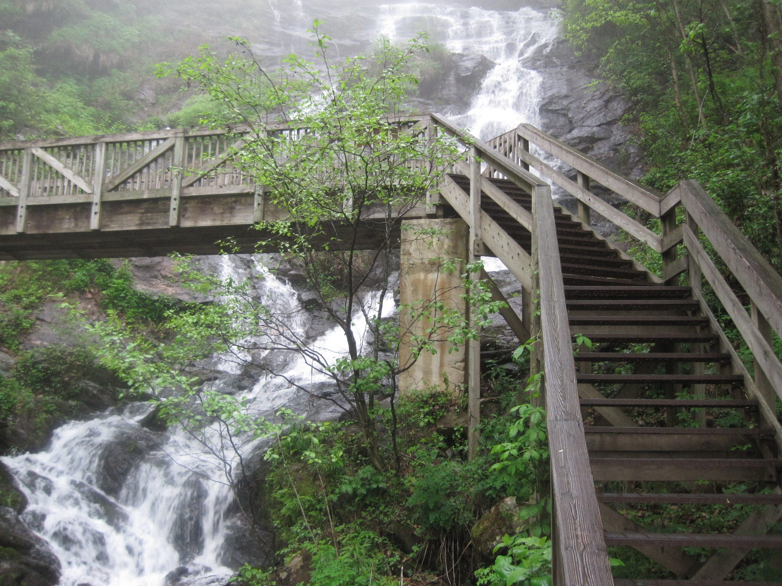
Image Credits: all Wikimedia Commons. Maps: ©2025 Clairmont Press.
Return to Main Menu

