Slide 1
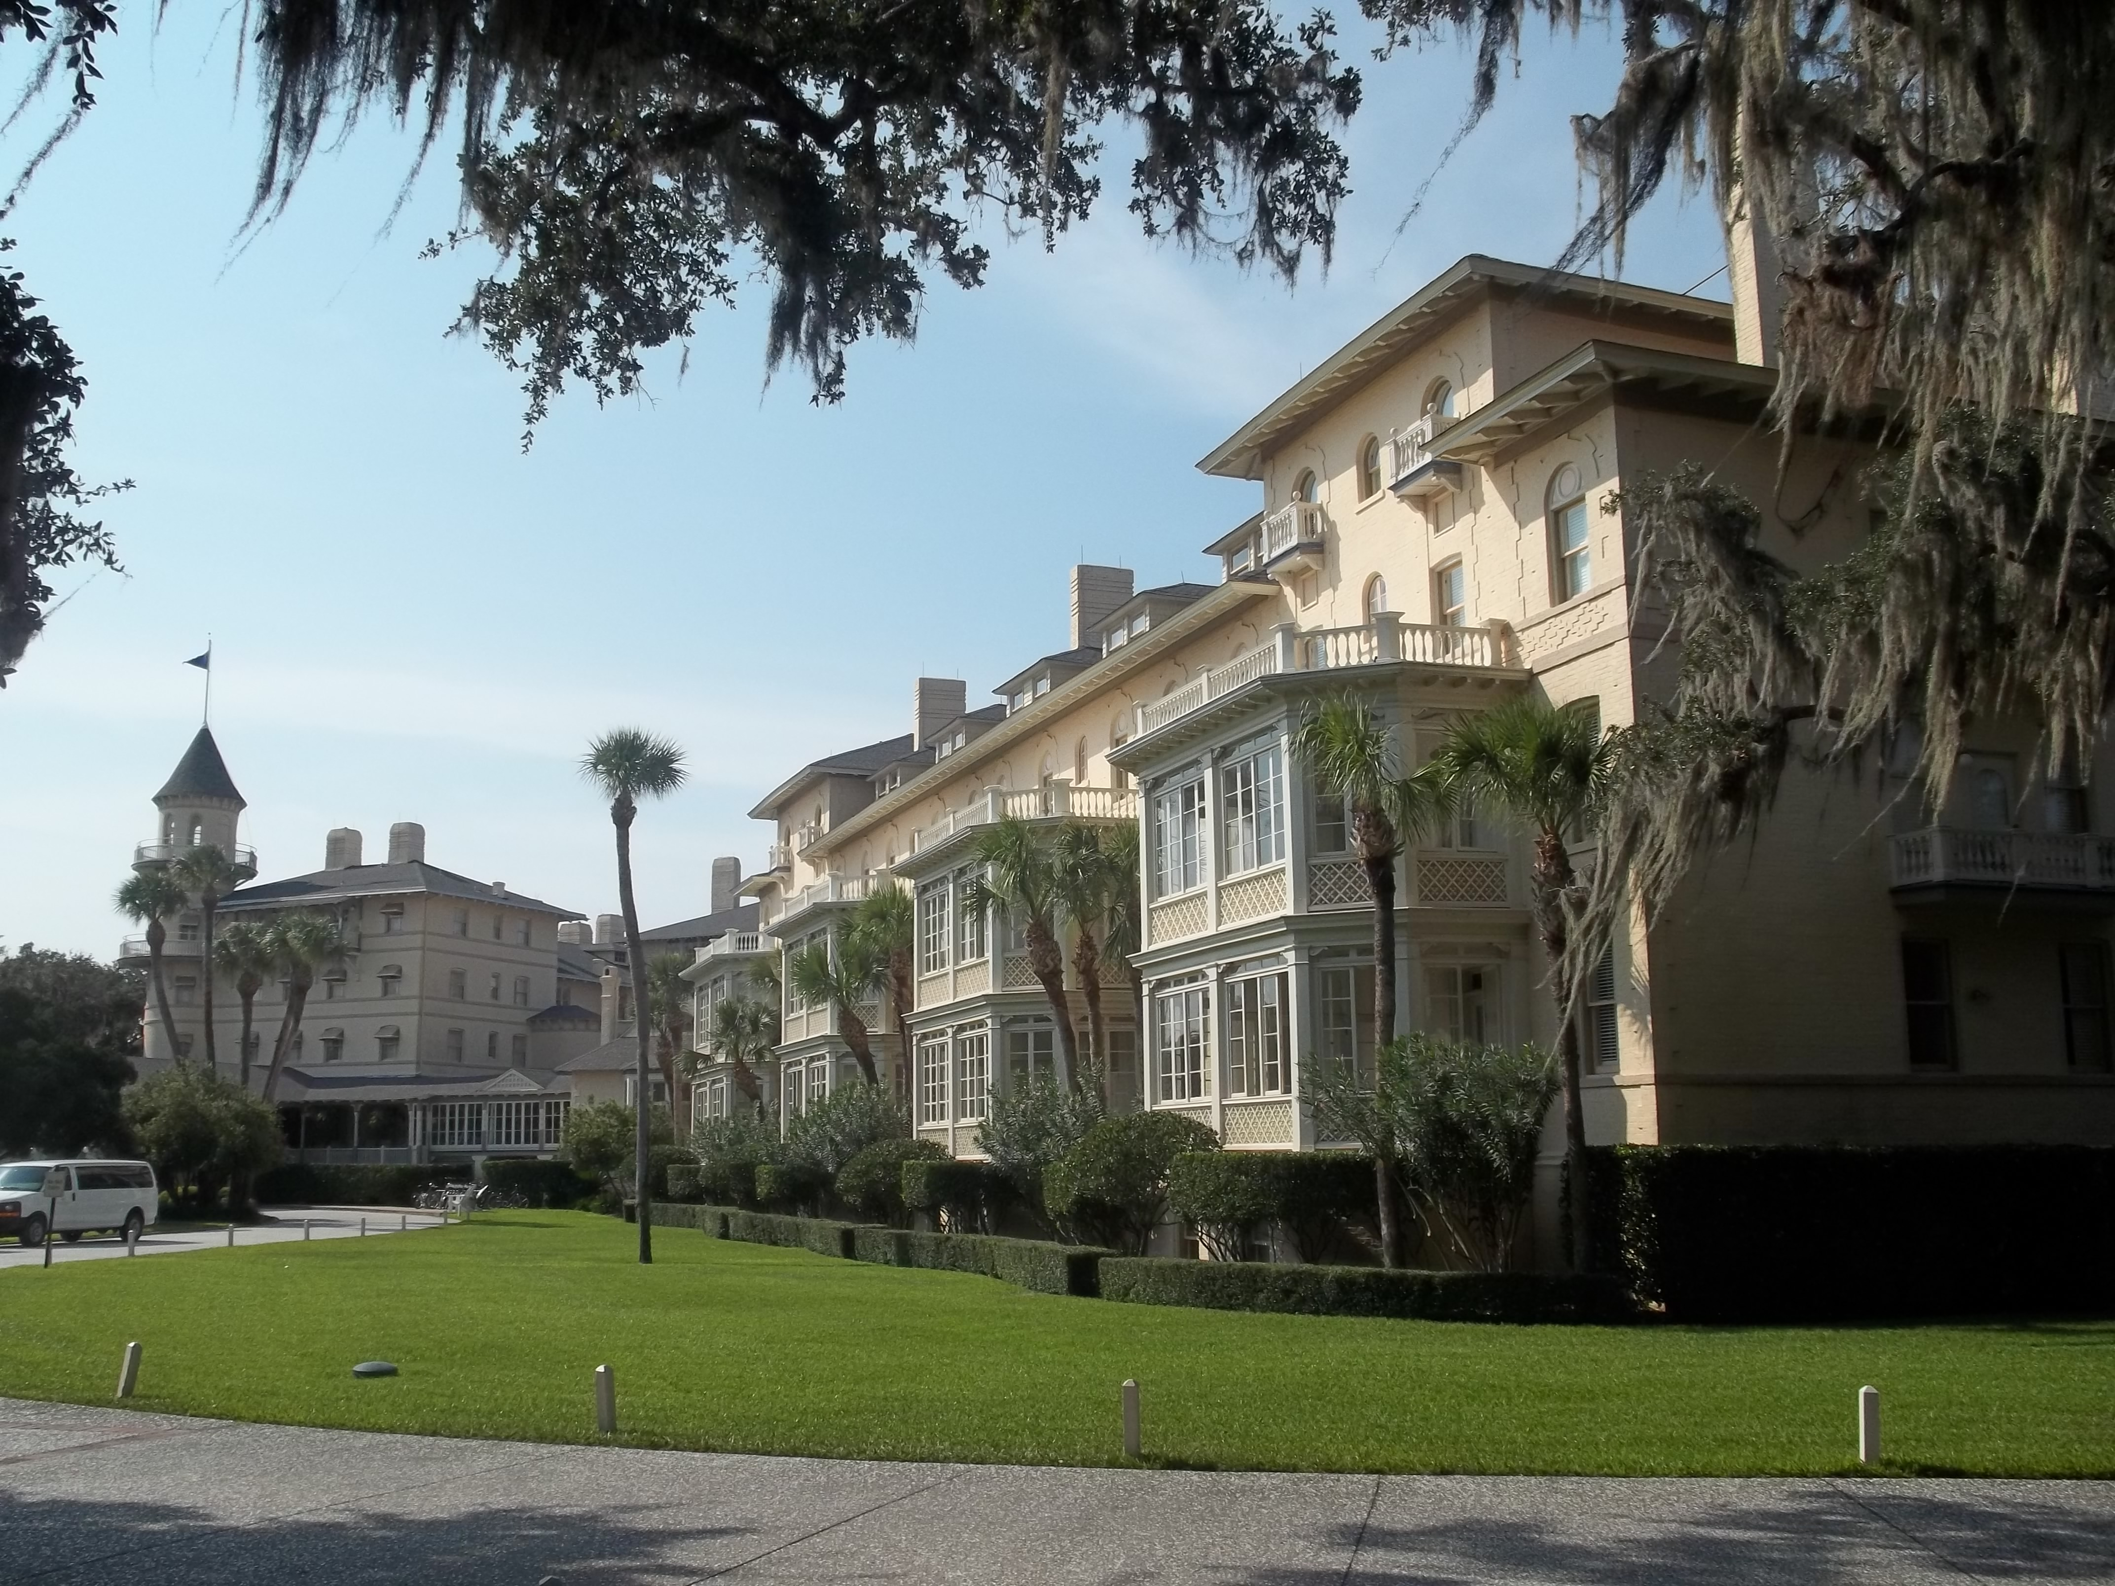

Chapter 9: Colonial Georgia
STUDY PRESENTATION
© 2025 Clairmont Press

Slide 2
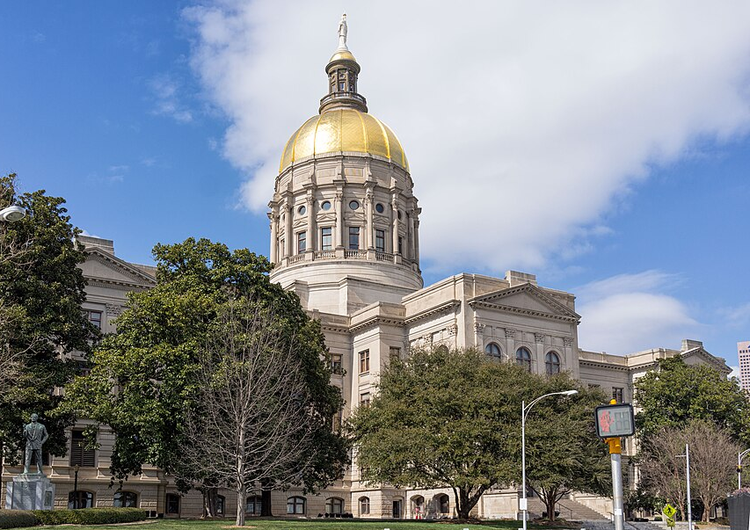
Section 1: Georgia’s Founding
Section 2: Diverse Groups in the Georgia Colony
Section 3: Georgia from Trustee to Royal Colony
Section 4: Economic Development in Royal Colony

Slide 3
SECTION 1: GEORGIA’S FOUNDING
  Essential Question:
    What were the reasons for the founding of Georgia?

Slide 4
SECTION 1: GEORGIA’S FOUNDING
  What terms do I need to know?:
    philanthropy
    charter
    trustee colony
    buffer
    mercantilism
    slavery
    militia

Slide 5
GEORGIA’S FOUNDING
By the early 1700s, Great Britain had twelve colonies in North America – all located along the East Coast:
Carolina had two settlement areas:
    The north, settled by small farmers from Virginia
    The south, settled by planters from Barbados, with plantations surrounding Charles Town
    By 1729, Carolina and Charles Town became royal colonies under control of the king.
By the late 1720s, no one had settled the part of South Carolina south of the Savannah River, which was the dividing line between the Carolinians and the Indian nations.

Slide 6
THE CHARTER OF 1732 AND
THE TRUSTEE PERIOD
James Oglethorpe and his associates asked King George II for a land grant to found the colony: philanthropy, defense, and economics.
    Philanthropy is when people give their time, money, or resources to help others without expecting something back.
Oglethorpe and his fellow trustees received the Charter of 1732, which stated the trustees could not profit from their position.
    A charter was a document that granted territory to trustees and set up rules under which the trust would work.
    Because the colony of Georgia was governed by trustees, it was considered a trustee colony.

Slide 7
Philanthropy
The Georgia colony was established to attracted both deserving poor English people and persecuted Protestant Europeans.
    Trustees would pay for the passage of some colonists.
    Males who became charity colonists would receive 50 acres of land to farm along with tools and other supplies for a year.
    However, no one from a debtor’s prison was chosen to be an original colonist.

Slide 8
Defense
Georgia was established to be a buffer (protection) between southern Carolina and the Spanish in Florida.
    Georgia colonists existing in the region between would make it harder for Spain to attack southern Carolina and disrupt their rice production.

Slide 9
Economics
Trustees believed the new colony could also grow plants England couldn’t, which would reduce import costs of those goods.
    This was part of the government’s economic policy of mercantilism (favorable balance of trade).
Colonies were expected to help their home countries by supplying raw materials as well as serving as a market for manufactured goods.

Slide 10
AUTHORITY OF THE TRUSTEES
The Charter of 1732 granted the trustees the land between the Savannah and Altamaha Rivers and westward to the Pacific Ocean.
Trustees would control the colony till 1752, and they could raise money, grant land to settlers, make rules and regulations, establish courts, and maintain a military defense until that time.
  Trustees banned slavery (owning people as property) and the sale and use of “spirits”.
  Land ownership was limited to ensure families owned and farmed the land rather than large plantations.

Slide 11
SAVANNAH, THE FIRST SETTLEMENT
Oglethorpe (the only trustee who came to the colony) led the first settlers:
    1732 – ship Anne set sail from England with chosen settlers (voyage took 57 days)
    settlers welcomed by Carolinians who donated food, provisions, slaves, etc., to help work
    site chosen for first settlement – a high bluff known as Yamacraw (good defense against enemies)
Tomochichi (leader of Yamacraw people and good friend to Oglethorpe) was valuable in ensuring early success of the colony.

Slide 12
SAVANNAH, THE FIRST SETTLEMENT, Pt. 2
John and Mary Musgrove, local trading post owners who spoke English and Creek, acted as interpreters between Oglethorpe and Tomochichi.
    Mary became the main interpreter after John’s death in 1735.
Oglethorpe brought the settlers to the future site of Savannah in February 1733, where they set up tents and began planning the town.
Oglethorpe supervised the town’s construction and led the people as the only trustee in Georgia.

Slide 13
JAMES OGLETHORPE, TOMOCHICHI,
AND MARY MUSGROVE
Tomochichi gave Oglethorpe permission to settle on Yamacraw land and acted as a diplomat between the British settlers and the Creek.
Oglethorpe promised to protect Tomochichi’s people from their mutual enemies and gained access to trade opportunities for his community.
Mary Musgrove helped build alliances and communicate needs effectively between each group, and she personally gained influence and trade opportunities.

Slide 14
DEFENDING GEORGIA
Oglethorpe had concerns about the colony’s defense and convinced the British government to pay for building forts at the northern and southern ends of the colony.
Oglethorpe built more forts and roads along the coast and was promoted to the rank of general, putting him in command of local British troops and militias (citizen soldiers).
When war broke out between Britain and Spain in 1739, Oglethorpe fought Spanish forces in Florida but eventually was forced to retreat despite initial success.

Slide 15
DEFENDING GEORGIA, Pt. 2
Spain invaded St. Simons, Georgia, in 1742, but Oglethorpe pushed them back and convinced them British reinforcements were coming, so they retreated.
Oglethorpe returned to England in 1743 after thanking Mary Musgrove for her work and never returned, but he did live long enough to see Georgia become part of the US.
Return to Main Menu

Slide 16
SECTION 2: DIVERSE GROUPS IN
THE GEORGIA COLONY
  Essential Question:
    What reasons did the diverse groups of settlers have for settling in Georgia?

Slide 17
SECTION 2: DIVERSE GROUPS IN
THE GEORGIA COLONY
  What terms do I need to know?:
    Malcontents

Slide 18
DIVERSE GROUPS IN
THE GEORGIA COLONY
Oglethorpe traveled to England in 1734 to advertise the colony, raise money, and prepare for the colony’s defense.
When Oglethorpe returned to Georgia in 1736, he brought cannons and weapons for the defense of the colony.
A pair of brothers, ministers John and Charles Wesley, also came along to work in the colony, but they didn’t stay long.
    After returning to England by 1738, the brothers ended up founding the Methodist branch of Protestant Christianity.

Slide 19
JEWISH SETTLERS
Forty-two Jews arrived a few months after the colony began, but the group did not ask for permission from the trustees.
    The trustees wanted Protestant Christians in the colony, so they didn’t like the idea of Jews living there.
    Oglethorpe gave them permission to stay since the colony doctor and 20 others had died from a fever and the Jews had a doctor with them.
    Dr. Samuel Nunez saved the lives of several victims suffering from the fever that was killing so many Georgians.

Slide 20
THE SALZBURGERS
Many people across Europe were persecuted for their religious choices.
The Salzburgers, German-speaking Lutherans, first came to Georgia in 1734 to escape this persecution.
The group was given land up the Savannah River and became very hardworking colonists.
    They were successful farmers, were anti-slavery, and dedicated to producing silk.

Slide 21
THE HIGHLAND SCOTS
Highland Scots were recruited by Oglethorpe himself to settle the colony, as they had a reputation for being good soldiers and fighters.
Many settled in the town of Darien and helped build other forts on Georgia’s islands.

Slide 22
THE MALCONTENTS
Some Georgia colonists became unhappy with the trustees’ policies and laws.
    The Rum Act often ignored or not enforced.
    Colonists objected to the rule of not allowing women to inherit land.
    Grape, olive, and mulberry trees did not grow well in coastal Georgia despite trustee hopes.
The biggest complainers, Malcontents, were mostly Scottish settlers who’d paid for passage and didn’t like the land policies.
    They felt limited by 500 acres and wanted to allow slavery.
Return to Main Menu

Slide 23
SECTION 3: GEORGIA FROM
TRUSTEE TO ROYAL COLONY
  Essential Question:
    What were some of the changes Georgia experienced when it became a royal colony?

Slide 24
SECTION 3: GEORGIA FROM
TRUSTEE TO ROYAL COLONY
  What terms do I need to know?:
    royal colony
    indentured servant
    headright system
    cash crops

Slide 25
GEORGIA FROM TRUSTEE
TO ROYAL COLONY
Georgian settlers in the trustee period spent most of their time working to meet their basic needs.
    They built homes, cleared land, farmed, and made clothes for themselves.
The trustees tried governing from Britain, but they didn’t understand the colonial experience.
The trustees had big plans, rules, and dreams for the colony, but the economy they needed never developed.

Slide 26
THE END OF THE TRUSTEE PERIOD
By the late 1740s, the trustees were disillusioned with the colony and gave in to many of the colonists’ demands.
Parliament failed to provide additional funds for Georgia in 1751, so the trustees turned over the colony to the government.
    Georgia became a royal colony (a colony under control of the king).
Despite its “failings”, Georgia had succeeded in repelling the Spanish, turned Augusta into a trade center with American Indians, and build homes and farms for basic survival.

Slide 27
BECOMING A ROYAL COLONY
The colony finally had its first legislatures as a royal colony, and both its population and economy grew.
Land settlement expanded after more treaties were signed with Native Americans.
Despite the positives, this time also saw the beginnings of slave laws and plantation systems that would devastate African men and women for generations.

Slide 28
Government
A royal governor appointed by the king oversaw the colony.
The royal governor set up a new framework and rules for how Georgia would be governed.
The Governor’s Council, made up of 12 local leaders, was both the upper legislature and supreme court of the colony.
The Commons House of Assembly would be the lower house and was made up of an elected assembly.

Slide 29
Land Ownership
During the royal period, settlers could procure land in three ways:
    buy it
    receive it as a gift or inheritance
    receive it as a gift from the government
Land grants were made by the governor and his Council, the size of which was based on the applicant’s household.
    Households included family members, indentured servants (persons sold into servitude for a period to gain passage to the New World), and slaves.

Slide 30
Land Ownership, Pt. 2
The headright system allowed the head of a household to ask for 100 acres for themselves and 50 additional acres for each household member.
As the British expanded Georgia’s territory, many Carolinians began moving to the state from expensive land in South Carolina.

Slide 31
Enslaved People in Georgia
Cash crops are crops grown to be sold for income, and crops like rice and indigo required a lot of labor.
Indentured servants had been used in Georgia during the trustee period, but they were free when they completed their terms.
Planters in the royal period favored using slaves to have a permanent workforce.
Most slaves were of African heritage, and until the 1770’s, most of Georgia’s slaves lived in coastal areas on plantations.
Return to Main Menu

Slide 32
SECTION 4: ECONOMIC DEVELOPMENT
IN ROYAL GEORGIA
  Essential Question:
    What were the goals of the Trustees who controlled the Georgia colony?

Slide 33
SECTION 4: ECONOMIC DEVELOPMENT
IN ROYAL GEORGIA
  What terms do I need to know?:
    artisan

Slide 34
ECONOMIC DEVELOPMENT
IN ROYAL GEORGIA
The royal period saw increased growth and prosperity for Georgia.
    As farmers introduced new crops, more slave labor was needed to grow them.
    Changing land policies made it easier for settlers to get large amounts of land.
By the end of the period, Georgia’s economy was very similar to South Carolina.

Slide 35
A CHANGING ECONOMY
Georgia’s economy depended on small-scale farming and trade, and all farmers grew subsistence crops (crops used to meet the needs of farmers and their families).
If farmers had a surplus, they could sell it to a nearby town or community.
Georgians also made money from pine trees, as both their timber and sap held value.
    Pine sap was used to make tar, pitch, and turpentine, which were considered naval stores because the Royal Navy used them so much.

Slide 36
IMPORTANT AGRICULTURAL PRODUCTS
Wheat, rice, indigo, silk, and tobacco were essential to the colony’s economy.
    Wheat could be exported as grain or milled into flour.
    Rice, which required field-flooding and lots of labor, became profitable after Georgia adopted slavery.
    Used to make blue dye, indigo was in high demand in England, and it grew well in Georgia.
    Silkworms produced silk, but many didn’t know how to care for them, and mulberry trees (their habitat) didn’t grow well.
    Tobacco was in high demand in Europe, and slavery made tobacco production more successful.

Slide 37
THE GROWTH OF TOWNS
Most Georgians were farmers or planters and lived away from others on farms.
However, towns provided places for trade and professional occupations.
    Doctors, government officials, and lawyers resided in towns.
    Artisans, cartwrights, blacksmiths, carpenters, bakers, tailers, printers, and chandlers were all important professions.
    Few people worked as teachers for children, and taverns and inns served both as traveling accommodations and gathering places.

Slide 38
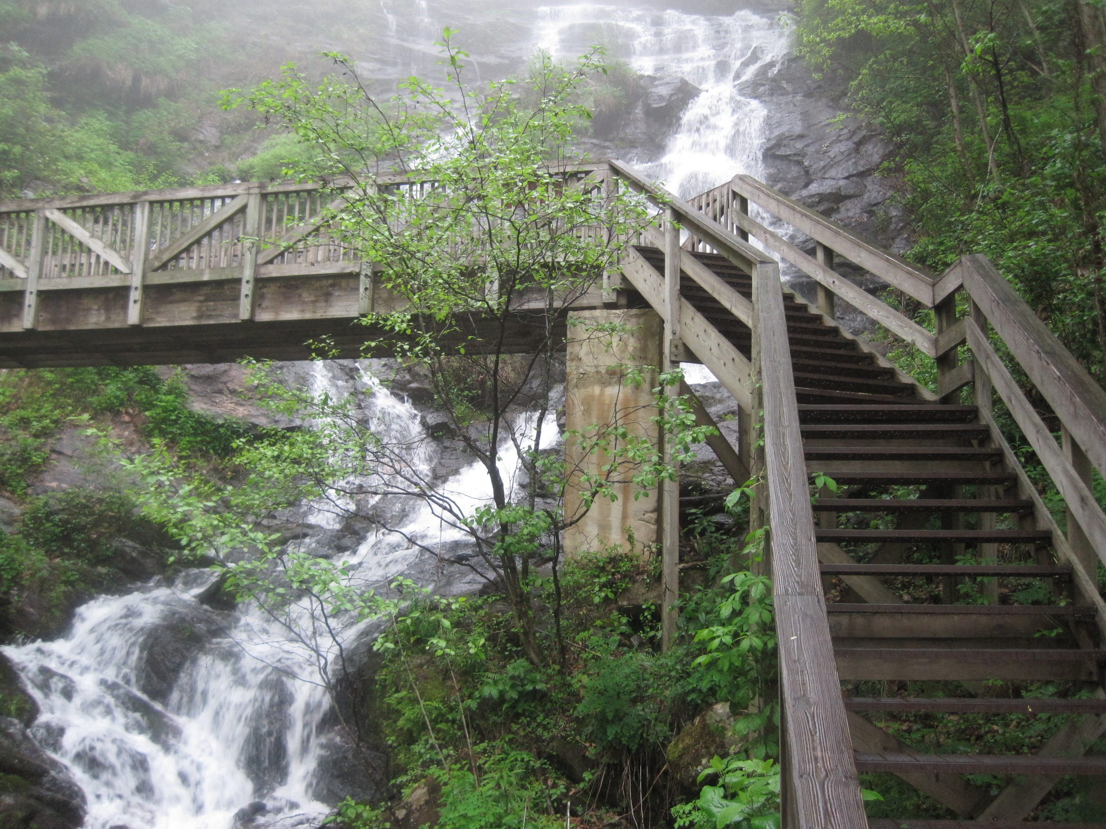
Image Credits: all Wikimedia Commons. Maps: ©2025 Clairmont Press.
Return to Main Menu

