Slide 1
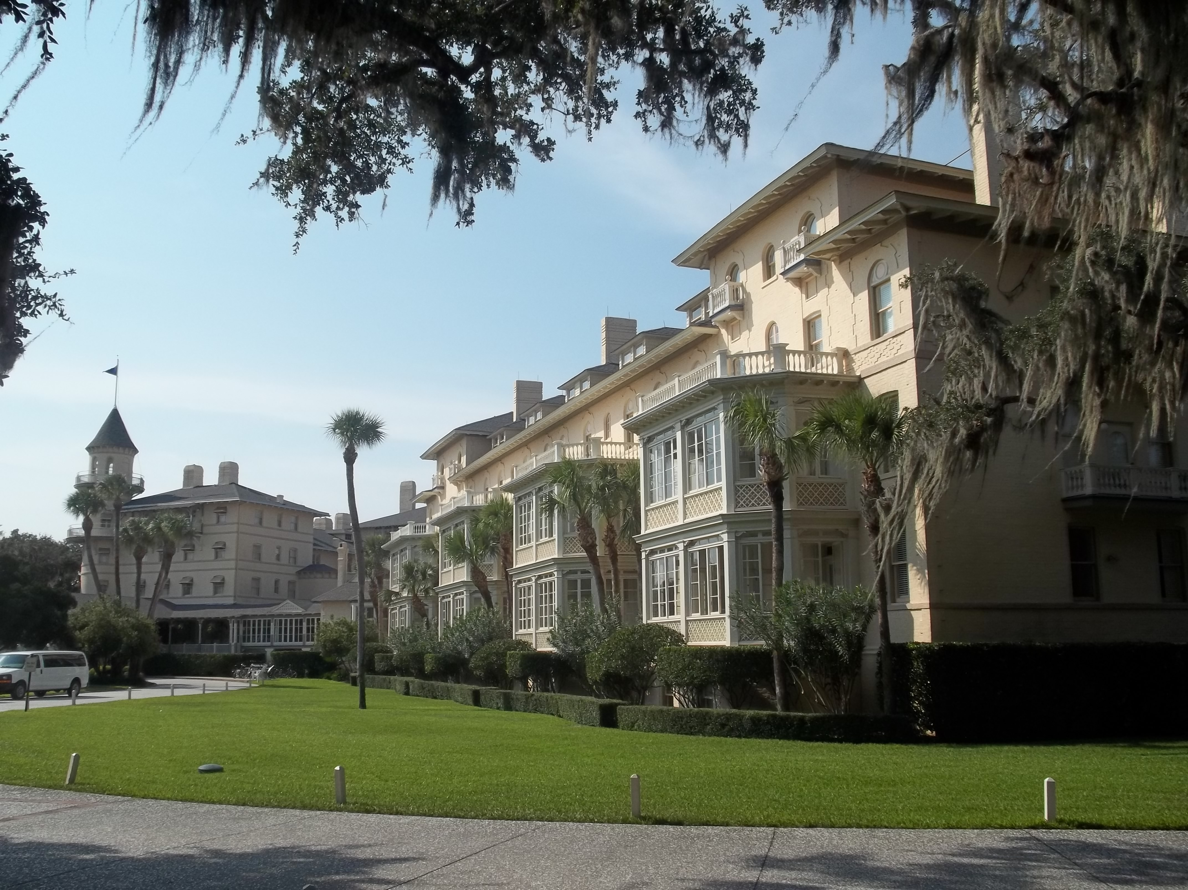

Chapter 18: The Civil Rights Movement in Modern Georgia STUDY PRESENTATION
© 2025 Clairmont Press

Slide 2
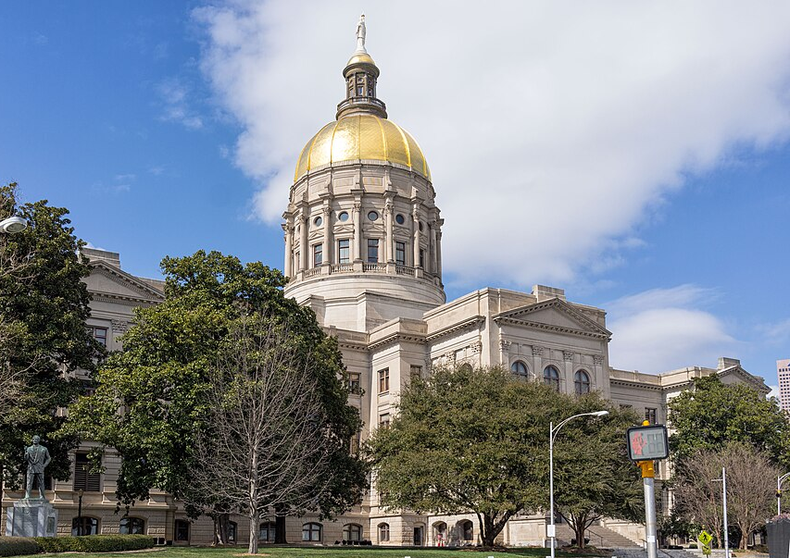
Section 1: Georgia’s Response to School Integration
Section 2: The People’s Fight for Civil Rights
Section 3: Results of Federal Civil Rights Laws

Slide 3
SECTION 1: GEORGIA’S RESPONSE TO SCHOOL INTEGRATION
Essential Question:
What was the impact of Brown v. Board of Education?

Slide 4
SECTION 1: GEORGIA’S RESPONSE TO SCHOOL INTEGRATION
What terms do I need to know?:
desegregation
integration

Slide 5
GEORGIA’S RESPONSE TO SCHOOL INTEGRATION
After the US entered WWII, some civil rights progress began.
There were Presidential executive orders as well as federal district court and US Supreme Court decisions.
By 1965, the legal framework for a more integrated society was established, marking the end of the Jim Crow era.

Slide 6
HARRY TRUMAN AND CIVIL RIGHTS
African Americans benefited from the jobs and programs during the New Deal, but they didn’t have any civil rights protections.
After WWII, President Harry Truman established the Committee on Civil Rights to study the challenges African Americans faced and recommend changes.
In 1948, Truman ordered the desegregation (ending the practice of segregating races) of the US military and federal government offices.
Despite this, black soldiers still could not enter the same businesses as white soldiers in places where general segregation was still legal.

Slide 7
HARRY TRUMAN AND CIVIL RIGHTS, Pt. 2
During this time, the Democratic Party split:
National leaders supported civil rights for African Americans.
Southern Democrats opposed the idea, forming their own party called “the States’ Rights Democratic Party”, or “Dixiecrats.”
Truman couldn’t pass any civil rights laws during his presidency, but courts began making decisions that favored them.

Slide 8
THE NAACP AND THE FIGHT FOR CIVIL RIGHTS
The National Association for the Advancement of Colored People has worked since its founding in 1909 to challenge discrimination and segregation in the courts.
While the US Supreme Court ruled some state and local laws violated the rights of African Americans, many unfair practices continued:
grandfather clauses
literacy tests
white voting primaries
white homeowners in white neighborhoods refusing to sell to African Americans

Slide 9
THE NAACP AND THE FIGHT FOR CIVIL RIGHTS, Pt. 2
After courts ruled that states must admit black students to white schools if they were not equal, southern states attempted to improve black schools.
Georgia Governor Herman Talmadge established the Minimum Foundation Program in 1949 to enhance school funding, especially black schools.
Talmadge and others wanted to keep segregated schools, and they even considered closing schools to maintain segregation.

Slide 10
BROWN V. BOARD OF EDUCATION
The case, led by NAACP lawyer Thurgood Marshall, argued that black children received an unequal education in segregated schools, violating the 14th Amendment.
Student funding was unequal
Teacher pay was lower
School buildings, classrooms, and textbooks were substandard
Students’ psychological and social well-beings were harmed
The US Supreme Court ruled in 1954 that “separate but equal” was unconstitutional, and shortly after, ordered schools to end segregation with “all deliberate speed.”

Slide 11
THE 1956 GEORGIA STATE FLAG
Many in the South opposed desegregation, even before the Supreme Court’s decision.
Georgia’s legislature passed a law in 1953 that allowed it to close public schools rather than integrate them.
Enrollment in private schools, which could remain segregated, increased.
In 1956, white southern members of the US House and Senate wrote the “Southern Manifesto,” calling the Brown decision an attack on states’ rights and wanting protection for white supremacy.

Slide 12
THE 1956 GEORGIA STATE FLAG, Pt. 2
Georgia’s legislature passed a law in February 1956 changing the state flag, which didn’t need approval from the public.
Much of the new flag featured the Confederate battle flag, with the state seal on a blue strip to the left.
The flag became more controversial in the 1990s, leading to the eventual adoption of the current flag in 2004, which has no reference to the Confederacy.

Slide 13
MORE OPPOSITION TO BROWN V. BOARD OF EDUCATION
Governors Herman Talmadge, Marvin Griffin, and Ernest Vandiver insisted black and white students would never attend school together in Georgia.
They declared the Brown decision did not apply to Georgia.
The KKK reactivated in Georgia in 1955, holding rallies at Stone Mountain and committing acts of violence against civil rights supporters.
Some white leaders, like religious figures, advocated for civil rights, but the KKK attacked and vandalized them.

Slide 14
GOVERNOR VANDIVER AND THE SIBLEY COMMISSION
Atlanta was ordered to desegregate its public schools in 1959, but state leaders vowed to close them.
A group of mostly white mothers formed HOPE and opposed school closures.
Business leaders were worried that opposing the Supreme Court would harm Atlanta’s reputation and hurt business and investment.
Vandiver refused to close Georgia’s schools and created the Sibley Commission to examine the issue and gather public opinion.
Most white Georgians told the commission they wanted segregation, even if it meant closing schools, but urban businesses and leaders were concerned about the economic impact.

Slide 15
GOVERNOR VANDIVER AND THE SIBLEY COMMISSION, Pt. 2
The Sibley Commission recommended that local school boards determine whether to integrate or close, and Atlanta desegregated peacefully in 1961.
Integration (bringing people of different racial or other groups into society/organization as equals) was slow in other cities, but eventually, civil rights efforts led to a full desegregation.
Return to Main Menu

Slide 16
SECTION 2: THE PEOPLE’S FIGHT FOR CIVIL RIGHTS
Essential Question:
What was the Albany Movement and the March on Washington?

Slide 17
SECTION 2: THE PEOPLE’S FIGHT FOR CIVIL RIGHTS
What terms do I need to know?:
sit-in

Slide 18
THE PEOPLE’S FIGHT FOR CIVIL RIGHTS
NAACP actions and court decisions helped enforce the rights guaranteed by the Constitution.
However, many ordinary citizens also took action, using peaceful protests to demand dignity and justice.
As people noticed and sympathized with their efforts, Jim Crow laws came tumbling down.

Slide 19
BUS BOYCOTTS
In Georgia, busses were important for daily work transit and city-to-city travel, but laws required black and white riders to be seated separately.
In 1955, Rosa Parks, an NAACP member, refused to give up her seat to a white rider on a crowded bus in Montgomery, Alabama.
She was arrested and jailed for violating segregation laws.

Slide 20
BUS BOYCOTTS, Pt. 2
News spread of what happened, and many black riders began boycotting city busses, refusing to ride until they were treated the same as white riders.
After more than a year of this boycott, the US Supreme Court ordered the desegregation of busses in Montgomery.
Six black pastors in Atlanta followed Rosa Parks’ example, with their trial resulting in Georgia’s transit segregation laws being declared unconstitutional.

Slide 21
MARTIN LUTHER KING JR. AND THE SOUTHERN CHRISTIAN LEADERSHIP CONFERENCE
The bus boycotts brought new leaders and strategies to the Civil Rights Movement.
Dr. Martin Luther King Jr. was a young Atlanta minister, and he and other ministers believed in nonviolent resistance to fight segregation.
The Southern Christian Leadership Conference (SCLC) was started in Atlanta by Dr. King and others in 1957.
The SCLC planned and organized protests, taught people about nonviolent protests, and worked on voter registration efforts.
Dr. King’s leadership and dedication to nonviolent protest led to him winning many awards and honors.

Slide 22
SIT-INS SPREAD ACROSS THE SOUTH
In 1960, four African American college students sat at a white-only lunch counter in Greensboro, North Carolina, and refused to leave in protest.
Sit-ins (a type of protest where people refuse to leave a public place until their demands are met) spread across the South.
On March 16, 1960, 8 sit-ins were staged by students at white-only lunch counters across Savannah, and when 3 students were arrested, a nearly city-wide boycott of businesses ensued.
The boycott only ended after an election for more moderate leaders and the city repealing its ordinance for segregation at lunch counters in October 1961.
Atlanta students also organized sit-ins, leading to several arrests, boycotts, and attempts at negotiations, with city leaders finally agreeing to desegregate in the fall of 1961.

Slide 23
JOHN LEWIS AND THE STUDENT NONVIOLENT COORDINATING COMMITTEE
The SCLC helped students form Atlanta’s Student Nonviolent Coordinating Committee (SNCC), with two important leaders being John Lewis and Julian Bond.
Inspired by the Montgomery Bus Boycotts and Dr. King, John Lewis became very active in the Civil Rights Movement after becoming a college student.
He joined sit-ins, led voter registration drives, served on the Atlanta city council, and was elected to Congress in 1986.
Julian Bond became the SNCC’s communications director, served in Georgia’s General Assembly, and was the NAACP chairman.

Slide 24
THE FREEDOM RIDES
In 1961, Freedom Riders boarded busses to challenge segregation in states where the segregation bans were ignored.
Beginning in Washington, DC, their route would take them through many segregated states on their way to New Orleans.
Despite violent attacks and destruction of busses in Alabama, the Freedom Riders continued their mission and forced the government to enforce desegregation laws.

Slide 25
THE ALBANY MOVEMENT
In 1961, a major effort to end segregation began in Albany, Georgia, but protests were risky as most black residents relied on white employers.
Citizens joined the SNCC to help register African Americans to vote, and protest marches for equal rights led to hundreds of arrests.
Dr. King and his team were arrested as soon as they arrived, bringing national attention to the situation.
The Albany Movement slowed in the fall of 1962 and did not result in immediate changes.
However, it led to more black citizens registering to vote, resulting in segregation laws ending sooner.

Slide 26
THE MARCH ON WASHINGTON
The Civil Rights Movement continued to grow in the South in 1963.
Americans watching TV saw shocking images of peaceful protesters attacked by police dogs and knocked down by powerful fire hoses.
Over 3,000 people were arrested, including children.
President John F. Kennedy supported a civil rights bill in Congress, but many southern lawmakers opposed the bill.

Slide 27
THE MARCH ON WASHINGTON, Pt. 2
Civil rights leaders organized the March on Washington in August 1963, gathering about 250,000 people, both black and white.
The event featured prayers, music, and speeches advocating for racial justice, the highlight of which was Dr. King’s “I Have a Dream” speech.
This event, along with a bombing by white supremacists that killed 4 young girls, increased pressure for federal civil rights legislation.
Return to Main Menu

Slide 28
SECTION 3: RESULTS OF FEDERAL CIVIL RIGHTS LAWS
Essential Question:
What was the purpose of the Civil Rights Act of 1964?

Slide 29
SECTION 3: RESULTS OF FEDERAL CIVIL RIGHTS LAWS
What terms do I need to know?:
Civil Rights Act of 1964
Bloody Sunday
Voting Rights Act of 1965

Slide 30
RESULTS OF FEDERAL CIVIL RIGHTS LAWS
Lester Maddox became a symbol of southern resistance to civil rights.
Despite his efforts, the Civil Rights Act of 1964 played a major role in ending legal segregation nationwide.
While the South would more toward racial equality, Maddox’s actions serve as a reminder of the racism and resistance to change during the Civil Rights Movement.

Slide 31
VIOLENCE TOWARD ACTIVISTS
Resistance to civil rights came in many forms, but violence was a common one.
Medgar Evers, the NAACP field secretary in Mississippi, was assassinated in 1963.
His alleged killer faced three trials, two of which ended in a hung jury; the third trial finally put him behind bars in 1994.
During the Mississippi Freedom Summer in 1964, three young men, one black and two white, were murdered while helping black citizens register to vote.

Slide 32
THE CIVIL RIGHTS ACT OF 1964
After the assassination of President Kennedy, Vice President Lyndon B. Johnson became president and worked hard to pass the Civil Rights Act of 1964.
This made segregation in public places illegal and affected both jobs and voting-ability.
The Equal Employment Opportunity Commission (EEOC) was created to enforce laws prohibiting discrimination based on race, color, religion, sex, national origin, disability, or age in hiring, promoting, firing, setting wages, testing, training, and apprenticeships.

Slide 33
BLOODY SUNDAY AND THE 1965 VOTING RIGHTS ACT
An Alabama state trooper shot and killed Jimmie Lee Jackson during a civil rights demonstration in February 1965.
A march from Selma to Montgomery was organized to draw attention to Jackson’s death and ongoing civil rights violations in the state.
Before they could even leave Selma, marchers were brutally attacked by officers with tear gas, clubs, and whips.

Slide 34
BLOODY SUNDAY AND THE 1965 VOTING RIGHTS ACT, Pt. 2
This violent event, known as Bloody Sunday, was broadcast on TVs and printed in newspapers nationwide.
Along with increased public support for the movement, Congress also passed the Voting Rights Act of 1965, eliminating racial discrimination in voting.
It also granted the federal government oversight of elections in states with a history of discrimination.

Slide 35
THE ELECTION OF GOVERNOR LESTER MADDOX
Lester Maddox was a restaurant owner and strong opponent of civil rights in Georgia.
Despite other businesses integrating in the early 60s and the passing of the Civil Rights Act of 1964, he still refused to serve black customers.
He even went as far as attacking three black civil rights workers who tried to dine in his restaurant.
The news and photos of this incident embarrassed Atlanta’s business leaders, who were trying to paint the city as racially tolerant.
Maddox lost a court case where he argued forced integration was unconstitutional, so he closed his restaurant instead.

Slide 36
THE ELECTION OF GOVERNOR LESTER MADDOX, Pt. 2
Maddox’s opposition to civil rights gained him political support from other white supremacists, leading to him running for governor.
Due to neither candidate securing a majority, the Democratic-controlled General Assembly selected the winner: Maddox.
He served from 1967 to 1971, but despite his beliefs, he appointed several African Americans to government positions.

Slide 37
THE ASSASSINATION OF DR. KING
Following the passage of the Voting Rights Act, Dr. King and the SCLC aimed to eliminate poverty among blacks, whites, Native Americans, and Hispanics Americans.
A planned march was interrupted by a trip in the spring of 1968 to support Memphis, Tennessee’s sanitation workers strike.
While Dr. King was on his hotel balcony, a sniper shot and killed him; his assassin was arrested and sent to prison.
Dr. King’s murder shocked the world, and his funeral on April 9, 1968, in Atlanta drew over 300,000 mourners.
Numerous dignitaries and politicians attended his funeral, marking the profound influence he had on the world.

Slide 38
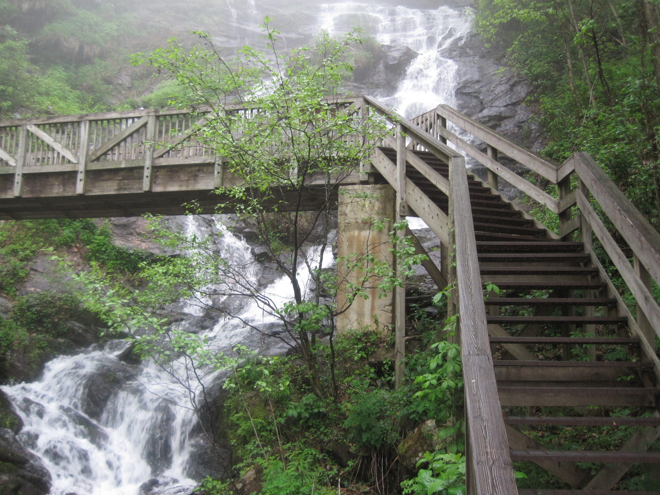
Image Credits: all Wikimedia Commons. Maps: ©2025 Clairmont Press.
Return to Main Menu

