Slide 1


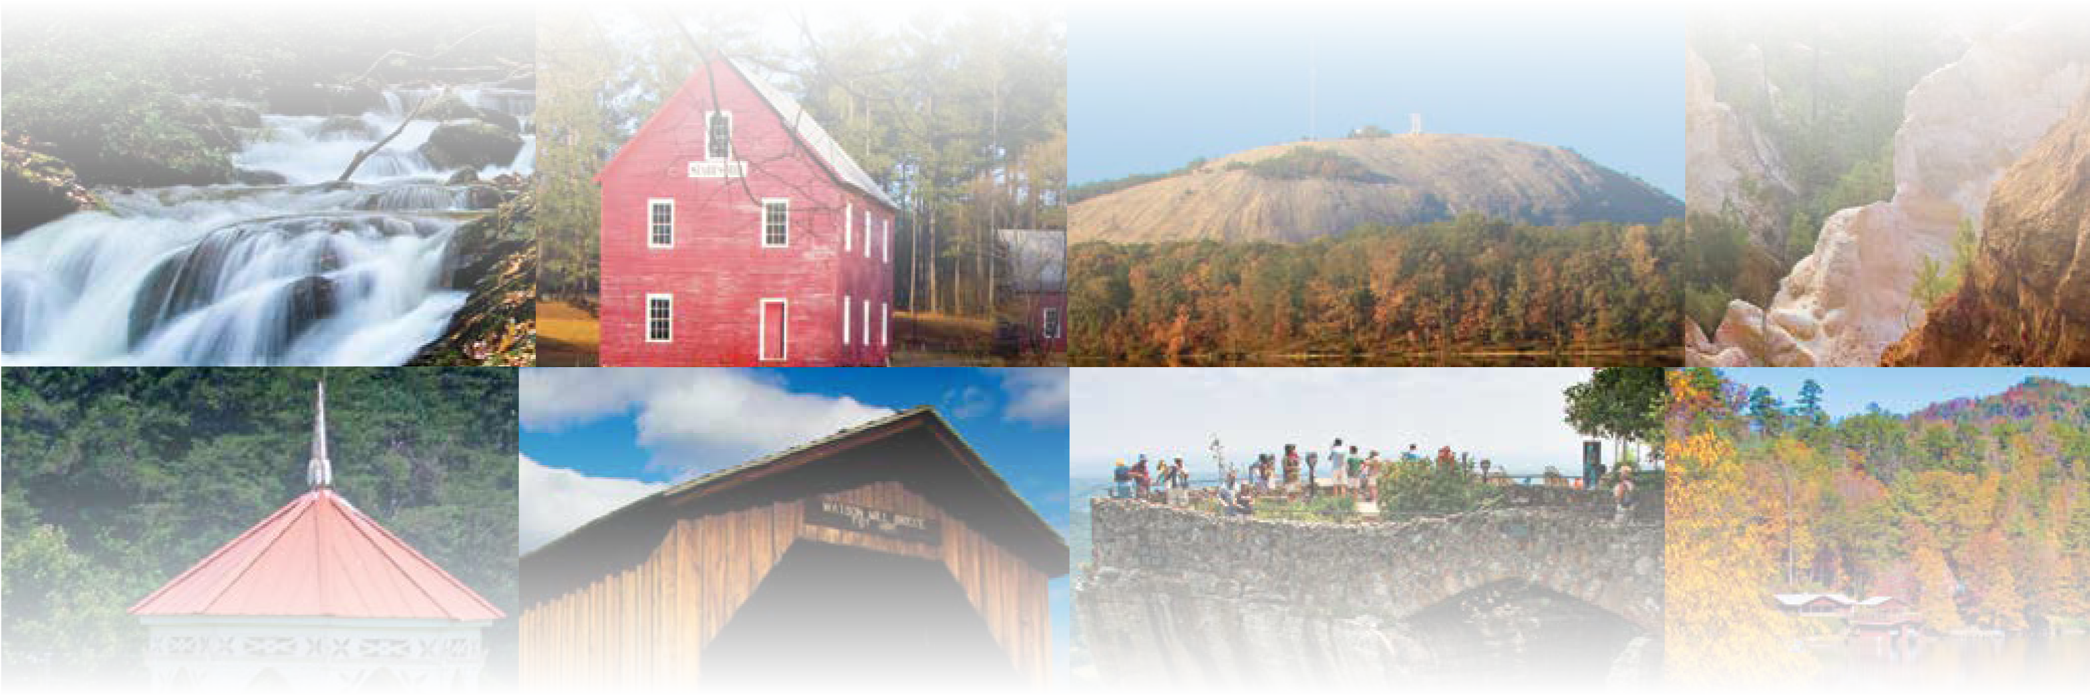
CHAPTER 1
Land and Location
CHAPTER 1
Land and Location
To play the game, go to the next slide and click on a point value to go to a question.
Click the Final Wrap-Up button on slide 3 to go to the final question.

Slide 2
Global Divisions
Georgia’s Location
Geographic Regions
Physical Features
Wild Card
100
100
100
100
100
200
200
200
200
200
300
300
300
300
300
400
400
400
400
400
500
500
500
500
500

Slide 3

If you have completed all the other questions on the board, then
click the button below!

Slide 4
Global Divisions - 100
Globes are divided into two halves, called __________.

Slide 5
Global Divisions - 100
Answer:
hemispheres
Board

Slide 6
Global Divisions - 200
What term refers to large, continuous masses of land located on Earth?

Slide 7
Global Divisions - 200
Answer:
continent
Board

Slide 8
Global Divisions - 300
Which term describes the location of one place in relation to another place?

Slide 9
Global Divisions - 300
Answer:
relative location
Board

Slide 10
Global Divisions - 400
What imaginary line of latitude divides the Northern from the
Southern Hemisphere?

Slide 11
Global Divisions - 400
Answer:
Equator
Board

Slide 12
Global Divisions - 500
What imaginary line of longitude runs through Greenwich, England, and divides the Western and Eastern Hemispheres?

Slide 13
Global Divisions - 500
Answer:
prime meridian
Board

Slide 14
Georgia’s Location - 100
In which nation do citizens of Georgia reside?

Slide 15
Georgia’s Location - 100
Answer:
United States of America
Board

Slide 16
Georgia’s Location - 200
On which continent are
the contiguous states of
the United States of America located?

Slide 17
Georgia’s Location - 200
Answer:
North America
Board

Slide 18
Georgia’s Location - 300
Georgia's relative
location is north of which border state?

Slide 19
Georgia’s Location - 300
Answer:
Florida
Board

Slide 20
Georgia’s Location - 400
Georgia is divided into five geographic __________, which share common characteristics such as soil, vegetation, climate, landforms, recreation, or economic opportunities.

Slide 21
Georgia’s Location - 400
Answer:
regions
Board

Slide 22
Georgia’s Location - 500
In which two
hemispheres is the state
of Georgia located?

Slide 23
Georgia’s Location - 500
Answer:
Northern and Western hemispheres
Board

Slide 24
Geographic Regions - 100
What term refers to the natural features of a land surface?

Slide 25
Geographic Regions - 100
Answer:
landforms
Board

Slide 26
Geographic Regions - 200
Which region is located
in Georgia's northwestern corner and the smallest of the state's geographic regions?

Slide 27
Geographic Regions - 200
Answer:
Appalachian Plateau
Board

Slide 28
Geographic Regions - 300
Which region is in the northwestern part of the state and is named for the series of long mountain ridges and valleys which define it?

Slide 29
Geographic Regions - 300
Answer:
Ridge and Valley region
Board

Slide 30
Geographic Regions - 400
Which region is in the northeastern corner of Georgia and has the highest elevation in the state?

Slide 31
Geographic Regions - 400
Answer:
Blue Ridge region
Board

Slide 32
Geographic Regions - 500
What is the most populated region in Georgia which lies between the mountains
and the Coastal Plain?

Slide 33
Geographic Regions - 500
Answer:
Piedmont region
Board

Slide 34
Physical Features - 100
Which eastern mountain range extends from Georgia to Maine?

Slide 35
Physical Features - 100
Answer:
Appalachian Mountains
Board

Slide 36
Physical Features - 200
Which river begins in the Blue Ridge region, flows through Atlanta, then through south Georgia and to the Gulf of Mexico?

Slide 37
Physical Features - 200
Answer:
Chattahoochee River
Board

Slide 38
Physical Features - 300
Which river forms
the eastern boundary between Georgia and
South Carolina?

Slide 39
Physical Features - 300
Answer:
Savannah River
Board

Slide 40
Physical Features - 400
What is the name of the nation's largest swamp, which is mostly located
in Georgia?

Slide 41
Physical Features - 400
Answer:
Okefenokee Swamp
Board

Slide 42
Physical Features - 500
What is the collective name
of the 14 islands that border the Georgia coast and protect the mainland from the
strong wind and weather
of the Atlantic Ocean?

Slide 43
Physical Features - 500
Answer:
Barrier Islands or
Golden Isles
Board

Slide 44
Wild Card - 100
What is the name of the natural boundary located at the southern edge of the Piedmont region which separates it from the
Coastal Plain?

Slide 45
Wild Card - 100
Answer:
Fall Line
Board

Slide 46
Wild Card - 200
What region is the state's largest (in terms of land) and southernmost region which can be further divided into Upper and Lower regions?

Slide 47
Wild Card - 200
Answer:
Coastal Plain region
Board

Slide 48
Wild Card - 300
In which Georgia region
are caves most likely to
be found and where mining was a major occupation
for over 100 years?

Slide 49
Wild Card - 300
Answer:
Appalachian
Plateau region
Board

Slide 50
Wild Card - 400
In the Ridge and Valley
region, fertile __________ formed in between ridgelines, which supports one of the areas top industries.

Slide 51
Wild Card - 400
Answer:
farmland
Board

Slide 52
Wild Card - 500
What is the name of
the portion of the Appalachian Mountains
that runs through Georgia?

Slide 53
Wild Card - 500
Answer:
Blue Ridge Mountains
Board

Slide 54

Make your wager on the scoresheet and prepare for
the final question!
Final Question

Slide 55
Final Wrap-Up
What is Georgia's highest mountain peak?

Slide 56
Final Wrap-Up
Answer:
Brasstown Bald
Board

