Slide 1
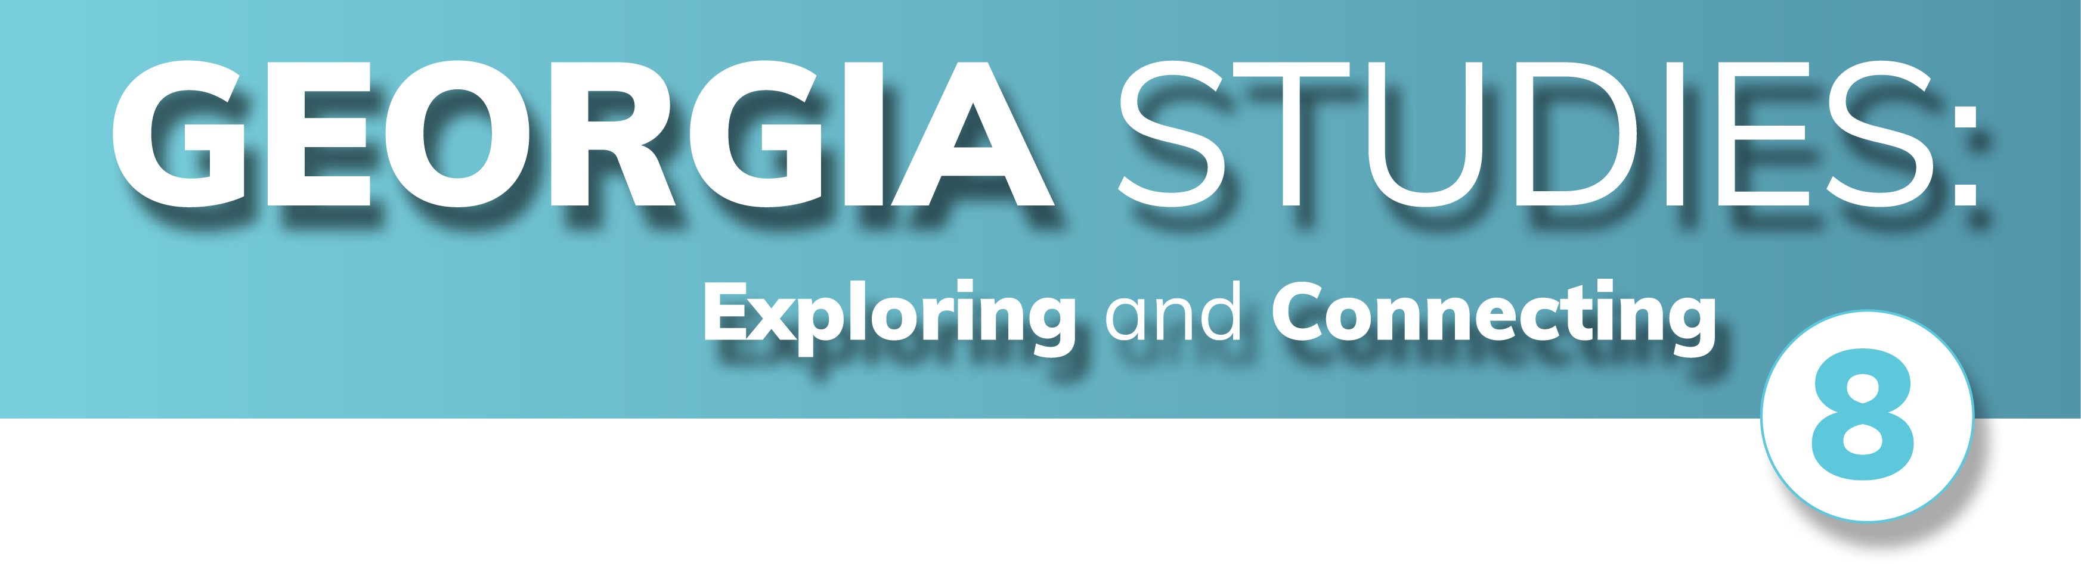

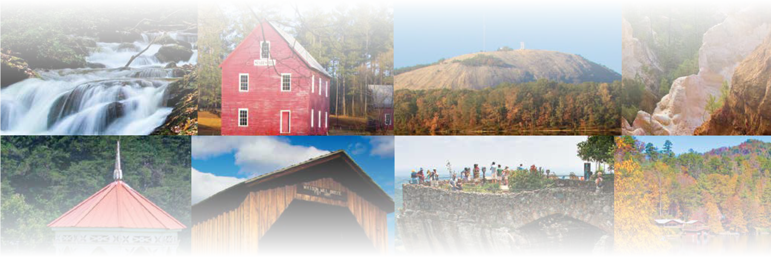
CHAPTER 9
Colonial Georgia
CHAPTER 9
Colonial Georgia
To play the game, go to the next slide and click on a point value to go to a question.
Click the Final Wrap-Up button on slide 3 to go to the final question.

Slide 2
Colonial People
Georgia’s Founding
Colonial Places
Non-Englishmen
Wild Card
100
100
100
100
100
200
200
200
200
200
300
300
300
300
300
400
400
400
400
400
500
500
500
500
500

Slide 3

If you have completed all the other questions on the board, then click the button below!

Slide 4
Colonial People - 100
Who received a land grant lead the founding of an English colony south of the Savannah River in 1732?

Slide 5
Colonial People - 100
Answer:
James Oglethorpe
Board

Slide 6
Colonial People - 200
What group was responsible for governing the Georgia colony when it was founded?

Slide 7
Colonial People - 200
Answer:
The Trustees
Board

Slide 8
Colonial People - 300
What term describes a force of local citizen soldiers?

Slide 9
Colonial People - 300
Answer:
militia
Board

Slide 10
Colonial People - 400
In the Royal period, what group helped govern Georgia along with the governor and the Governor's Council?

Slide 11
Colonial People - 400
Answer:
Commons House of Assembly
Board

Slide 12
Colonial People - 500
Which brothers established Methodist churches in the Georgia colony?

Slide 13
Colonial People - 500
Answer:
John and Charles Wesley
Board

Slide 14
Georgia’s Founding - 100
What country threatened South Carolina, and caused its people to support a buffer to the south for protection?

Slide 15
Georgia’s Founding - 100
Answer:
Spain
Board

Slide 16
Georgia’s Founding - 200
What term means a document from the king which granted territory and explained the rules of how a colony would operate?

Slide 17
Georgia’s Founding - 200
Answer:
charter
Board

Slide 18
Georgia’s Founding - 300
What reason for Georgia's founding means giving of one's time, money, or resources to help someone without expecting anything in return?

Slide 19
Georgia’s Founding - 300
Answer:
philanthropy
Board

Slide 20
Georgia’s Founding - 400
Which economic plan, practiced by England, focused on having colonies to provide raw materials to the home country that could be made into goods to sell for the country's profit?

Slide 21
Georgia’s Founding - 400
Answer:
mercantilism
Board

Slide 22
Georgia’s Founding - 500
The Yamacraw Indians agreed to give the colony all the land between which two rivers?

Slide 23
Georgia’s Founding - 500
Answer:
Altamaha River and Savannah River
Board

Slide 24
Colonial Places - 100
What type of labor was used to develop the colony's rice plantations?

Slide 25
Colonial Places - 100
Answer:
enslaved people
Board

Slide 26
Colonial Places - 200
What was the first town established by James Oglethorpe in Georgia?

Slide 27
Colonial Places - 200
Answer:
Savannah
Board

Slide 28
Colonial Places - 300
What river served as the northeastern boundary of the Georgia colony?

Slide 29
Colonial Places - 300
Answer:
Savannah River
Board

Slide 30
Colonial Places - 400
What inland town on the Savannah River became one of the colony's most important, after Savannah?

Slide 31
Colonial Places - 400
Answer:
Augusta
Board

Slide 32
Colonial Places - 500
What fort was built by Oglethorpe on St. Simons Island?

Slide 33
Colonial Places - 500
Answer:
Fort Frederica
Board

Slide 34
Non-Englishmen - 100
Dr. Samuel Nunez and 42 others were members of which ethnic group who arrived in Savannah soon after Oglethorpe?

Slide 35
Non-Englishmen - 100
Answer:
Jews
Board

Slide 36
Non-Englishmen - 200
Men from which country arrived in the Georgia colony at Oglethorpe's invitation because they had a reputation for being good soldiers and fighters?

Slide 37
Non-Englishmen - 200
Answer:
Scotland
Board

Slide 38
Non-Englishmen - 300
What name was given to German-speaking Lutherans who arrived in the Georgia colony seeking religious freedom?

Slide 39
Non-Englishmen - 300
Answer:
Salzburgers
Board

Slide 40
Non-Englishmen - 400
What woman famously served as Oglethorpe's interpreter and helped Oglethorpe build alliances with the American Indian leaders?

Slide 41
Non-Englishmen - 400
Answer:
Mary Musgrove
Board

Slide 42
Non-Englishmen - 500
Which Muscogee (Creek) leader was known to have allowed Oglethorpe to settle at Savannah?

Slide 43
Non-Englishmen - 500
Answer:
Tomochichi
Board

Slide 44
Wild Card - 100
What type of colony did Georgia become after the trustees turned the colony over to the British government?

Slide 45
Wild Card - 100
Answer:
Royal colony
Board

Slide 46
Wild Card - 200
Some colonists believed the raising of which larvae could be profitable for producing a fine, expensive fabric?

Slide 47
Wild Card - 200
Answer:
silkworms
Board

Slide 48
Wild Card - 300
What crop did Georgia's hope to sell for making expensive dyes?

Slide 49
Wild Card - 300
Answer:
indigo
Board

Slide 50
Wild Card - 400
Which Georgia town as settled by the Scottish Highlanders as part of strengthening Georgia's coastal defenses?

Slide 51
Wild Card - 400
Answer:
Darien
Board

Slide 52
Wild Card - 500
What 1742 battle is the most famous of Oglethorpe's fight against Spanish attacks from the south?

Slide 53
Wild Card - 500
Answer:
Battle of Bloody Marsh
Board

Slide 54

Make your wager on the scoresheet and prepare for
the final question!
Final Question

Slide 55
Final Wrap-Up
What ship transported James Oglethorpe and the first colonists to Georgia?

Slide 56
Final Wrap-Up
Answer:
Anne
Board

