Slide 1
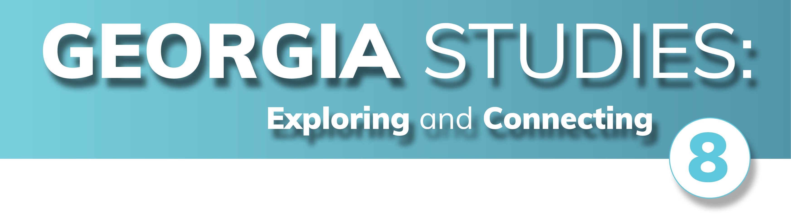

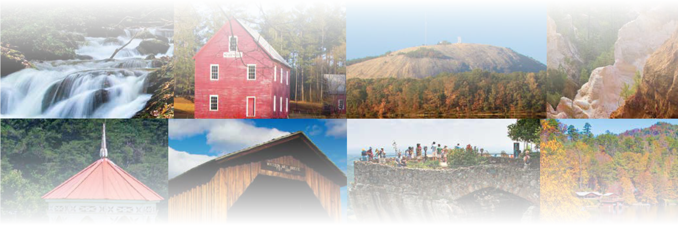
CHAPTER 18
The Civil Rights Movement in Modern Georgia
CHAPTER 18
The Civil Rights Movement in Modern Georgia
To play the game, go to the next slide and click on a point value to go to a question.
Click the Final Wrap-Up button on slide 3 to go to the final question.

Slide 2
People
Places
Events
Activism
Wild Card
100
100
100
100
100
200
200
200
200
200
300
300
300
300
300
400
400
400
400
400
500
500
500
500
500

Slide 3

If you have completed all the other questions on the board, then click the button below!

Slide 4
People - 100
Which civil rights leader helped form the Southern Christian Leadership Conference (SCLC) and promoted nonviolent protests and citizenship schools?

Slide 5
People - 100
Answer:
Dr. Martin Luther King, Jr.
Board

Slide 6
People - 200
Which president ordered the desegregation of the military and federal offices in 1948?

Slide 7
People - 200
Answer:
President Harry Truman
Board

Slide 8
People - 300
Which civil rights leader was associated with the Student Nonviolent Coordinating Committee (SNCC) and later served as a U.S. Congressman from Georgia for over 30 years?

Slide 9
People - 300
Answer:
John Lewis
Board

Slide 10
People - 400
Which opponent of civil rights in Georgia was elected governor in 1966 despite not having a majority of the votes in the general election?

Slide 11
People - 400
Answer:
Lester Maddox
Board

Slide 12
People - 500
Which civil rights leader was an officer of the SNCC, chairman of the NAACP, and served in the Georgia General Assembly?

Slide 13
People - 500
Answer:
Julian Bond
Board

Slide 14
Places - 100
Hamilton Holmes and Charlayne Hunter were the first black students to attend which state university?

Slide 15
Places - 100
Answer:
The University of Georgia
Board

Slide 16
Places - 200
The restaurant of which Atlanta department store was targeted for sit-ins in 1960 which resulted the restaurant's desegregation?

Slide 17
Places - 200
Answer:
Rich's Department Store
Board

Slide 18
Places - 300
What Alabama city was the location of the bus boycott associated with Rosa Parks and Dr. Martin Luther King, Jr.?

Slide 19
Places - 300
Answer:
Montgomery, AL
Board

Slide 20
Places - 400
In what Alabama town in the Edmund Pettus Bridge where the events of Bloody Sunday occurred in 1965?

Slide 21
Places - 400
Answer:
Selma, AL
Board

Slide 22
Places - 500
What Tennessee city was the site of the assassination of Dr. Martin Luther King, Jr. in 1968?

Slide 23
Places - 500
Answer:
Memphis, TN
Board

Slide 24
Events - 100
The work of the Sibley Commission led to the peaceful desegregation of which public facilities in Georgia in the 1960s?

Slide 25
Events - 100
Answer:
schools
Board

Slide 26
Events - 200
What symbol of Georgia was changed by the state legislature in 1956 to resist integration?

Slide 27
Events - 200
Answer:
the state flag
Board

Slide 28
Events - 300
Which 1954 landmark Supreme Court decision declared segregated public schools unconstitutional?

Slide 29
Events - 300
Answer:
Brown v. Board of Education of Topeka, Kansas
Board

Slide 30
Events - 400
Which act signed by President Lyndon Johnson made segregation in public places illegal?

Slide 31
Events - 400
Answer:
Civil Rights Act of 1964
Board

Slide 32
Events - 500
Which act by Congress prohibited discriminatory voting practices and led to a significant increase in the number of black voters?

Slide 33
Events - 500
Answer:
Voting Rights Act of 1965
Board

Slide 34
Activism - 100
What type of protest involved black people refusing to use public transportation to end segregation?

Slide 35
Activism - 100
Answer:
boycott
Board

Slide 36
Activism - 200
Which female NAACP member became famous for refusing to give up her seat to a white passenger on a crowded bus in Montgomery, Alabama?

Slide 37
Activism - 200
Answer:
Rosa Parks
Board

Slide 38
Activism - 300
What type of protest involved black college students sitting at white-only lunch counters?

Slide 39
Activism - 300
Answer:
sit-in
Board

Slide 40
Activism - 400
Which activity saw black and white activists in the early 1960s testing that the buses in southern states were integrated?

Slide 41
Activism - 400
Answer:
Freedom Rides
Board

Slide 42
Activism - 500
Which south Georgia city was known for its civil rights movement in the early 1960s which eventually led to ending its segregation laws?

Slide 43
Activism - 500
Answer:
Albany
Board

Slide 44
Wild Card - 100
African Americans' contributions during which war helped to increase calls for racial equality and expand the civil rights movement?

Slide 45
Wild Card - 100
Answer:
World War II
Board

Slide 46
Wild Card - 200
In what city did Dr. Martin Luther King, Jr. deliver his "I Have a Dream" speech as part of a larger civil rights demonstration in 1963?

Slide 47
Wild Card - 200
Answer:
Washington, DC
Board

Slide 48
Wild Card - 300
What type of facility was bombed by white supremacists in Birmingham, Alabama, in 1963 killing four young girls?

Slide 49
Wild Card - 300
Answer:
a church
Board

Slide 50
Wild Card - 400
What was the nickname of the Southern Democrats who opposed the civil rights movement and followed the States' Rights Democratic Party in 1948?

Slide 51
Wild Card - 400
Answer:
Dixiecrats
Board

Slide 52
Wild Card - 500
What civil rights bill in Congress was passed in part because of the events of Bloody Sunday in Selma, Alabama?

Slide 53
Wild Card - 500
Answer:
Voting Rights Act of 1965
Board

Slide 54

Make your wager on the scoresheet and prepare for
the final question!
Final Question

Slide 55
Final Wrap-Up
In what city was Dr. Martin Luther King, Jr. in jail when he wrote his famous "Letter" urging white Americans to recognize the injustice of segregation?

Slide 56
Final Wrap-Up
Answer:
Birmingham, AL
Board

