Slide 1
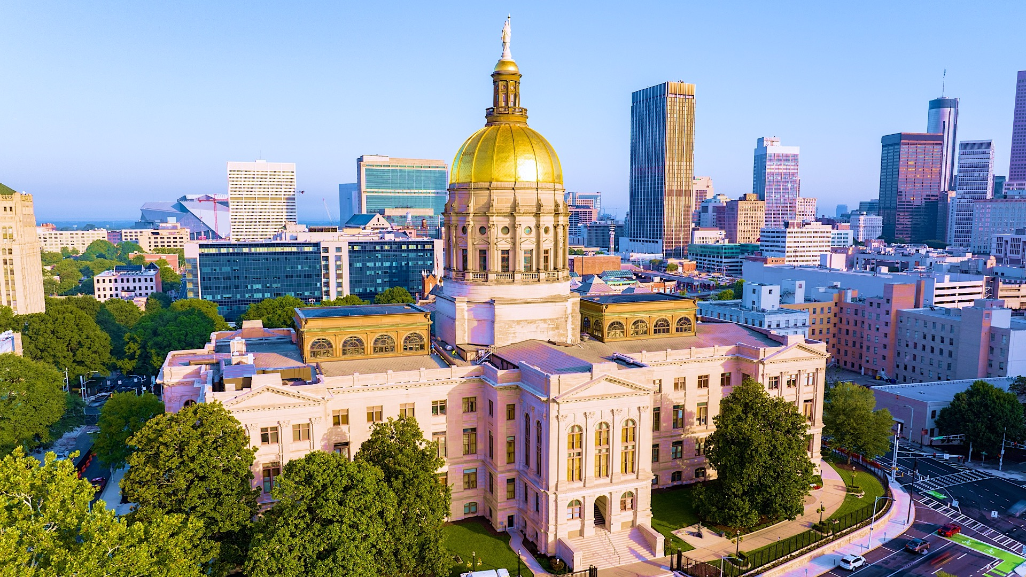

Smart Skills
Week 1
Map 1: Georgia Counties and County Seats
Notes:
See the Smart Skills directions on the Teacher Tech Website for Georgia Studies: Exploring and Connecting 8 for teaching suggestions.
Teacher notes and answers will display in this space.

Slide 2

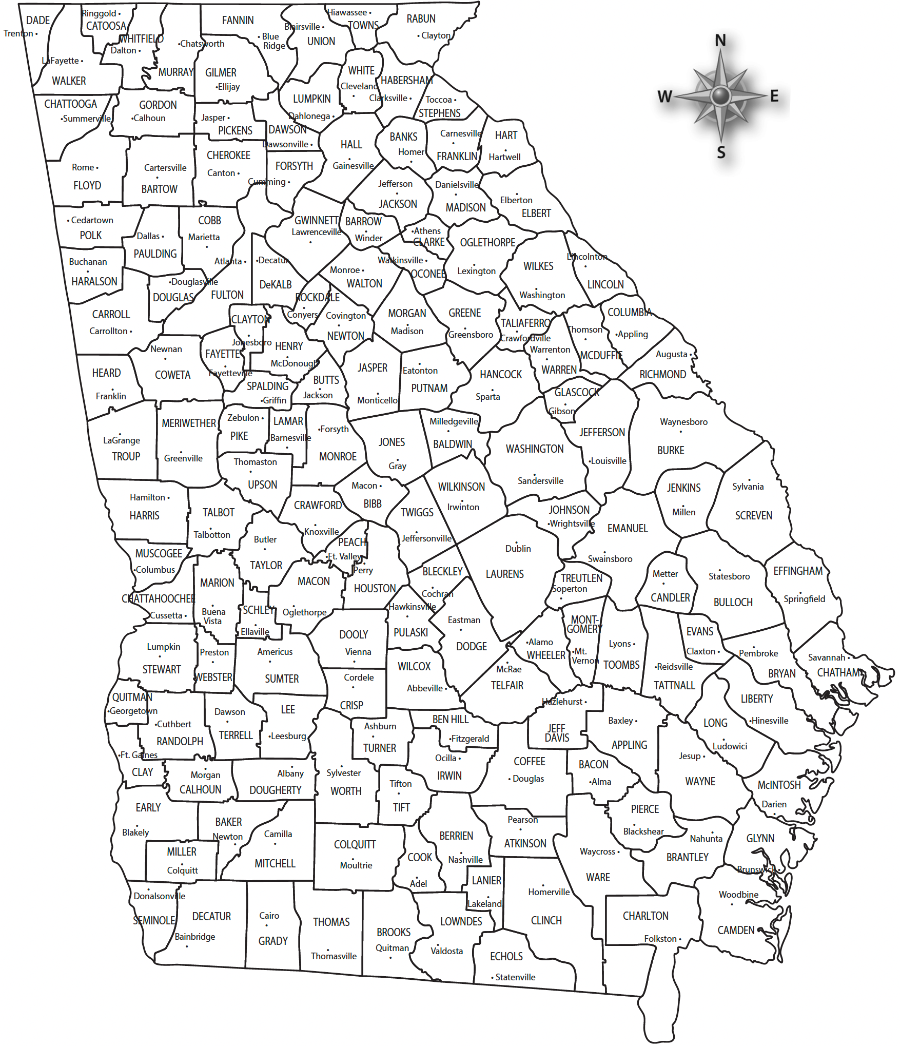
Monday
Study the map. What do you notice about it? In the time given by your teacher, jot down the things that you notice about the map.
Notes:
Answers will vary.
TEACHER NOTE: This opener allows students to view the map with no specific question to answer. Often, it is beneficial to study a map and its components before searching for a specific answer. Allow at least one minute for students to silently study the map and create a jot list before discussing responses as a group. Students may notice that this is a map of the state of Georgia. Counties are outlined, and county seats are identified. There is a compass rose. Students may notice that there are no physical features (such as mountains or rivers). Border states are not shown, etc.

Slide 3
TUESDAY
What is the county seat of Fulton County?
What is the county seat of your county?
Notes:
Atlanta
The answer will depend on your county.
TEACHER NOTE: These are basic locate and identify questions. If you have not done so already, this is an opportunity to discuss the significance of a county seat and gauge what students already know about the county seat as a center of local government. You may want to discuss the types of government functions that are directed from the county seat, where the county courthouse is located.
Have a student physically point out these locations on the map during the discussion rather than assuming that all students have seen them.

Slide 4
WEDNESDAY
Which general direction would you travel from Atlanta (Fulton County seat) to get to Waycross (Ware County seat)?
Write a similar question to the one above based on your county. Share your question with another student, and agree upon the answer.
Notes:
southeast
Answers will vary
TEACHER NOTE: This is a basic directions question. You should ensure that the discussion includes both cardinal and intermediate points on the compass rose. Some students may need direct instruction on using the points of the compass rose in directions.
Classroom management: Provide students with directions on who they should share their questions with (e.g., elbow partners, nearby students, etc.). Allow a few students to share their questions with the class while another student points out the answers to the group using the projected map.

Slide 5
THURSDAY
What counties border Fulton County?
What counties border your county?
Notes:
Cherokee, Forsyth, Gwinnett, DeKalb, Clayton, Fayette, Coweta, Carroll, Douglas, Cobb
Answers will vary according to your school’s location.
TEACHER NOTE: This is an opportunity to gauge whether students understand the concept of a border. You may want to discuss how they would know if they were at a border. For example, most county borders are marked by signs on the roadside. You may want to ask why the borders matter. For example, local government services vary by county. Taxes may differ from one county to the next. School districts are often aligned with county borders, and so on.

Slide 6
FRIDAY
If a person wanted to travel from Hamilton (Harris County seat) to Irwinton (Wilkinson County seat), passing through the fewest counties, which counties would they cross?
Write a question like the one above. Share it with another student and agree upon an answer.
NOTE: Your routes must stay within Georgia’s boundaries.
Notes:
Harris, Talbot, Upson, Crawford, Bibb, Twiggs, Wilkinson
Answers will vary.
TEACHER NOTE: A tricky response to the second question would be traveling from Trenton to Chatsworth. In a straight line, the answer would be: Dade, Walker, Catoosa, Whitfield, Murray. However, due to the shape of the counties, the traveler could go around Catoosa. So the answer would be: Dade, Walker, Whitfield, Murray.

Slide 7
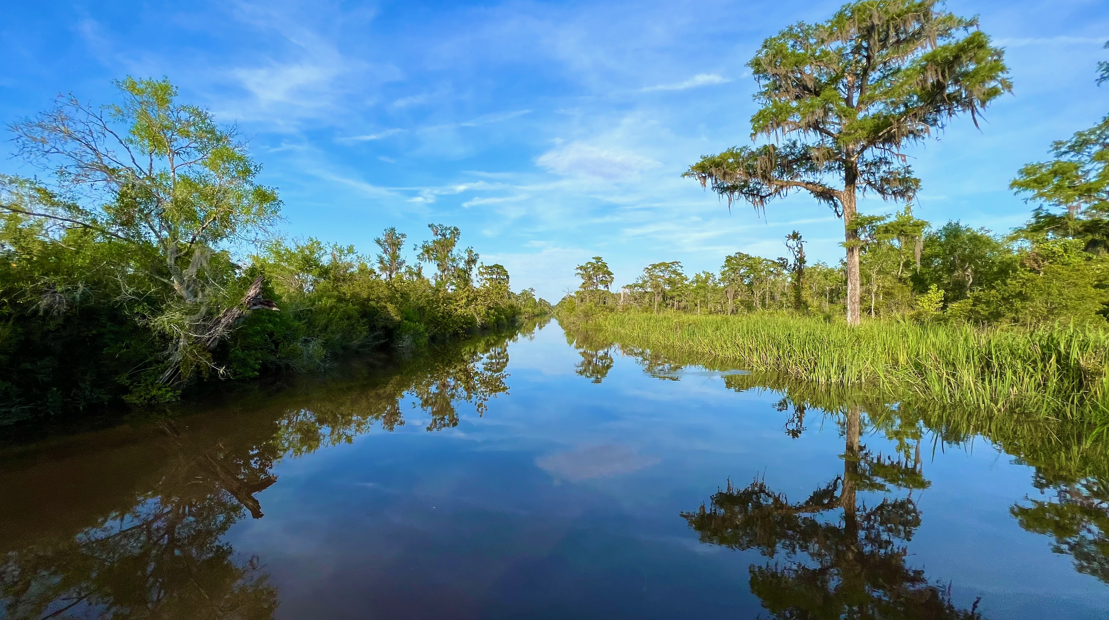
The Altamaha Waterfowl Management Area near Darien consists of 27,000 acres of hardwood trees and cypress-tupelo swamps.
Image credits: Title slide, Georgia State Capitol, Atlanta, GA, ©Shutterstock; End slide, Altamaha Waterfowl Management Area, Darien, GA, Emmett Mullins

