Slide 1


Smart Skills
Week 3
Art & Artifacts 1: Native American Artifact
Notes:
See the Smart Skills directions on the Teacher Tech Website for Georgia Studies: Exploring and Connecting 8 for teaching suggestions.
Teacher notes and answers will display in this space.

Slide 2

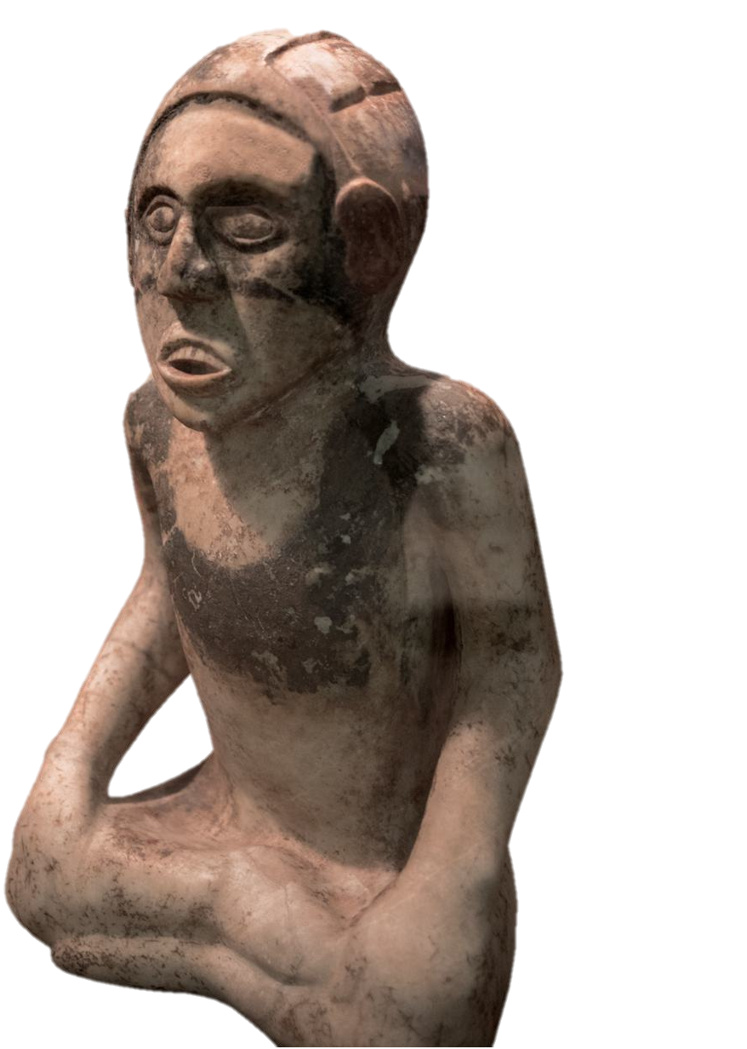
Monday
The object shown is an artifact or item of historical interest made by humans.
What do you notice about the artifact?
What questions would you have about it?
Notes:
This opener allows students to view the map with no specific question to answer.
Allow at least one minute for students to silently study the image and create a jot list before discussing responses as a group.
Students may notice the shape, color, and texture. They may wonder about its size, which is not given. Point out that it would be helpful to have that before determining the purpose of the artifact. It would also be helpful to know what it was made of.

Slide 3
TUESDAY
An effigy artifact is a sculpture or model of a person.
What reason could indigenous people have had for making effigies in the past?

Slide 4
WEDNESDAY
This effigy was made of marble and found at the Etowah Indian Mound site in Bartow County.
What might this effigy represent or be related to?
What information has been added?
How does the extra information help answer questions about the artifact?
24 inches
Notes:
Answers will vary.
The height has been added.
This provides more context for understanding the object and the person who created it. If it were 24 feet high or 2.4 inches high, that would alter our perception of it.

Slide 5
THURSDAY
What does this effigy reveal about the civilization that created it?
24 inches
Notes:
As civilizations develop and grow, more time can be made for art and expression. These people had the time, skill, and resources to create this work.

Slide 6
FRIDAY
Why might the ancient Etowah people have created such objects?
24 inches
Notes:
Answers will vary.
TEACHER NOTE: This is a good time to reinforce the idea that artifacts, when discovered, should be handled delicately and not removed from their location. When an artifact is moved without proper identification, its value to archaeologists and our understanding of the past are limited.

Slide 7
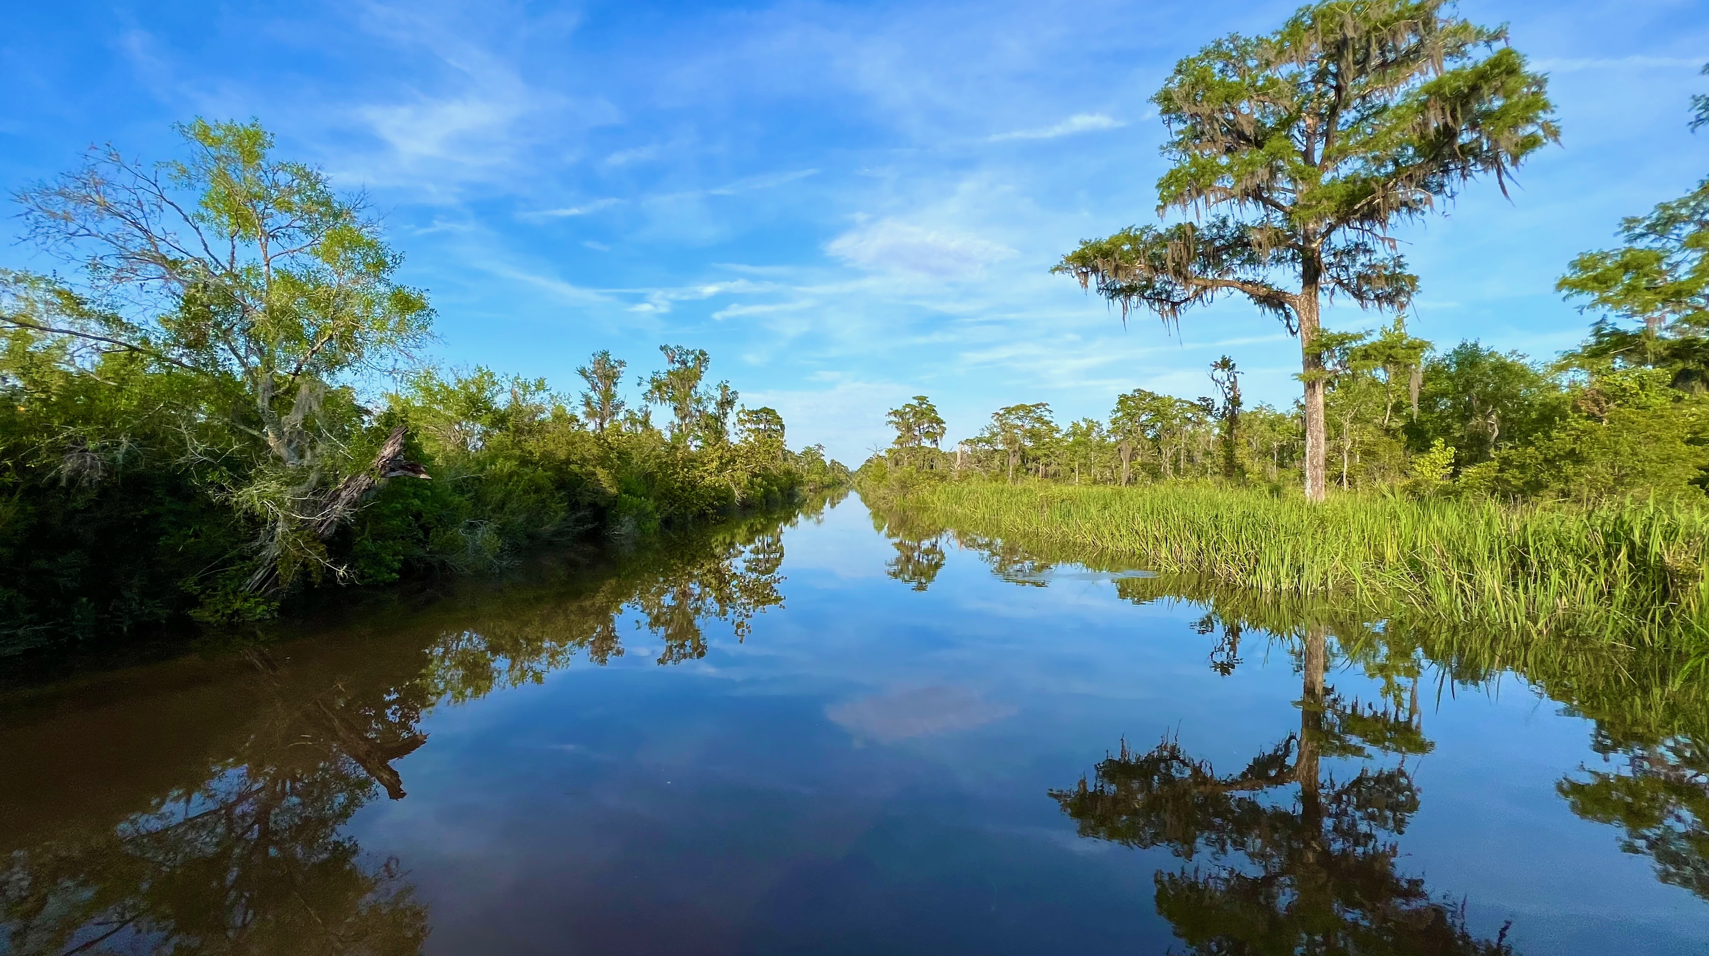
The Altamaha Waterfowl Management Area near Darien consists of 27,000 acres of hardwood trees and cypress-tupelo swamps.
Image credits: Title slide, Georgia State Capitol, Atlanta, GA, ©Shutterstock; End slide, Altamaha Waterfowl Management Area, Darien, GA, Emmett Mullins

