Slide 1
Smart Skills
Week 16
Map 4
© 2015 Clairmont Press

Slide 2
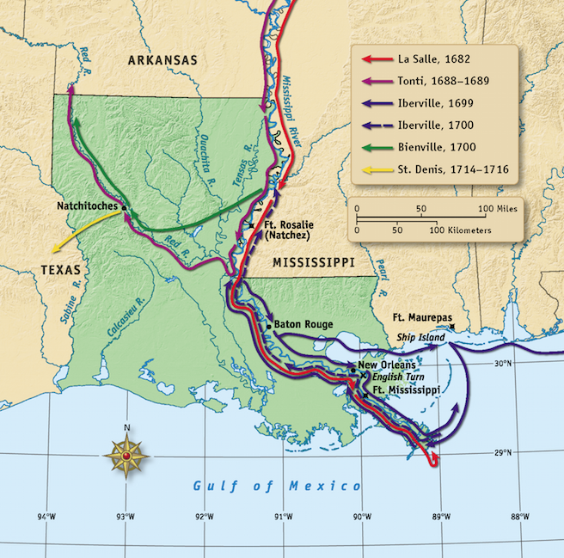
Monday
What is the purpose of the map?
Notes:
The purpose of the map is to show the different routes used by French explorers in Louisiana.

Slide 3
Tuesday
What do the different colors on the map mean?
Notes:
Each color represents the different French explorers’ paths through Louisiana.

Slide 4
Wednesday
Why did all of the explorers begin their explorations on the southeastern coast?
Notes:
This was the first part of Louisiana where ships sailing from France would land.

Slide 5
Thursday
Which two rivers did Tonti explore?
Notes:
Tonti explored the Mississippi and Red Rivers.

Slide 6
Friday
Explain how physical features affected the explorers’ routes through Louisiana.
Notes:
Many of the explorers followed the Mississippi River, which would allow them to have access to fresh water throughout their journey and travel easily inland.

Slide 7
Image Credits
Slide 1: Chris Miceli on Wikimedia Commons, Public Domain; Image Credits Slide: Edd Prince on Wikimedia Commons; maps copyright Clairmont Press; all others public domain
Shown here: Fontainebleau State Park

