Slide 1
Smart Skills
Week 2
Chart 1
© 2015 Clairmont Press

Slide 2
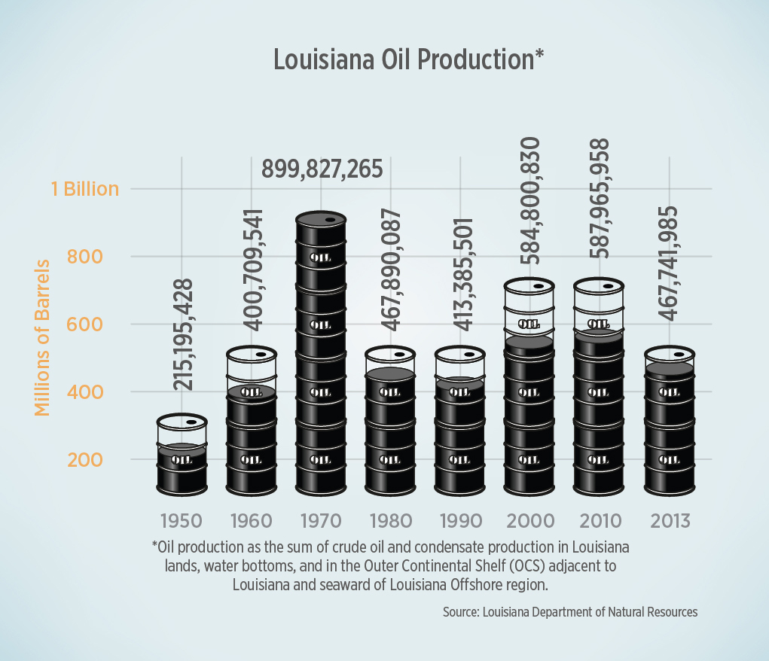
Monday
What type of graph is this?
What are the X and Y axis showing?
Notes:
The chart is a bar graph. The X axis is showing the year by decades, and the Y axis is showing the amount of oil produced in Louisiana in millions of barrels.

Slide 3
Tuesday
What is the date range?
How much oil was produced in Louisiana in 1980?
Notes:
The date range is 1950-2013. 467,890,087 barrels of oil were produced in Louisiana in 1980?

Slide 4
Wednesday
In what year was oil production the lowest? Why do you think the amount of oil produced has increased since then?
Notes:
Oil production was lowest in 1950. Possible answers to the second question include: an increase in demand for oil worldwide, better methods of finding oil deposits, and better technology for extracting oil.

Slide 5
Thursday
In what year was oil production the highest? How do you think it affected the people of Louisiana when oil production fell?
Notes:
Oil production was the highest in 1970. The fall in oil production might have hurt the economy of Louisiana and resulted in the loss of jobs for many people.

Slide 6
Friday
Oil is a nonrenewable resource, which means it cannot be replaced once it is used. Based on this graph, what trend do you notice? What predictions can you make about the future of oil production in Louisiana?
Notes:
The overall trend on this graph is that oil production is decreasing in Louisiana. The people of Louisiana must begin to look at other sources of revenue and begin to diversify their economy.

Slide 7
Image Credits
Slide 1: Chris Miceli on Wikimedia Commons, Public Domain; Image Credits Slide: Edd Prince on Wikimedia Commons; maps copyright Clairmont Press; all others public domain
Shown here: Fontainebleau State Park

