Slide 1
Smart Skills
Week 3
Artifact 1
© 2015 Clairmont Press

Slide 2
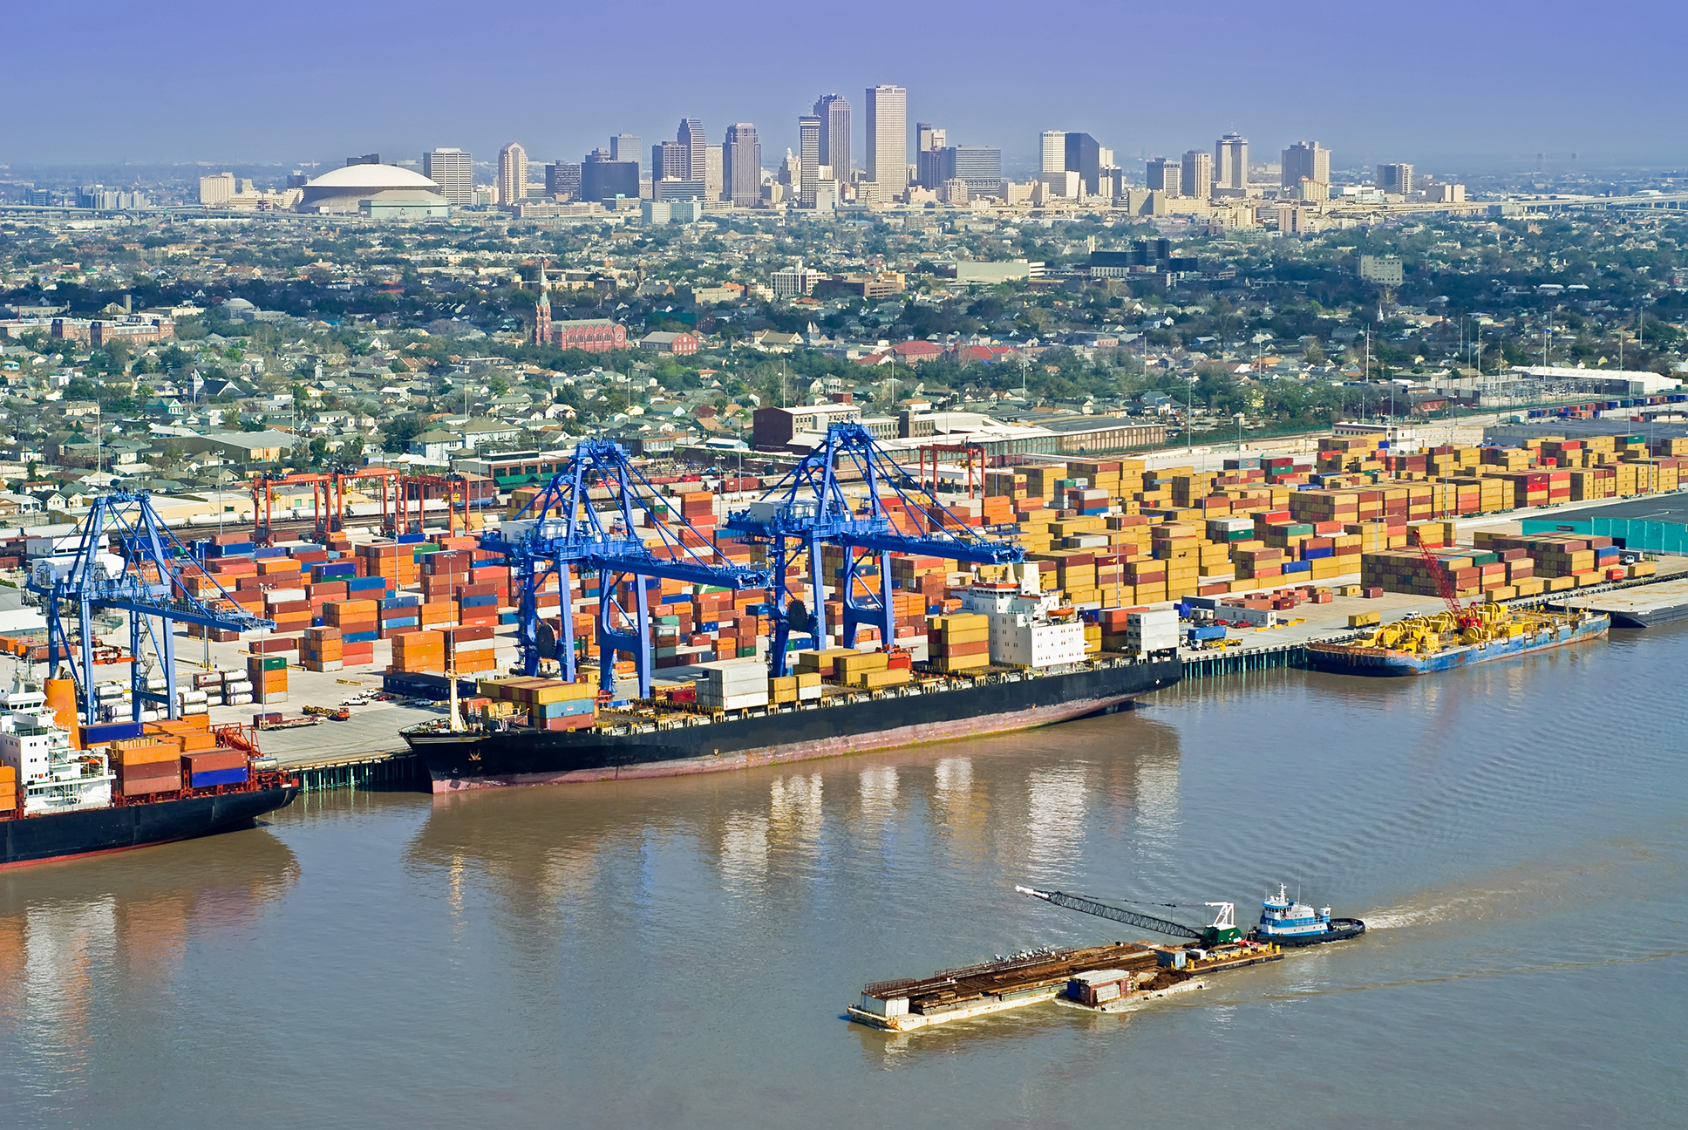
Monday
What is shown in this photograph? What evidence from the photograph helped you determine the location?
Notes:
The picture shows the city of New Orleans in the background and the port of New Orleans with the Mississippi River in the foreground. Students should cite evidence from their experience which would let them know the location (e.g. Superdome in background).

Slide 3
Tuesday
What do you notice in the photograph? List as many things as you can in two minutes.
Notes:
Students’ lists may include: river, barge, ships, cargo containers, railroad tracks, train, church, skyscrapers, sports stadium, trees, power lines, street lights, cranes, houses, warehouses, sky, tugboat

Slide 4
Wednesday
How would Louisiana benefit from having this type of port?
Notes:
Having a large port helps attract trade into New Orleans and the entire state of Louisiana, which will promote economic growth.

Slide 5
Thursday
Why would early settlers in Louisiana’s history want to establish settlements near the Mississippi River?
Notes:
Settlers would want to settle near rivers because of the ease of transportation and water for irrigation, drinking, and hygiene.

Slide 6
Friday
How could a picture like this one help encourage businesses to move to New Orleans?
Notes:
Answers will vary. Possible answers should focus on the ease of trade since it has a large port and already established major city.

Slide 7
Image Credits
Slide 1: Chris Miceli on Wikimedia Commons, Public Domain; Image Credits Slide: Edd Prince on Wikimedia Commons; maps copyright Clairmont Press; all others public domain
Shown here: Fontainebleau State Park

