Slide 1
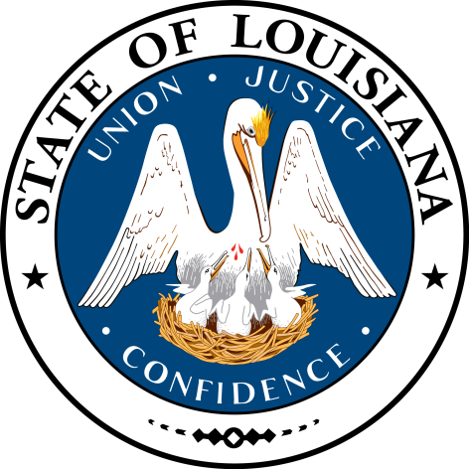
Smart Skills
Week 5
Political Cartoon 1
© 2015 Clairmont Press

Slide 2
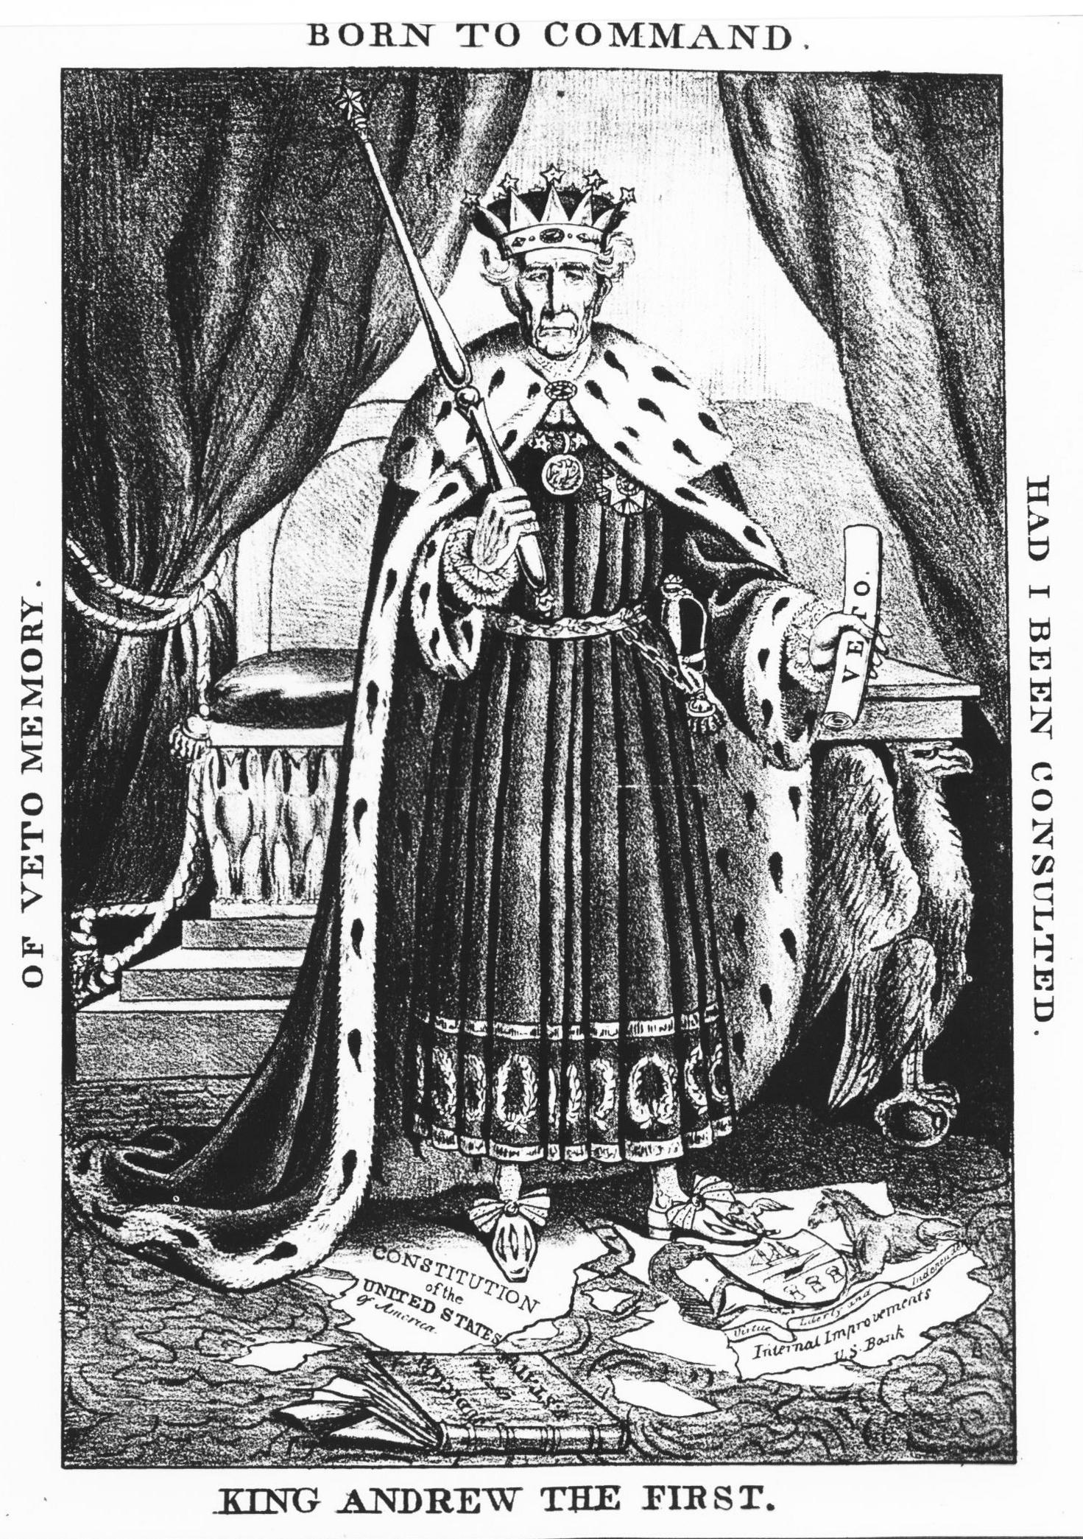
Monday
Study the cartoon. List the objects in the cartoon. Who is the person in the cartoon? What action is taking place?
Notes:
SAMPLE RESPONSES
king, table with eagle leg, scroll, scepter, a book and torn papers on the floor, fancy rugs, big curtains, throne on a dais, crown
The person is Andrew Jackson.
The king is standing in a fancy room holding a veto paper and standing on other papers.

Slide 3
Tuesday
What words are in the cartoon? Write three important words or phrases that help the viewer understand who is in the picture.
Notes:
SAMPLE RESPONSES
King Andrew the First, of veto memory, had I been consulted, born to command, Constitution of the United States, Judiciary of the U. States (book)
(students should write three words or phrases that they believe are key to understanding who is in the picture and be challenged to explain why they chose those words or phrases)

Slide 4
Wednesday
Which of the objects in the picture are symbols? What do you think the symbols mean?
Notes:
SAMPLE
The throne, crown, scepter, and robe are symbols of royal power. The American colonies had been ruled by a king.

Slide 5
Thursday
Which words or phrases are most important? Explain your thinking.
List adjectives that describe emotions portrayed in the cartoon.
Notes:
SAMPLE RESPONSE
King Andrew the First because this sounds like a name for a king instead of an elected president of the United States.
smug, important, fancy, serious

Slide 6
Friday
What is the message of the cartoon? Which types of people would agree with the cartoon’s message? Who would disagree? Explain your thinking.
Notes:
SAMPLE RESPONSE
The cartoonist does not believe that Andrew Jackson is acting like a president. He is acting like a king. He is ignoring the U.S. Constitution and is commanding as if he were the king of America. People who liked Jackson and his policies would not like this cartoon because it tries to insult him. People against the president would like the cartoon because they thought he did not follow the rules of the United States.

Slide 7
Image Credits
Slide 1: Chris Miceli on Wikimedia Commons, Public Domain; Image Credits Slide: Edd Prince on Wikimedia Commons; maps copyright Clairmont Press; all others public domain
Shown here: Fontainebleau State Park

