Slide 1
Smart Skills
Week 6
Map 2
© 2015 Clairmont Press

Slide 2
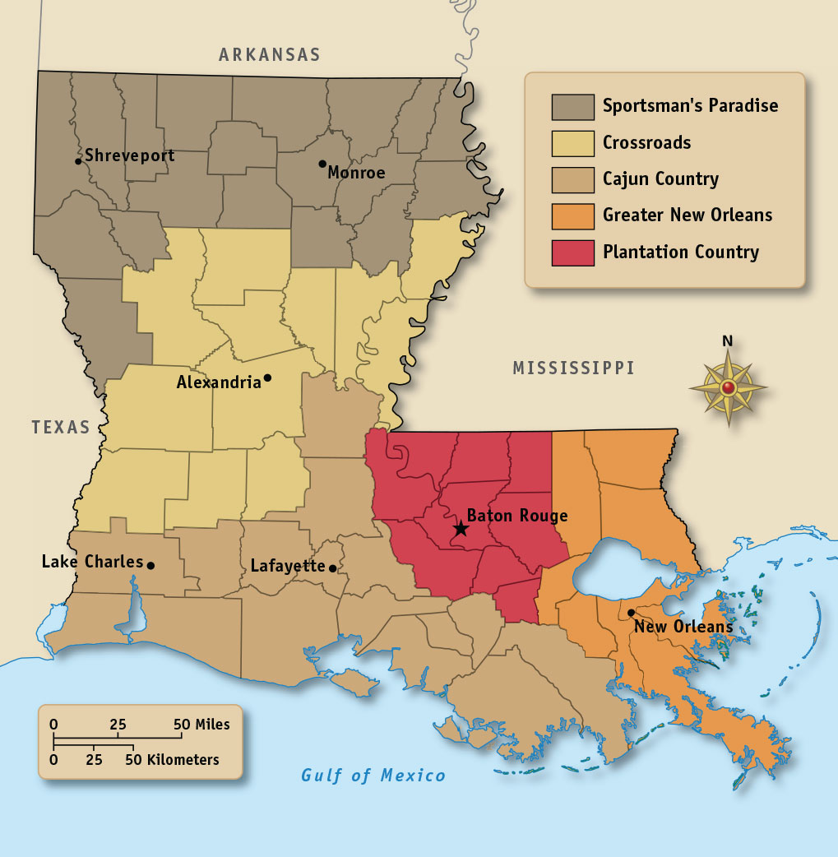
Monday
What would be an appropriate title for this map?
Notes:
Answers will vary. Sample: Louisiana’s Culture Regions

Slide 3
Tuesday
What are the five major cultural regions of Louisiana? How are they identified on the map?
Notes:
Answer: Sportsman’s Paradise, The Crossroads, Cajun Country, Greater New Orleans, and Plantation Country
Discuss that maps often use colors or patterns with a key (or legend) to help viewers understand the information on the map. Ask what other ways a map maker might differentiate regions besides the use of color (e.g. shades of gray, symbols, patterns, etc.).

Slide 4
Wednesday
In which cultural region is your school located? What characteristics of your school’s region are the same as its cultural region? Do you agree with the label? Is there a better label?
Notes:
Answers will vary by school location and student. Students should be able to identify their school’s location and culture area and explain whether or not they believe the label matches their region.

Slide 5
Thursday
Based on this map, which group of people settled in the southwestern region of Louisiana? How do you know?
Notes:
The Acadians settled in the southwestern region of Louisiana. We know this because the Cajun culture developed from the Acadian culture.

Slide 6
Friday
What are some challenges Louisiana’s government and people might face as a result of the different cultural regions?
Notes:
Answers will vary among students. This might be a good opportunity to discuss the challenges and benefits of having a so many cultures represented in one state.

Slide 7
Image Credits
Slide 1: Chris Miceli on Wikimedia Commons, Public Domain; Image Credits Slide: Edd Prince on Wikimedia Commons; maps copyright Clairmont Press; all others public domain
Shown here: Fontainebleau State Park

