Slide 1
Smart Skills
Week 7
Chart 2
© 2015 Clairmont Press

Slide 2
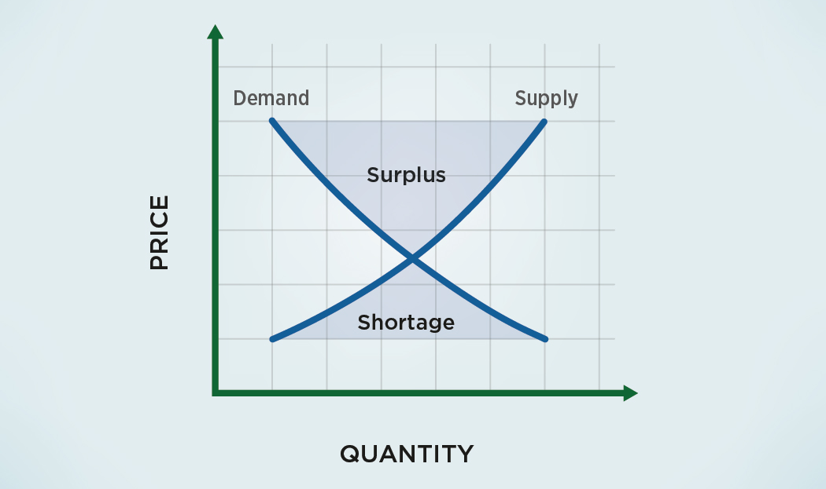
Monday
What type of graph is this? What is the title of the X axis and
the Y axis?
Notes:
This is a line graph. The X axis is displaying the quantity (of goods) and the Y axis is displaying the price (of goods).

Slide 3
Tuesday
What is the purpose of this graph?
Notes:
This graph shows the relationship between the supply of and demand for goods.

Slide 4
Wednesday
Study the graph. If demand is low, but quantity is high for a good, what would happen to the good’s price?
Notes:
In the described circumstances, prices would generally be low.

Slide 5
Thursday
Based on the graph, what happens to the price of a good when there is a high demand but the quantity (supply) is low?
Notes:
When demand is high, the price of a good is high.

Slide 6
Friday
Why is it important for businesses to pay attention to supply and demand?
Notes:
If a business charges too much for a product, the demand will decrease. If a business produces too much for a product, the price will decrease. Businesses try to keep the quantity of goods at a level that they get a good price.
This chart looks simple, but it represents some complex ideas. Take time to discuss how shrinking demand might cause the quantity of a good to drop, forcing the price downward. Conversely, increased demand may cause prices to rise, especially if the quantity of the good is in short supply.

Slide 7
Image Credits
Slide 1: Chris Miceli on Wikimedia Commons, Public Domain; Image Credits Slide: Edd Prince on Wikimedia Commons; maps copyright Clairmont Press; all others public domain
Shown here: Fontainebleau State Park

