Slide 1
Smart Skills
Week 8
Artifact 2
© 2015 Clairmont Press

Slide 2
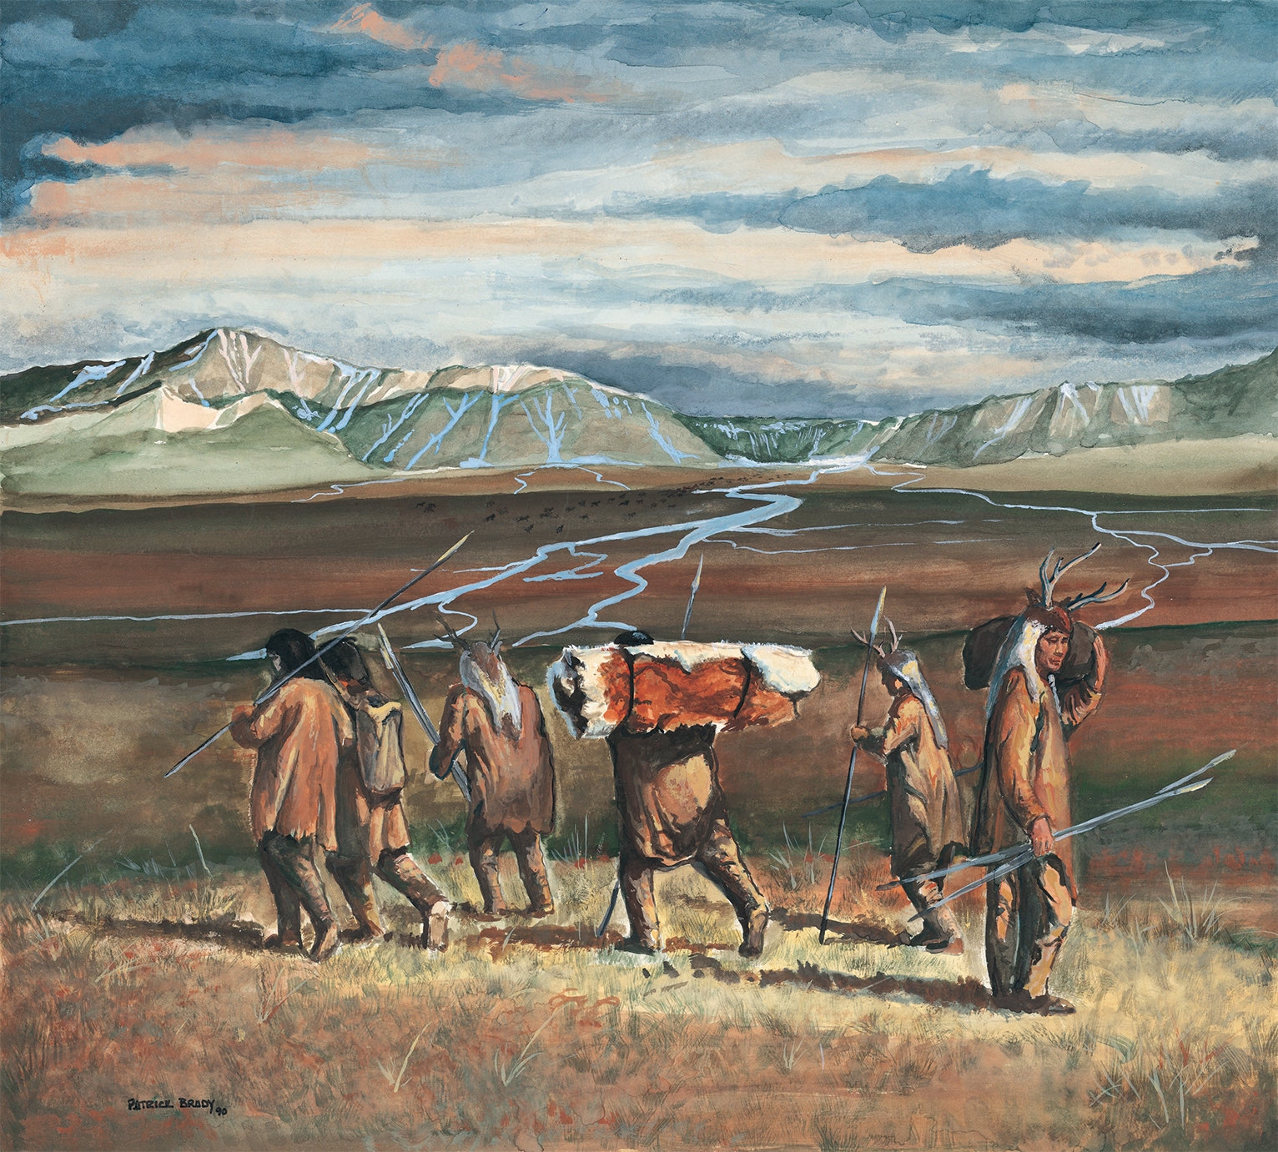
Monday
What type of artifact is this? What evidence do you have to support your answer?
Notes:
This is a painting. It does not have the realistic look of a photograph. There is more color than a drawing. There seems to be an artist’s signature in the bottom left corner.

Slide 3
Tuesday
What do you notice in the photograph? List as many things as you can in two minutes.
Notes:
Answers may include: people with horns on their heads who are wearing animal skins, one person with a pack, spears, mountains, rivers, clouds in the sky, grassy land, rolled pack looks like an animal skin, moccasins for shoes, etc.

Slide 4
Wednesday
What is the purpose of this painting?
Notes:
The painting shows the Native Americans migrating across the land bridge from Siberia to Alaska.

Slide 5
Thursday
Which prehistoric people are featured in the painting?
What evidence supports your answer?
Notes:
The Paleo people are featured in the painting. The spears are a clue to the culture group.

Slide 6
Friday
What would be an appropriate, effective title for the painting? Defend your choice.
Notes:
Answers will vary. Students should be able to think of a title that would be symbolic in some way rather than just stating what’s in the picture. For instance, “Native Americans Walking” would be less effective as a title than “Looking Back.”

Slide 7
Image Credits
Slide 1: Chris Miceli on Wikimedia Commons, Public Domain; Image Credits Slide: Edd Prince on Wikimedia Commons; maps copyright Clairmont Press; all others public domain
Shown here: Fontainebleau State Park

