Slide 1
Smart Skills
Week 9
Timeline 2
© 2015 Clairmont Press

Slide 2
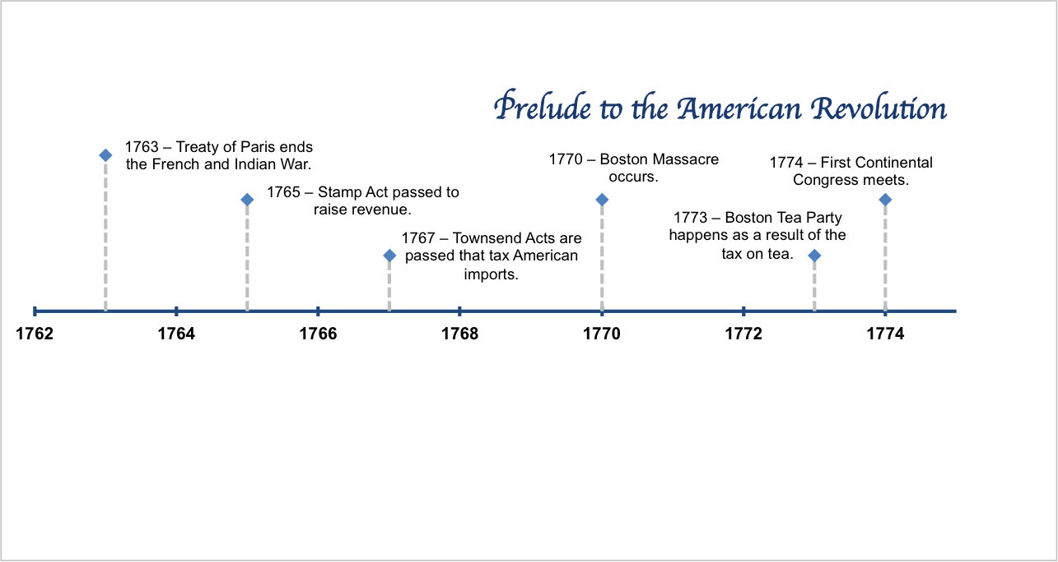
Monday
What is the date range for this timeline?
How many years are included?
Notes:
This timeline shows the years 1762-1774. There are 12 years included in this timeline.

Slide 3
Tuesday
The following memorial was written for Crispus Attucks. What is the error?
Crispus Attucks is considered to be the first American killed in the American Revolution. Attucks was of African heritage and died in the streets of Boston – killed by British soldiers in what became known as the Boston Massacre. He was known as a participant in the Boston Tea Party, and his grave may be visited today in Boston, Massachusetts.
Notes:
Crispus Attucks was killed at the Boston Massacre in 1770 three years before the Boston Tea Party.

Slide 4
Wednesday
The time line title mentions the American Revolution. However, the American Revolution began in 1776. Is the title incorrect? Explain your thinking. Suggest a new title, if needed.
Notes:
The title is correct because “prelude” means that the events lead to the American Revolution.

Slide 5
Thursday
The Treaty of Paris of 1783 officially ended the American Revolution. Where would this event be placed on the time line? Should it have been included?
Notes:
The Treaty of Paris of 1783 is not an appropriate event for the time line because the title indicates that these events lead to the American Revolution. The treaty was at the end of the American Revolution.

Slide 6
Friday
Based on the timeline, would you classify the years before the American Revolution as peaceful? Explain your thinking?
Notes:
Answers will vary. Students should be able to defend their thinking with information from the time line.

Slide 7
Image Credits
Slide 1: Chris Miceli on Wikimedia Commons, Public Domain; Image Credits Slide: Edd Prince on Wikimedia Commons; maps copyright Clairmont Press; all others public domain
Shown here: Fontainebleau State Park

