Slide 1
Smart Skills
Week 10
Political Cartoon 2
© 2015 Clairmont Press

Slide 2
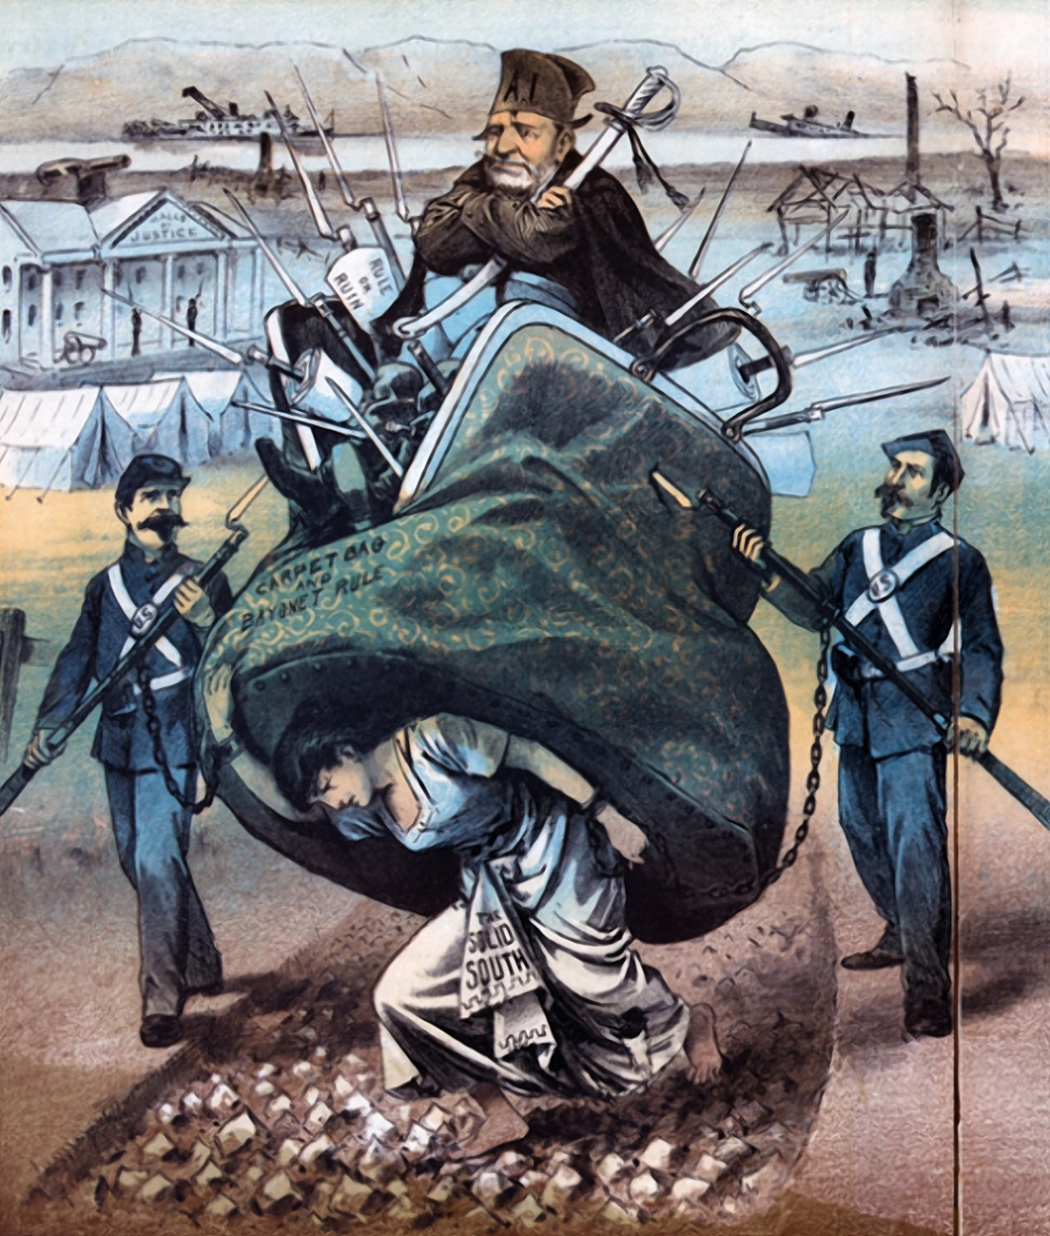
Monday
Study the cartoon. What objects can you find?
Who are the people in the cartoon? Who do they represent?
Notes:
Sample objects: white building (plantation house?) with tents in the front; burned houses with only a chimney, sunken ships in a river, bare tree
The people in the cartoon are US soldiers, a man, and a woman. The woman represents the Old South, and the man represents carpetbaggers.

Slide 3
Tuesday
What actions are taking place in the cartoon? What do they symbolize?
Notes:
The woman is carrying the man, who is being guarded by the soldiers. The woman’s struggle to carry the man represents the South’s struggle with carpetbaggers after the Civil War.

Slide 4
Wednesday
What are the different phrases in this cartoon? Which of them do you think is the most important?
Notes:
The woman’s dress says Solid South. The carpetbag says carpetbag and bayonet rule. The paper in the carpetbag says rule or ruin. Students answers will vary.

Slide 5
Thursday
Compare and contrast the objects in the front of the cartoon with the objects in the background.
Notes:
In the foreground of the cartoon are the main characters in color. In the background are ruined steamboats and burned down plantation houses in black and white.

Slide 6
Friday
What is the message of the cartoon? Which types of people would agree with the cartoon’s message? Who would disagree? Explain your thinking.
Notes:
Students’ answers will vary, but they should come to the mention that the cartoonist is making a point that the carpetbaggers are crushing the South. People of the South (former plantation owners) would agree with the cartoon. The carpetbaggers from the North would disagree with the unflattering portrayal of themselves.

Slide 7
Image Credits
Slide 1: Chris Miceli on Wikimedia Commons, Public Domain; Image Credits Slide: Edd Prince on Wikimedia Commons; maps copyright Clairmont Press; all others public domain
Shown here: Fontainebleau State Park

