Slide 1
Smart Skills
Week 12
Chart 3
© 2015 Clairmont Press

Slide 2
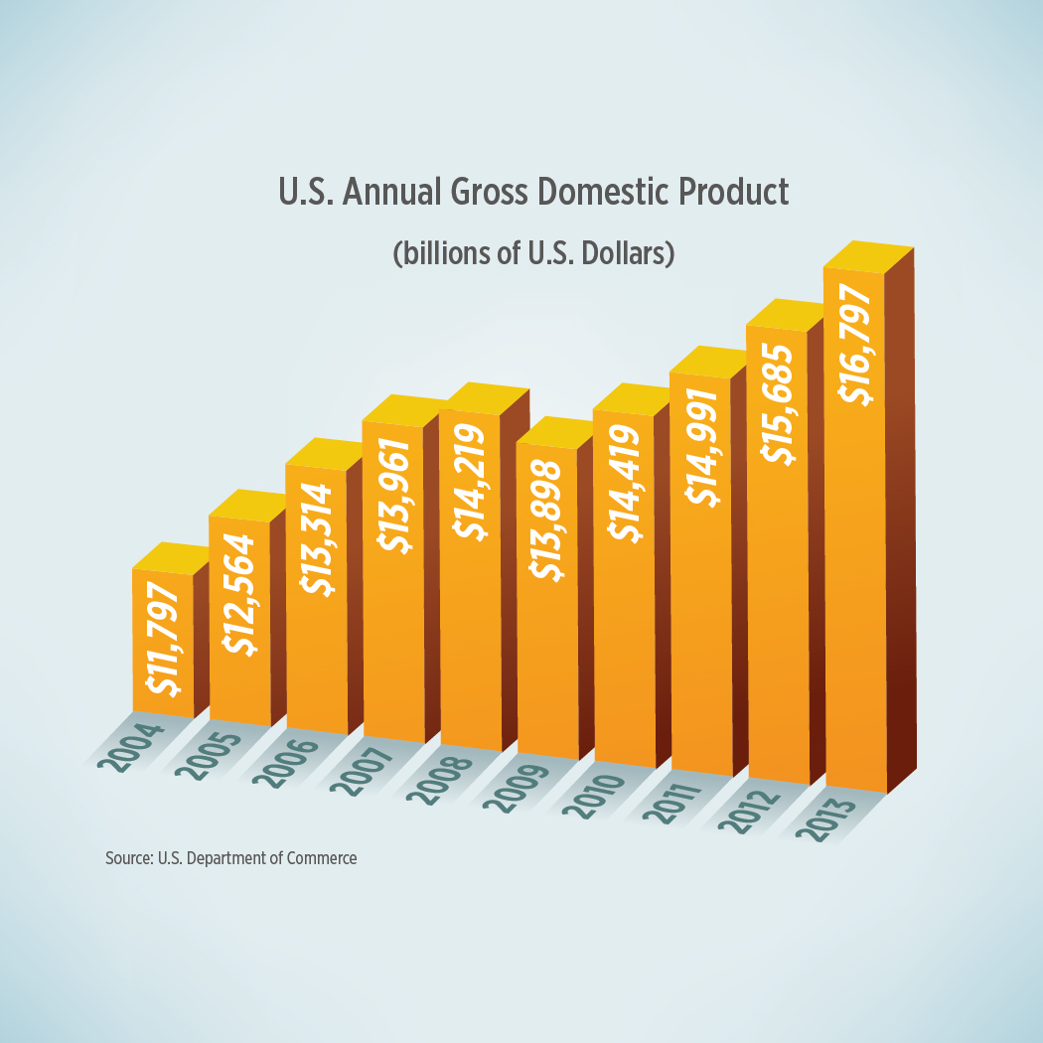
Monday
What type of graph is this? What is the X axis showing?
Notes:
The graph is a column, or bar, graph. The X axis is showing the years, from 2004-2013.

Slide 3
Tuesday
What is the purpose of this graph? What is the overall trend?
Notes:
The purpose of the graph is to show the gross domestic product of the United States. The overall trend is that the GDP of the United States is increasing.

Slide 4
Wednesday
The gross domestic product is the total value of goods and services produced in one country in one year. What was the gross domestic product of the U.S. in 2013?
Notes:
The U.S. gross domestic product in 2013 was $16,797,000,000,000. Students should understand that the totals on the graph are in “billions of U.S. dollars”.

Slide 5
Thursday
An economic recession began in the United States in 2008. What evidence of the recession is shown by this graph?
Notes:
The GDP decreased from 2008-2009 because the economy went into recession. The decrease in the GDP reflected the loss of jobs or pay cuts many Americans experienced, and the closing of companies as a result of the economic slowdown.

Slide 6
Friday
Imagine you are a foreign business owner. Why would you be interested in the GDP of a country?
Notes:
Answers will vary. Possible answers include: the GDP shows the strength of a country’s economy, which might influence a business owner’s decision to set-up a business there or sell their products there.

Slide 7
Image Credits
Slide 1: Chris Miceli on Wikimedia Commons, Public Domain; Image Credits Slide: Edd Prince on Wikimedia Commons; maps copyright Clairmont Press; all others public domain
Shown here: Fontainebleau State Park

