Slide 1
Smart Skills
Week 17
Chart 4
© 2015 Clairmont Press

Slide 2
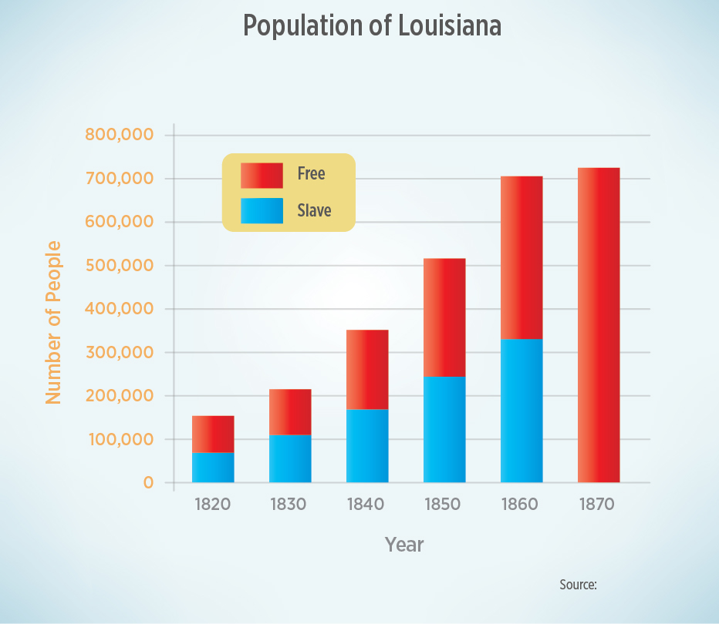
Monday
What type of graph is this? What is the X axis showing?
What is the Y axis showing?
Notes:
This is a bar graph. The X axis is showing the years from 1820 to 1870. The Y axis is showing the number of people in Louisiana.

Slide 3
Tuesday
What do the colors of the bars mean? What information is missing from the graph that would give the reader confidence in the data?
Notes:
Red means the number of people in Louisiana that were free, and blue means the number of people in Louisiana that were slaves.
The graph does not show the source of the data (which, by the way, is the U.S. Census).

Slide 4
Wednesday
What was the overall trend of population, both slave and free, between 1820 and 1860?
Notes:
Both slave and free populations were growing quickly between 1820 and 1860.

Slide 5
Thursday
What happened to the number of enslaved people between 1860 and 1870? Why did the population of Louisiana grow little between 1860 and 1870?
Notes:
As a result of the American Civil War, slavery ended in Louisiana – there were no people in slavery. The population in Louisiana did not grow much between 1860 and 1870 because of Civil War losses and people, including freed slaves, moving to other states.

Slide 6
Friday
Based on the graph above, what conclusions can you make about the challenges the people of Louisiana faced in 1870?
Notes:
Since slaves were freed at the end of the Civil War in 1865, Louisiana faced many challenges, including: tensions between former masters and slaves, racism, and recovery from the war, and freed slaves (workforce) leaving the state.

Slide 7
Image Credits
Slide 1: Chris Miceli on Wikimedia Commons, Public Domain; Image Credits Slide: Edd Prince on Wikimedia Commons; maps copyright Clairmont Press; all others public domain
Shown here: Fontainebleau State Park

