Slide 1
Smart Skills
Week 18
Artifact 4
© 2015 Clairmont Press

Slide 2
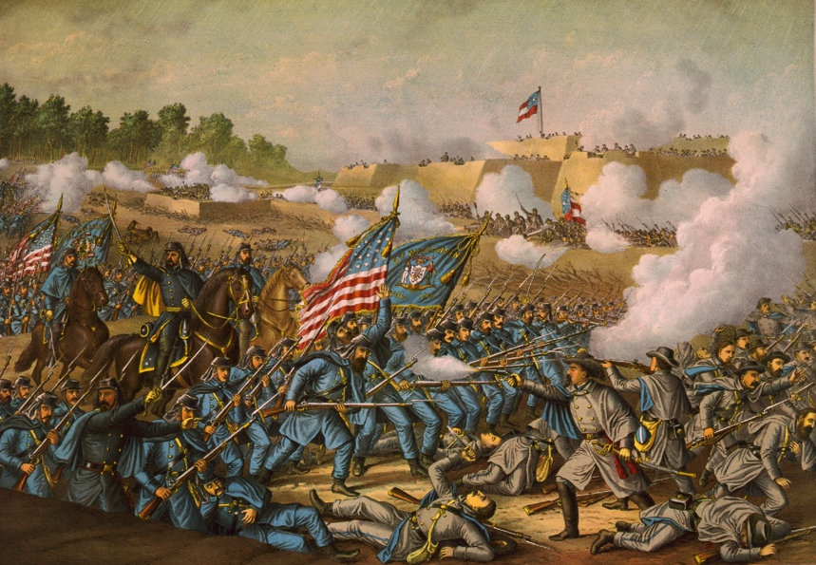
Monday
Study this painting. What objects do you notice? List as many as you can in two minutes.
Notes:
A battle from the American Civil War is featured in the painting.
The painting is “Battle of Williamsburg – General Hancock’s Charge, May 5, 1862”. The painting is by Kurz & Allison, 1893.
Students may notice: United States and other flags, soldiers in blue and gray, swords, smoke, a fort, bayonets, soldiers in different hats, rows of soldiers, men on horses, trees, hills, a grey sky with clouds

Slide 3
Tuesday
What is at the focal point of the painting? What draws your eye?
Notes:
United States flags and blue uniformed soldiers are at the center, in close fighting with gray-uniformed soldiers.

Slide 4
Wednesday
What is the purpose of the fortifications in the background of the picture?
Notes:
The fortifications would be difficult to attack and allow the Confederates to defend their territory.

Slide 5
Thursday
Why do you think the painting’s artist featured the American flag in the center of the picture?
Notes:
Answers will vary. Students might say that the artist was showing that the Union troops would win.

Slide 6
Friday
Predict which side you think will win the battle pictured above. Provide evidence to support your prediction.
Notes:
Student answers will vary. Possible answers include: the Union because they seem to have more soldiers or the Confederates because they have the higher ground in the background. The artist seems to be showing an advantage for the Union soldiers.

Slide 7
Image Credits
Slide 1: Chris Miceli on Wikimedia Commons, Public Domain; Image Credits Slide: Edd Prince on Wikimedia Commons; maps copyright Clairmont Press; all others public domain
Shown here: Fontainebleau State Park

