Slide 1
Smart Skills
Week 19
Timeline 4
© 2015 Clairmont Press

Slide 2
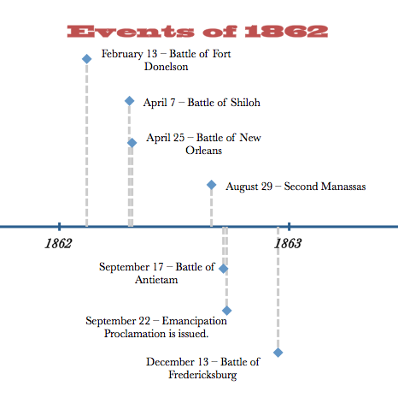
Monday
What is the date range of this timeline?
Notes:
This timeline shows the year of 1862.

Slide 3
Tuesday
Did the Battle of Shiloh happen before or after the Battle of New Orleans?
Notes:
The Battle of Shiloh happened before the Battle of New Orleans.

Slide 4
Wednesday
What would be a better title for the time line?
Notes:
Since the time line focuses on battles, one suggestion would be “Civil War Battles in 1862”.

Slide 5
Thursday
The Battle of Antietam is the bloodiest day in US history. Why do you think Lincoln issued the Emancipation Proclamation so soon after it?
Notes:
Lincoln was hoping that the Emancipation Proclamation would help end the war sooner. Students may not have been taught this yet, but they can begin to make educated guesses based on their prior learning and the information in the time line.

Slide 6
Friday
What could be added to this timeline to make it more informative?
Notes:
Answers will vary.

Slide 7
Image Credits
Slide 1: Chris Miceli on Wikimedia Commons, Public Domain; Image Credits Slide: Edd Prince on Wikimedia Commons; maps copyright Clairmont Press; all others public domain
Shown here: Fontainebleau State Park

