Slide 1
Smart Skills
Week 21
Map 5
© 2015 Clairmont Press

Slide 2
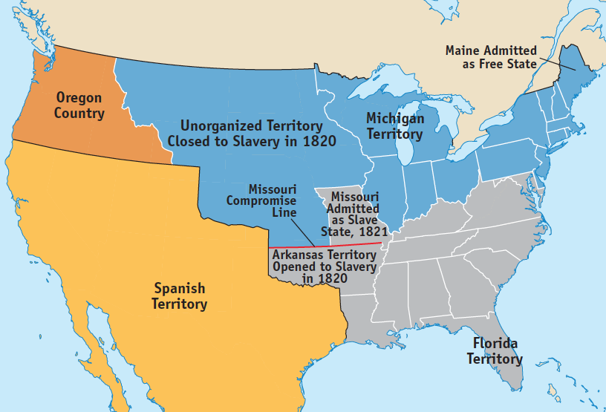
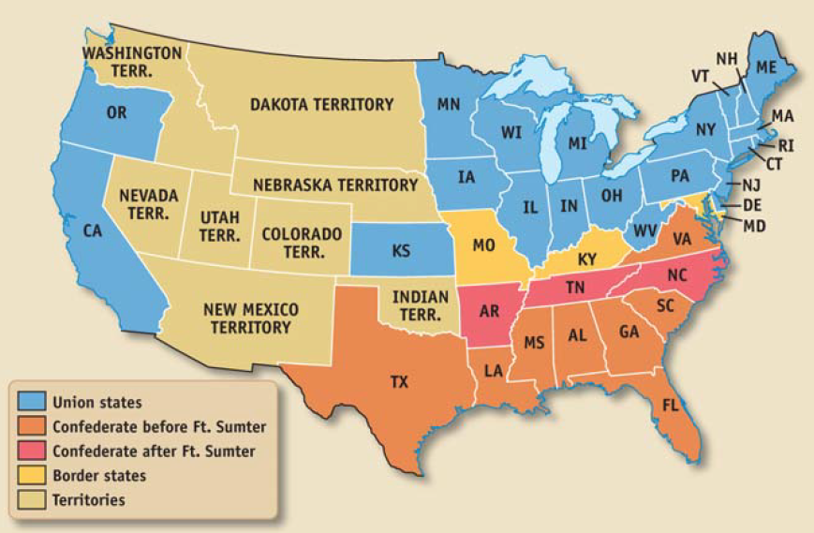
Monday
What is each of the maps above showing?
Notes:
The map on the left is showing the United States before the Civil War. The map on the right is showing the United States divided during the Civil War.

Slide 3
Tuesday
Looking at the two maps, what do you think the gray areas on the map on the right are showing?
Notes:
The gray areas are showing where slavery was legal.

Slide 4
Wednesday
Create a map key for the map on the left to explain the colors used, similar to the key for the map on the right.
Notes:
Gray areas are slave states. Blue areas are where slavery was illegal. Orange indicates Oregon Country (claimed at times by the United States, Spain, Russia, and Great Britain). Yellow represents the region controlled by Spain.

Slide 5
Thursday
Locate Louisiana on both maps. What can you learn about Louisiana from the maps?
Notes:
Louisiana was a slave state and joined the Confederacy before Fort Sumter.

Slide 6
Friday
Why would the maps above be useful to students of history?
Notes:
The maps show how the spread of slavery correlates to the division of the United States during the Civil War.

Slide 7
Image Credits
Slide 1: Chris Miceli on Wikimedia Commons, Public Domain; Image Credits Slide: Edd Prince on Wikimedia Commons; maps copyright Clairmont Press; all others public domain
Shown here: Fontainebleau State Park

