Slide 1
Smart Skills
Week 22
Chart 5
© 2015 Clairmont Press

Slide 2
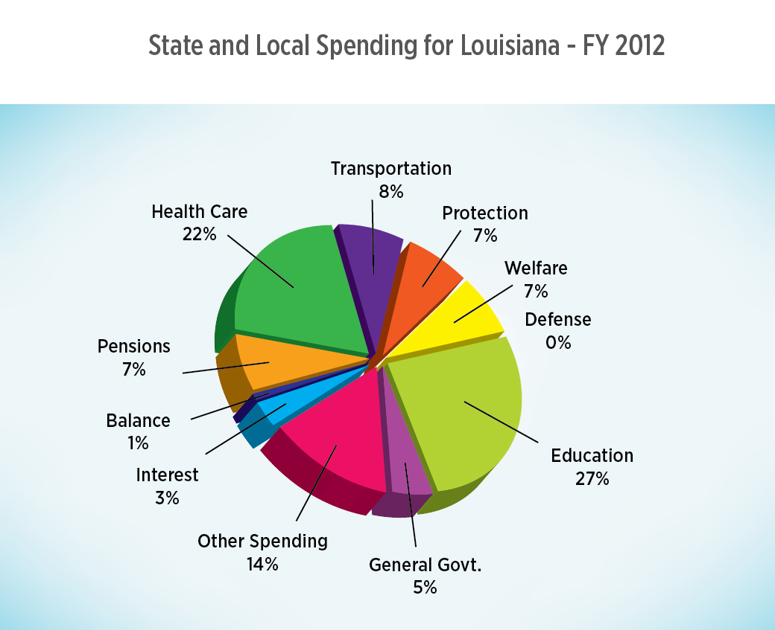
Monday
What type of chart is this?
Notes:
This is a pie chart.

Slide 3
Tuesday
What is the purpose of this chart?
Notes:
The purpose is to show how the state and local governments in Louisiana spent money in 2012.

Slide 4
Wednesday
What were the two categories that governments spent the most on in 2012?
Notes:
The two categories that government spent the most amount of money on were education (27%) and health care (22%).

Slide 5
Thursday
In which category did the governments spend the least on? Why?
Notes:
The governments spent the least on defense (0%) because the federal government of the United States provides for the defense of all states.

Slide 6
Friday
How would a chart like this be useful to government planners?
Notes:
This chart would be useful to government planners because it will help them predict future spending and make sure money is going to the most important projects.

Slide 7
Image Credits
Slide 1: Chris Miceli on Wikimedia Commons, Public Domain; Image Credits Slide: Edd Prince on Wikimedia Commons; maps copyright Clairmont Press; all others public domain
Shown here: Fontainebleau State Park

