Slide 1
Smart Skills
Week 26
Map 6
© 2015 Clairmont Press

Slide 2
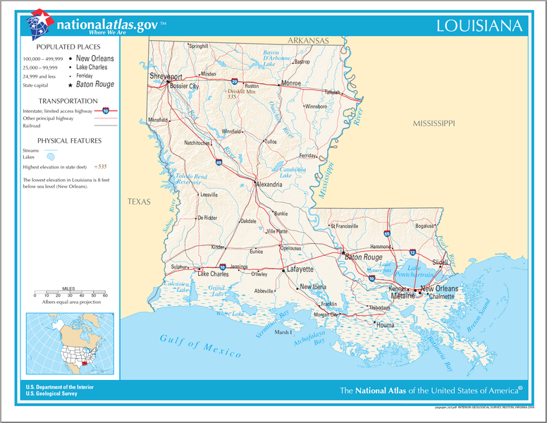
Monday
What do the different sized dots mean?
Notes:
The different sized dots correlate to the population of the city. The larger the dot, the larger the population of the city.

Slide 3
Tuesday
What is the purpose of this map? Why would it be useful to people visiting Louisiana?
Notes:
The purpose of the map is to show the major interstates and highways in Louisiana. This map would help visitors by showing them the most direct routes to get to different places within Louisiana.

Slide 4
Wednesday
If you were to travel from Shreveport to New Orleans, what is the most direct route to take?
Notes:
Take Interstate 49 southeast and then Interstate 10 east to New Orleans.

Slide 5
Thursday
What are the five interstates that cross through Louisiana?
Notes:
The Interstates Highways are 20, 49, 10, 12, and 55.

Slide 6
Friday
Explain how the transportation system in Louisiana affects the economy. Use evidence to support your answer.
Notes:
The presence of many roads and interstates promotes trade both within and outside Louisiana. Major cities are connected by transportation routes, which would improve local economies.

Slide 7
Image Credits
Slide 1: Chris Miceli on Wikimedia Commons, Public Domain; Image Credits Slide: Edd Prince on Wikimedia Commons; maps copyright Clairmont Press; all others public domain
Shown here: Fontainebleau State Park

