Slide 1
Smart Skills
Week 28
Artifact 6
© 2015 Clairmont Press

Slide 2
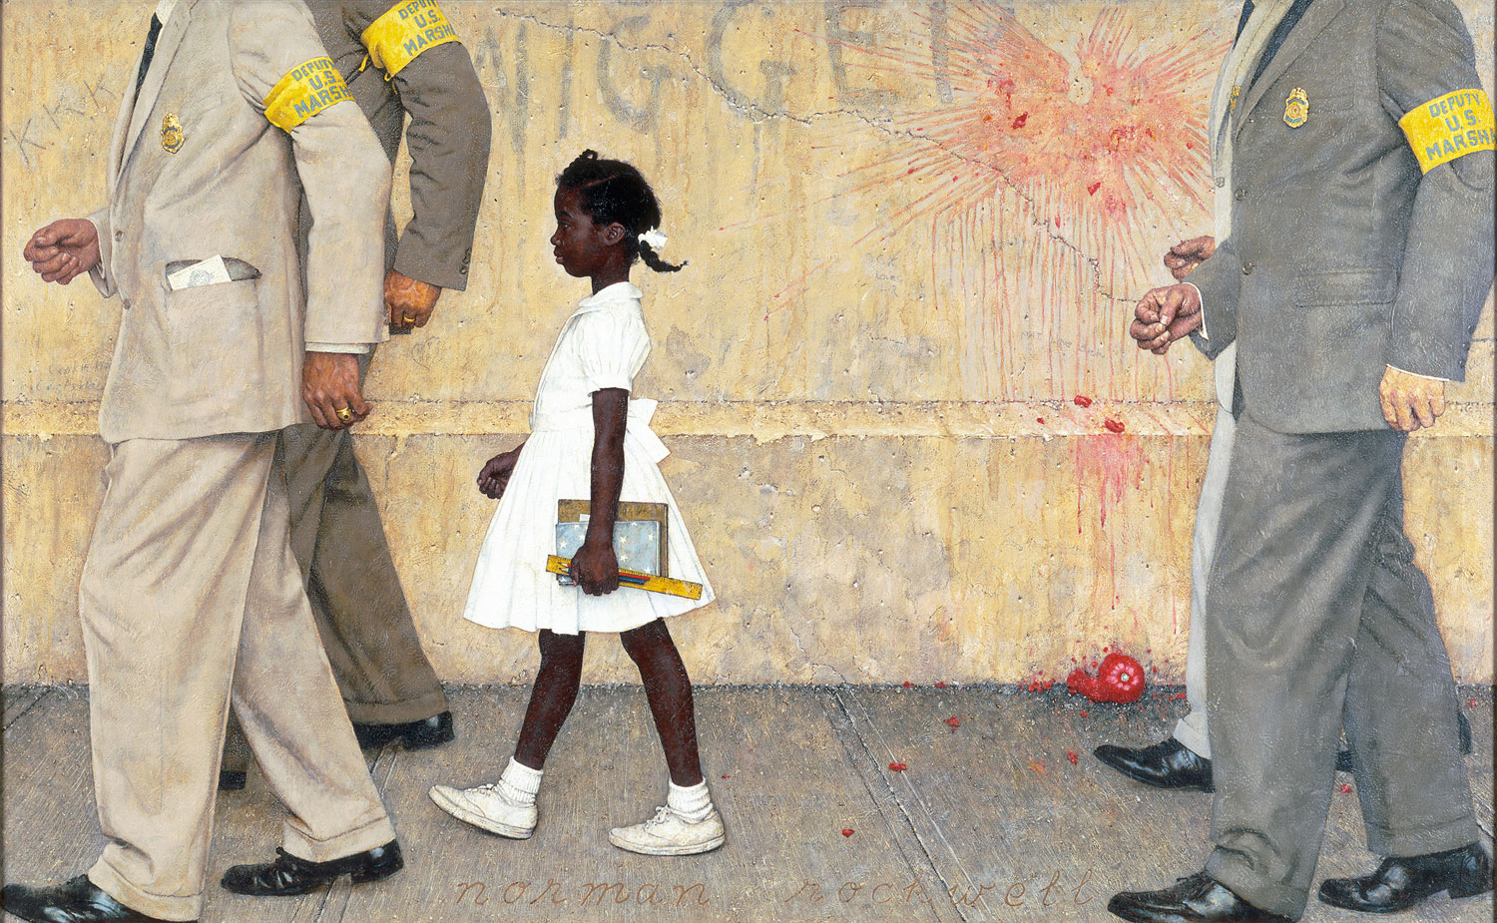
Monday
Study this painting. What objects do you notice? List as many as you can in two minutes.
Notes:
Teacher Note: This painting “The Problem We All Live With” is a 1964 work by Norman Rockwell. It has become famous as a symbol of the Civil Rights Movement in the United States. The subject is a young African-American girl, Ruby Bridges, as she is escorted to a previously all-white public school in New Orleans. The racial slur written on the wall in the background may be offensive to some students. The teacher may need to assist students in understanding that the artist was not against segregation, but instead was painting a picture in support of the young girl.
Sample objects: young African-American girl in white dress, white shoes and socks, with school books, pencils, and ruler; hair neatly set with braids and bows; four men in suits with polished dress shoes, badges, ties, armbands reading “Deputy U.S. Marshal”; one man has an official-looking paper in his front suit pocket; signature at bottom of painting “Norman Rockwell”; concrete sidewalk, stone wall, tomato splattered on wall and sitting broken on sidewall; racial slur in graffiti on wall; “KKK” scratched on wall; the men’s faces are not shown; the girl is standing upright and walking with head high, facing in the direction the group is walking

Slide 3
Tuesday
Who is the famous young girl from Louisiana in the painting? How do you know?
Notes:
The girl in the painting is Ruby Bridges. The context of the painting implies a time of desegregation.

Slide 4
Wednesday
What do you think the symbolism is of Ruby Bridges’ white dress?
Notes:
Sample answer: Ruby Bridges’ white dress is symbolic of her innocence and hope for the future.

Slide 5
Thursday
What is the mood of the painting? How does it make you feel?
Notes:
Answers will vary.
The teacher may want to guide the discussion to speculation about the purpose of the painting. What was the goal of the artist? Was he simply trying to record an historic event? If so, why not just use a camera? How does the painting allow the artist some additional control over the emotions of the viewer?

Slide 6
Friday
How do you think the future of Louisiana would be different if Ruby Bridges had not attended a white school?
Notes:
Answers will vary.

Slide 7
Image Credits
Slide 1: Chris Miceli on Wikimedia Commons, Public Domain; Image Credits Slide: Edd Prince on Wikimedia Commons; maps copyright Clairmont Press; all others public domain
Shown here: Fontainebleau State Park

