Slide 1
Smart Skills
Week 30
Political Cartoon 6
© 2015 Clairmont Press

Slide 2
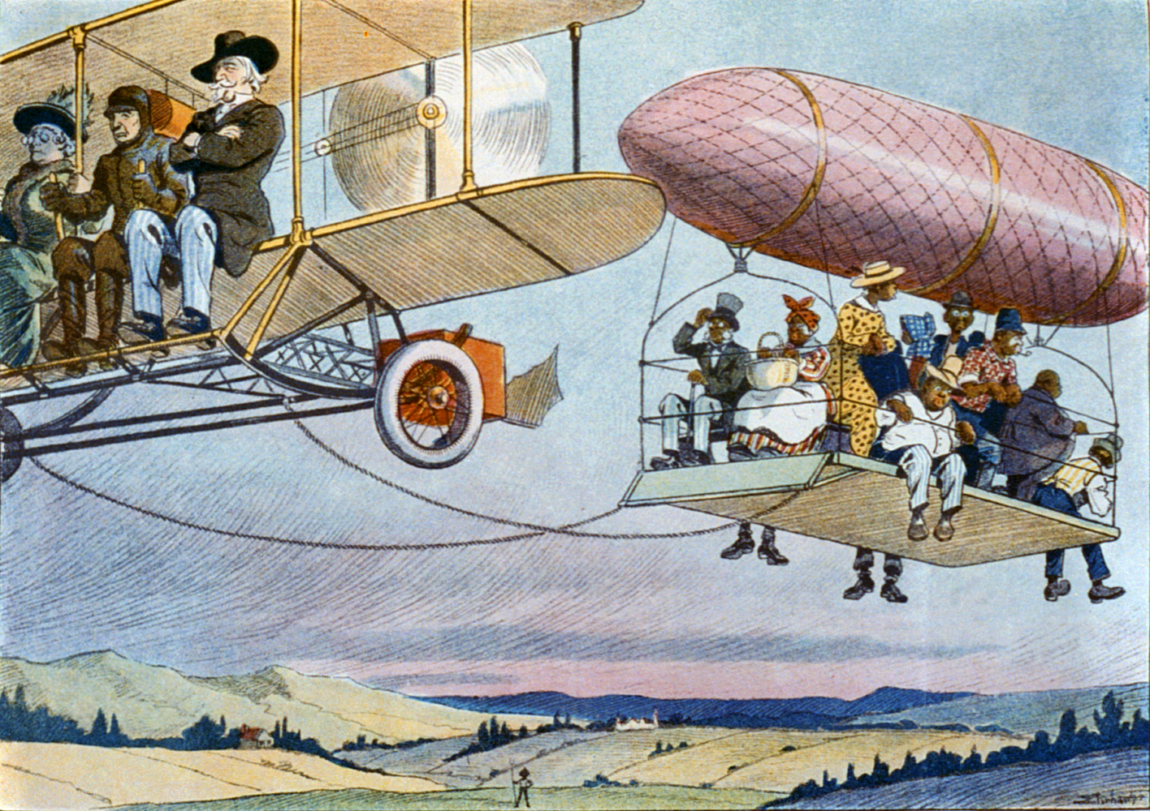
Monday
Study the cartoon. List as many objects as you can in two minutes.
Notes:
Objects: old bi-plane with white people sitting on the wings; African-Americans being pulled along suspended by a dirigible; the whites are dressed finely; clear skies with farmlands below; farmer in the distance; African-Americans are dressed in a variety of ways from fine (with a top hat) to person who might be a farm worker, the women are wearing bonnets or have their heads covered.

Slide 3
Tuesday
Based upon what you know about Louisiana history, what is the cartoon depicting? What event might have caused the cartoonist to draw it?
Notes:
The cartoon is depicting segregation. The event that might have sparked this cartoon was the street car segregation in New Orleans.

Slide 4
Wednesday
Compare and contrast the vehicles the two groups of people are riding in. What point do you think the artist is trying to make?
Notes:
The white people are riding in a plane with an engine in seats with plenty of space. The African-Americans are riding below a dirigible connected to the plane. The African-Americans are crowded, and there are no seats for them. This is showing how the idea of separate but equal was not equal at all.

Slide 5
Thursday
There are no words in this cartoon. What words or phrases do you think could be added to make this cartoon easier to understand?
Notes:
Students’ answers will vary. Students might say that adding signs on the two vehicles, like “Whites Only,” might make the cartoon easier to understand.

Slide 6
Friday
What is the message of the cartoon? Which types of people would agree with the cartoon’s message? Who would disagree? Explain your thinking.
Notes:
The message of this carton is that segregation is unfair. Most people would agree with this cartoon in the present day. When this cartoon was created, people who supported segregation would not agree with the cartoon, or they would not see anything wrong with the situation. Those that opposed segregation would agree with the cartoonist’s intent to show the inequality of separate but equal.

Slide 7
Image Credits
Slide 1: Chris Miceli on Wikimedia Commons, Public Domain; Image Credits Slide: Edd Prince on Wikimedia Commons; maps copyright Clairmont Press; all others public domain
Shown here: Fontainebleau State Park

