Slide 1
Smart Skills
Week 31
Map 7
© 2015 Clairmont Press

Slide 2
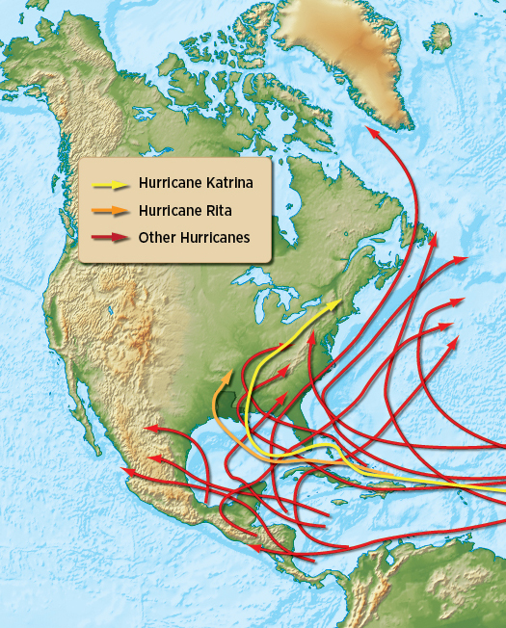
Monday
What is the purpose of this map?
Notes:
This map shows the paths of major hurricanes in the United States.

Slide 3
Tuesday
What do the different colored arrows on the map represent?
Notes:
The different colors show the different hurricanes. Hurricane Katrina is yellow. Hurricane Rita is orange. All other major hurricanes are red.

Slide 4
Wednesday
Based on the map, where do most hurricanes begin? In which general direction do most hurricanes travel?
Notes:
Hurricanes begin southeast of the United States (off the coast of Africa). Hurricanes generally travel east to west then turn toward the north and northeast.

Slide 5
Thursday
Which two hurricanes are singled out on the map above? Why?
Notes:
Sample Answer: The two singled out hurricanes are Hurricane Katrina and Hurricane Rita because they are relatively recent and had significant impact on Louisiana.

Slide 6
Friday
Why would a map like this be useful to government officials?
Notes:
Answers will vary among students. General answers should reflect being able to plan ahead for hurricanes based on trends and patterns.

Slide 7
Image Credits
Slide 1: Chris Miceli on Wikimedia Commons, Public Domain; Image Credits Slide: Edd Prince on Wikimedia Commons; maps copyright Clairmont Press; all others public domain
Shown here: Fontainebleau State Park

