Slide 1
Smart Skills
Week 33
Artifact 7
© 2015 Clairmont Press

Slide 2
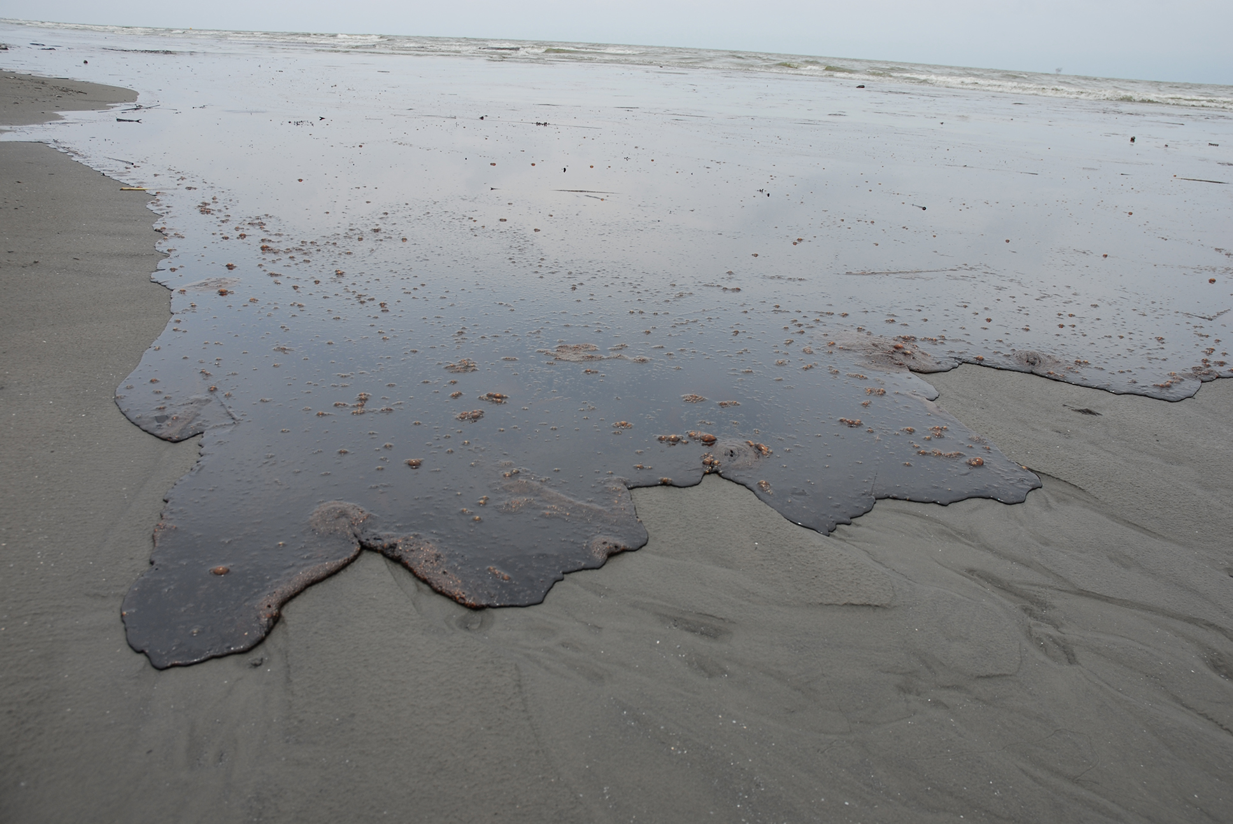
Monday
What is shown in the photograph?
Notes:
The photograph appears to show a large body of water (sea, bay, ocean, lake) with dirty or oily water washing ashore on a sandy beach.
Teacher Note: This photograph shows a Louisiana beach with oil washing ashore as a result of the 2010 Deepwater Horizon accident.

Slide 3
Tuesday
How does this photograph make you feel? Why?
Notes:
Answers will vary.

Slide 4
Wednesday
Other than the ecological impact of an oil spill, what are the other consequences of an oil spill?
Notes:
Students’ answers will vary, but they should make the connection that oil spills can also affect the people who live along the coast and their jobs and food sources.

Slide 5
Thursday
Louisiana’s economy is dependent on oil. How can government leaders balance the oil industry and protecting the environment?
Notes:
Answers will vary.

Slide 6
Friday
Offshore drilling is common in the Gulf of Mexico. Do you think offshore drilling is good? Why or why not?
Notes:
Answers will vary.

Slide 7
Image Credits
Slide 1: Chris Miceli on Wikimedia Commons, Public Domain; Image Credits Slide: Edd Prince on Wikimedia Commons; maps copyright Clairmont Press; all others public domain
Shown here: Fontainebleau State Park

