Slide 1
Smart Skills
Week 35
Political Cartoon 7
© 2015 Clairmont Press

Slide 2
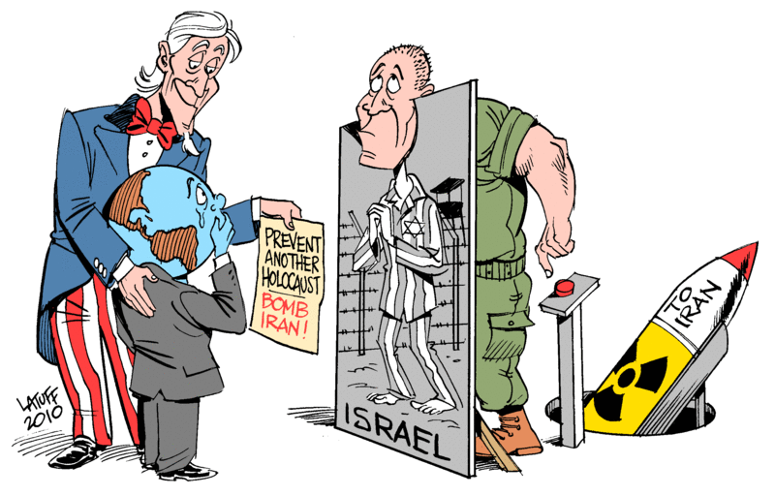
Monday
Study the cartoon. List as many things as you can that you notice in the cartoon in two minutes.
Notes:
Sample Objects: Uncle Sam, globe wearing a suit, Uncle Sam is holding a paper for the world to read, big man dressed as soldier behind a sign labeled “Israel” with a holocaust victim on it; soldier has red button to control a missile (nuclear) labeled “To Iran”
Teacher Notes: The first man on the left is Uncle Sam and represents the United States government. The second man on the left represents the world or United Nations. The last man is a solider and represents the Israeli army.

Slide 3
Tuesday
Who is the author of this cartoon? When was it created?
Notes:
This cartoon was created by Latuff in 2010.

Slide 4
Wednesday
Why do you think the Israeli soldier is standing in front of the Holocaust picture? What is the artist trying to say?
Notes:
Sample Answer: The Israeli solider is trying to make the world feel sorry for Israel because of the Holocaust, which would get the world to support bombing Iran. The picture is also blocking the bomb that Israel has pointed towards Iran. This shows that Israel is not weak, but likes to play the role of pitiful victim.

Slide 5
Thursday
Based upon this cartoon, do you think the United States and Israel are allies? Why or why not?
Notes:
The United States and Israel are allies. In the cartoon, they are working together to get the world to support bombing Iran.

Slide 6
Friday
What is the message of the cartoon? Do you think the cartoonist supports attacking Iran? Explain your thinking.
Notes:
The message of the cartoon is the United States and Israel both want to attack Iran, but they also want the world to support their decision. The cartoonist does not support attacking Iran because in the cartoon it appears that the United States and Israel are tricking the world into supporting them.

Slide 7
Image Credits
Slide 1: Chris Miceli on Wikimedia Commons, Public Domain; Image Credits Slide: Edd Prince on Wikimedia Commons; maps copyright Clairmont Press; cartoon by Carlos Latuff on Wikimedia Commons; all others public domain
Shown here: Fontainebleau State Park

