Slide 1

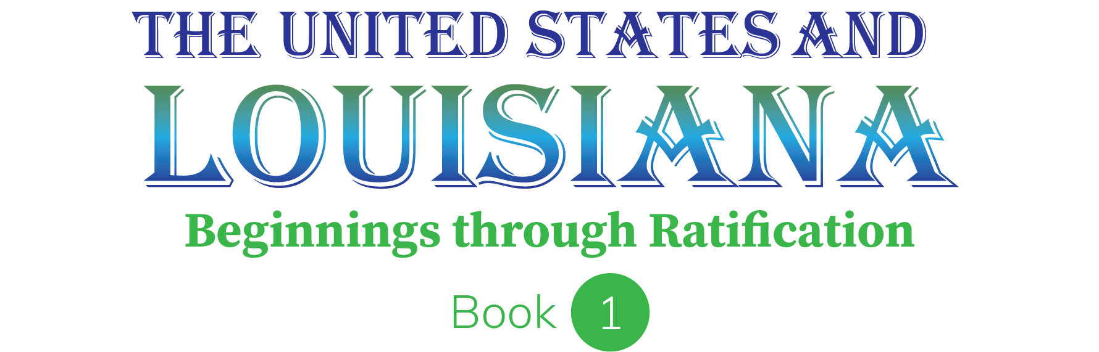
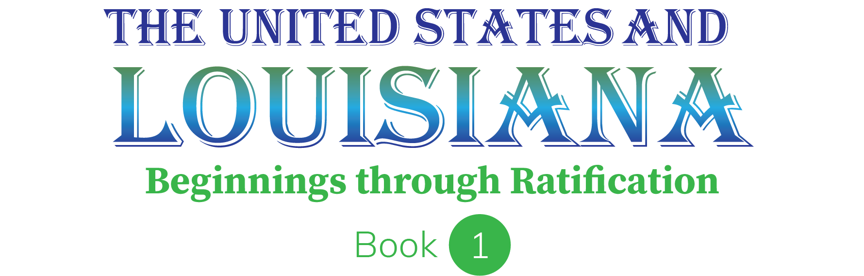
Chapter 10: The Road to Independence
STUDY PRESENTATION
© 2023 Clairmont Press

Slide 2
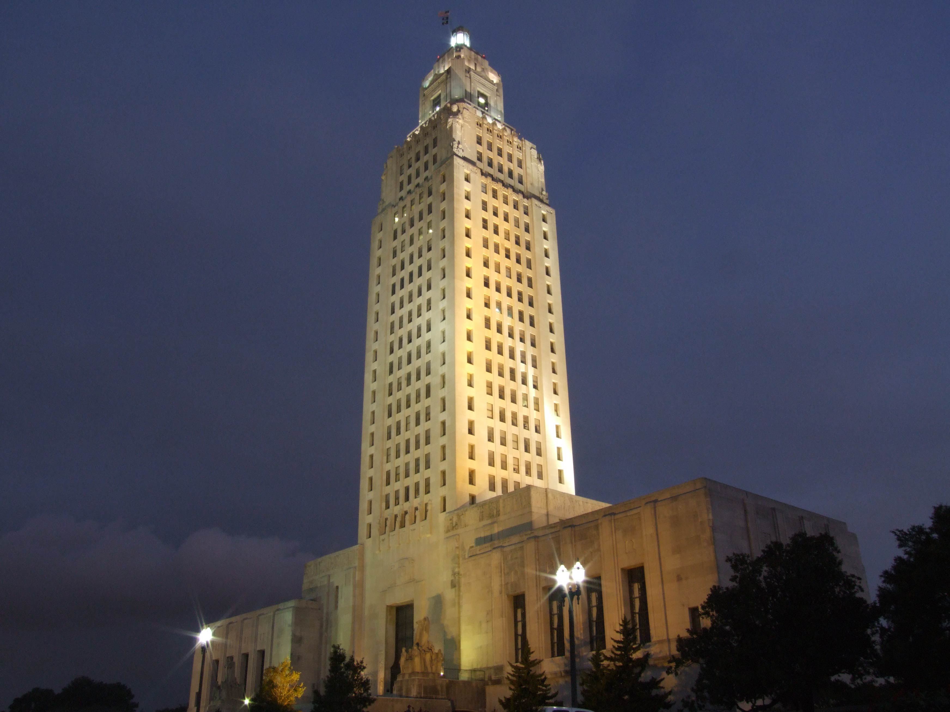
Louisiana State Capitol building, Baton Rouge
Section 1: British America in the 18th Century
Section 2: The French and Indian War
Section 3: Dispute with Britain
Section 4: Tensions Rise to a Breaking Point

Slide 3
Section 1: British America in the 18th Century
Essential Question:
  What was the economic system that kept the colonists connected with Great Britain?

Slide 4
Section 1: British America in the 18th Century
What terms do I need to know?
  Enlightenment
  Great Awakening
  mercantilism
  Navigation Acts
  smuggling
  salutary neglect

Slide 5
British America in the 18th Century
Many different languages, cultures, and religious beliefs were present in the British colonies.
Such diversity was rare in Europe, where most countries were populated by those with similar cultures, languages, heritages, and religions.
The degree of religious intolerance in Britain and her colonies was low compared to other European nations.

Slide 6
Proud to Be British
Britain and her colonies were thriving 150 years after initial settlement.
Most colonists were proud to be British.
Colonists copied the latest fashions and read the latest news from London, aspired to send their sons to schools in Britain, and copied popular British architecture.

Slide 7
The Enlightenment
There were many common beliefs about governing a country present in European countries leading up to the colonial era.
Monarchs ruled from crowning until death and would be succeeded by another blood relative, usually their child.
Monarchs were also typically absolute rulers, with England being an unusual case because parliament shared some governing power with the monarch.
Finally, most people accepted the monarch’s governing powers as a gift of God.

Slide 8
The Enlightenment Pt. 2
In the 16th and 17th centuries, an increasing number of people became educated.
European thinkers began to study various sciences and shared their new ideas and discoveries with other educated people across the continent.
Ideas emerged about the treatment of people and about the ability of people to ask and answer questions through logic and reasoning.

Slide 9
The Enlightenment Pt. 3
By the 1700s, new ideas about science, government, and society were shared and talked about in Europe and its colonies, marking the era known as the Enlightenment, or Age of Reason.
Some enlightened thinkers argued, among other things, that the main purpose of government was to protect the natural rights of life, liberty, and property of the people, and that government obtained power through the consent of the people.
Such thinking would lead to many changes in the world, including the formation of the United States.

Slide 10
The Great Awakening
Another important movement in the colonies was the Great Awakening of the 1700s.
The Great Awakening was a reaction against the negligence of the established churches in the colonies that had grown stale in their preaching and teaching.
In calling for people to revitalize their religious beliefs and live by them, the movement encouraged many to rebel against their own church and ministers.

Slide 11
Mercantilism
Rebellion was not on the mind of many colonists in the 1750s since they enjoyed being protected by the powerful British navy and army.
Colonists were vital to the British Empire due to supplying valuable raw materials.
The population growth of the colonies also meant the colonists were a very important market for British manufacturers.

Slide 12
Mercantilism Pt. 2
England operated under a practice called mercantilism, which is an economic theory that aimed to increase the success and power of a nation through restrictive trade practices.
With this system, the colonies were only allowed to trade with British markets, and the British did not allow colonists to produce goods made by the British.
Only a very limited amount of trade with other countries was allowed, as well.

Slide 13
Mercantilism Pt. 3
The British Parliament passed a series of trade laws in the 1660s called the Navigation Acts to discourage colonists from buying foreign-made goods.
They placed high tariffs upon foreign-made goods and required all colonial exports from America to be carried only on British ships.
Such laws allowed British authorities better control over colonial trade.
Smuggling, or moving something from one country into another illegally and secretly, became a common practice among some colonists to avoid these laws.

Slide 14
Salutary Neglect
Despite the trade restrictions imposed by the British, most colonists managed to prosper in the American colonies.
They viewed the trade laws as an acceptable price to pay for British protection.
They also appreciated the salutary neglect, in which the British leaders let the colonies make many decisions for themselves, which gave the colonists a sense of freedom and self-rule.
Return to Main Menu

Slide 15
Section 2: The French and Indian War
Essential Question
  What were the consequences of the French and Indian War?

Slide 16
Section 2: The French and Indian War
What terms do I need to know?
  Treaty of Paris of 1763
  Treaty of Fontainebleau

Slide 17
The French and Indian War
By the 1750s, over 2,000,000 colonists lived in Britain’s thirteen American colonies while just 60,000 French colonists lived to the north in Canada.
Farming in Canada’s cold climate likely limited the number of people who were willing to leave France and settle in Canada.
The valuable fur trade with Native Americans was the most profitable activity of the colonists in Canada.
This led to frequent conflict among Indian nations for greater control of the fur trade.

Slide 18
The French and Indian War Pt. 2
The Iroquois Wars began in 1640 and lasted into the next century.
The Iroquois Confederacy wanted more land for fur trading with the Dutch and British, but this provoked conflict with their Native American neighbors and their French allies.
France maintained good relations with many Indian groups despite the Iroquois' victory.
This proved important when disputes over land west of the Appalachian Mountains erupted in the 1750s between eager British colonists and the French.

Slide 19
Control of the Ohio River
No roads existed in the frontier, and while there were paths made by Indians and animals, travel by river was an easier and faster way to move people and supplies.
Control of rivers like the Ohio River, which flowed from Pennsylvania to the Gulf of Mexico, was important.
The point where the Allegheny and Monongahela Rivers form the Ohio River made an ideal location for a fort that could control the rivers and region.
This spot became the flash point for war between Great Britain, France, their Indian allies, and their colonists in the 1750s.

Slide 20
Young George Washington, Diplomat
Virginia’s Royal Governor Dinwiddie was alarmed by reports in 1753 that the French were building forts to secure the Ohio River.
Dinwiddie sent a young George Washington, a Virginia militia major, and a handful of men to order the French to leave.
The French politely welcomed Washington, read Dinwiddie’s demand for them to return to Canada, and then sent Washington back to Virginia with their refusal.
Both sides raced to seize and secure the land at the Ohio River.

Slide 21
The Battle of Fort Necessity
The next year, Washington, now a colonel, led a force of Virginia troops westward to secure the site.
He learned the French had already built their own Fort Duquesne, so he had his men build a small fort 50 miles away called Fort Necessity and waited for reinforcements.
Colonel Washington learned a party of potential French spies were encamped nearby, so he confronted them and ended up capturing or killing most in a few minutes.
This was Washington’s first military victory, but war had not been declared between Great Britain and France yet, which would be a problem.

Slide 22
The Battle of Fort Necessity Pt. 2
The French commander at Fort Duquesne was furious when he learned what happened.
He claiming his troops had been sent on a diplomatic mission to tell Washington leave French territory and had no intention of fighting.
Washington and his men found themselves in a desperate situation on July 3, 1754.
  They were outnumbered two-to-one by the French and their Indian allies
  They were stuck in their fort in an open field while the enemy was in the trees.
  They were stuck in heavy rain with damp gunpowder while the enemy continued to shoot at them from dry cover.

Slide 23
The Battle of Fort Necessity Pt. 3
The French asked for a truce just when it seemed Washington and his men would be defeated.
They allowed Washington and his men to march back to Virginia after he signed a surrender document pledging they would not return to the region for a year.
Since the document was written in French, Washington was shocked to learn later that it said he had assassinated a French diplomat in the small French force, that such actions were grounds for war, and that Washington’s admission was enough to blame the British for the conflict.
Washington argued that he didn’t know the document said anything about a French diplomat, and he would have never signed had he understood what it said.

Slide 24
The Battle of Fort Necessity Pt. 4
Washington’s reputation was damaged by these events, but most Virginians believed his explanation and supported him.
One year later, Washington joined General Edward Braddock and his troops in an expedition against Fort Duquesne.
Braddock’s army was nearly wiped out by a much smaller force of Indians allied with the French, and Braddock was killed, forcing a disgraceful return to Virginia.
By 1756, the conflict between France and Britain expanded into with fighting in Europe and much of the rest of the world.

Slide 25
The End of the War
British and colonial troops, as well as the navy, kept the pressure on France and eventually captured Fort Duquesne, Quebec, and Montreal from 1758 to 1760.
To avoid capture of their valuable Caribbean sugar colonies, France ended the war with the signing of the Treaty of Paris of 1763, which included the transfer of Canada to British rule.
France secretly transferred control of Louisiana to Spain, who had sided with France through the Treaty of Fontainebleau in 1762, to prevent the British from gaining possession of it.
Spain gained territory in this arrangement, but it lost valuable colonies in Cuba and the Philippines to Britain, so to regain control of those colonies, Spain surrendered Florida to the British.

Slide 26
War Debt Leads to New Colonial Policies
The end of the French and Indian War in 1763 should have been a good thing for Britain and her American colonies.
  The land Britain gained from the ordeal was enormous.
  The removal of France from North America reduced the threat of French or Indian attacks.
However, the war cost so much money to fund that British leaders had to borrow millions of English pounds, which left the government heavily in debt.
British leaders felt that the inhabitants of Great Britain already paid enough in taxes, so they turned to the colonies to relieve the debt.
Return to Main Menu

Slide 27
Section 3: Dispute with Britain
Essential Question
  Which acts passed by the British Parliament angered the colonists?

Slide 28
Section 3: Dispute with Britain
What terms do I need to know?
  Proclamation Line of 1763
  Sugar Act
  Stamp Act
  “No Taxation without Representation,”
  Sons of Liberty
  boycott
  Declaratory Act
  Townshend Duties
  Boston Massacre

Slide 29
Dispute with Britain
The first policy Britain enacted to relieve the nation’s debt was the Proclamation Line of 1763.
France’s Indian allies still remained to the west, and they were determined to defend their land against British settlement.
To avoid further expensive fighting in the colonies, King George III forbade the colonists from settling land west of the Appalachian Mountains, but this was not well received by colonists.
Many colonists were eager to settle west, with some promised western land for military service.

Slide 30
Dispute with Britain Pt. 2
Smuggling had also been a problem in the colonies, causing British suppliers to lose customers and the British government to lose taxes on imported foreign goods.
To address this, Parliament cut the tariff on foreign molasses in half with the Sugar Act of 1764.
Colonial merchants liked the lower tariff, so many paid it and imported legally rather than risk smuggling it.
The law also added regulations on shipping to better control colonial trade, which annoyed the colonists.
Although both laws were unpopular, the next action Parliament took actually pushed the colonies towards revolution.

Slide 31
The Stamp Act
In 1765, Parliament passed the Stamp Act, which taxed the colonies on paper, legal documents, and even playing cards, which caused an uproar among colonists.
Opponents declared Parliament had no authority to impose such a direct tax to raise money from them, saying the only taxes Parliament could levy on them were trade tariffs.
Colonists argued tariffs were not meant to raise money since they encouraged buying cheaper British goods over pricy foreign goods.

Slide 32
The Stamp Act Pt. 2
The Stamp Act had nothing to do with regulating trade and was a direct tax meant solely to raise money from the colonists.
Many argued the law was illegal since it violated a long-held British principle that taxes and laws could only pass with the consent of the people or elected representatives.
If the colonists lived in England, their members of Parliament would have a say in the taxes, but living in the colonies, they had no such representation.

Slide 33
The Stamp Act Pt. 3
Opposition to the Stamp Act swept through the colonies, declaring Parliament had no right to pass such laws because it did not represent the colonists, saying “No Taxation Without Representation”.
Opponents argued that, if Parliament was allowed to pass any law it wanted over the colonists, then the colonists would be nothing more than slaves.
Colonists had no voice or representation in Parliament, so Parliament had no reason to listen to them and instead chose to please English voters.
Many colonists became determined to stop Parliament.

Slide 34
The Stamp Act Pt. 4
Some colonists, known as the Sons of Liberty, harassed, threatened, and even tarred and feathered British officials and the colonists who supported the Stamp Act.
Victims of tarring and feathering were stripped of their clothes, coated in hot tar, and then covered in feathers, with the result being public shame and trauma.
Most colonial leaders preferred a more peaceful means of opposition, so delegates from nine colonies met in New York in 1765, less than a month before the Stamp Act took effect, to brainstorm.
One idea was a boycott of British goods, which meant refusing to trade with a country, person, or organization as a way of protesting or forcing changes.

Slide 35
The Stamp Act Pt. 5
Some members of Parliament opposed the Stamp Act, and combined with the colonial uproar and the threat of colonial boycott, they caused Parliament to reconsider.
Sent to England in 1765, Benjamin Franklin disputed the tax before Parliament in 1766 and skillfully showed the defects in the law, with Parliament repealing the tax a month later.
To look strong and still pay the debt, Parliament passed the Declaratory Act, which stated they had power and authority over the colonies “in all cases whatsoever.”
Essentially, Parliament said it could pass whatever laws it wanted, but most colonists rejected the law as an attempt to take away their rights as Englishmen.

Slide 36
The Townshend Duties
The Townshend Duties were passed in 1767 and placed tariffs on English products like paper, paint, glass, lead, and tea, and once again, the colonists opposed.
Colonists agreed Parliament could regulate colonial trade with foreign countries, as it had done for over a hundred years.
However, the Townshend Duties were tariffs on English items, and since tariffs were designed to discourage buying foreign goods, it made no sense to place them on English goods unless their true purpose was to raise revenue.
In other words, these new tariffs were just a sneaky way to tax the colonists.

Slide 37
The Townshend Duties Pt. 2
Colonial leaders called for a boycott of the taxed goods, hurting both the tax revenue and producer’s income, pressuring Parliament to repeal the law.
Parliament sent two regiments of British soldiers to Boston, Massachusetts, in 1768 to keep the peace.
Tensions grew with the occupation of the city by the king’s troops, and despite the efforts of leaders from both sides, frequent fistfights between off-duty soldiers and city residents occurred.
These clashes resulted with bloodshed in 1770 when soldiers fired into a crowd of Bostonians.

Slide 38
The Boston Massacre
British soldiers posted in Boston had grown accustomed to the harassment of the city’s residents during their occupation of the city.
On the night of March 5, 1770, a crowd of about 50 Bostonians took things a step further, gathering around a lone guard at his post to taunt him.
British troops came to support the sentry while the taunting crowd grew to the hundreds, with them beginning to throw snowballs, ice, sticks, and other items at the soldiers.
Suddenly, a musket shot rang out followed by several more as the British soldiers fired into the crowd, killing five people total, including black sailor Crispus Attucks, and injuring another six.

Slide 39
The Boston Massacre Pt. 2
Colonial leaders demanded the soldiers be punished, and the soldiers were charged with murder.
John Adams was the soldiers’ attorney, and while he did not agree with Parliament or the troops, he believed in the rule of law.
He argued the soldiers were under attack, had a right to defend themselves, and that those in service to the king might be forced to take a life, but that was not murder.
Adams won the case, and the soldiers were not convicted of murder.

Slide 40
The Boston Massacre Pt. 3
Interestingly, the same day as the Boston Massacre and unknown to the colonists, the British Parliament began debate on repealing the Townshend Duties.
The boycott of British goods had hurt many British merchants and pressured Parliament to end the Townshend Duties.
Parliament reluctantly repealed most of the duties except for tea, insisted it had the right to tax the colonists.
Return to Main Menu

Slide 41
Section 4: Tensions Rise to a Breaking Point
Essential Question
  Why did colonists opposed the Tea Act even though it might lower the price of tea?

Slide 42
Section 4: Tensions Rise to a Breaking Point
What terms do I need to know?
  Tea Act
  Committees of Correspondence
  Boston Tea Party
  blockade
  Coercive (Intolerable) Acts
  First Continental Congress

Slide 43
Tensions Rise to a Breaking Point
Repealing the Townshend Duties and removing British troops from Boston helped calm tensions between Britain and the colonies.
Although the tax on tea remained, most colonists resumed their purchase of boycotted goods except for tea.
Many colonists refused to buy British tea, others drank smuggled Dutch tea, and some stopped drinking tea.
The British East India Company soon found itself with a large supply of rotting.
It begged Parliament for help, and they passing a new law they hoped would convince the American colonists to drink the tea.

Slide 44
The Tea Act of 1773
The Tea Act was not designed to raise money from the colonies and was instead meant to help the East India Company, making them the only legal supplier of tea to the colonies.
The act also removed several trade regulations that increased the price of the tea.
Parliament believed the Tea Act would allow the East India Company to sell its tea to the colonists even cheaper than the smuggled Dutch tea and might convince the boycotting colonists to purchase it.

Slide 45
The Tea Act of 1773 Pt. 2
Many colonial leaders condemned the Tea Act, noting the tax on tea remained and lowering the price was just a way to trick colonists into buying the taxed tea.
Committees of Correspondence formed in most of the colonies, with the purpose to share information between the colonies through frequent letters and allow the colonies to coordinate their opposition to Parliament.
When large tea shipments were sent to the colonies in 1773, protesters in several cities prevented the tea from being unloaded, but they went a step further in Boston.

Slide 46
The Boston Tea Party
On December 16, 1773, a large crowd of Bostonians discussed what to do about three East India tea ships docked in the harbor, wanting to prevent it from being unloaded, sold, or consumed.
Fifty men disguised themselves as Indians and dumped over 300 chests of tea, worth over a million dollars today, into the ocean.
British officials were furious, and they demanded those involved be arrested and the tea be paid for.
Few in Boston cooperated, and only one person was identified and arrested for his involvement in the event known as the Boston Tea Party.

Slide 47
The Coercive (Intolerable) Acts
Parliament hit back in spring of 1774 with many laws punishing the whole colony of Massachusetts, especially Boston.
The Boston Port Act ordered the British navy to close blockade Boston’s port, meaning the use of naval forces to stop shipping.
Hundreds of people lost their jobs as a result, and the entire city suffered from the lack of trade.
The Massachusetts Government Act replaced the elected government official with a military general, Thomas Gage, who was free to rule the colony as he pleased.
The new military governor also sent accused criminals to England for trial instead, violating a long-held British principle of the right to be tried by a jury of one’s peers.

Slide 48
The Coercive (Intolerable) Acts Pt. 2
Thousands of British troops were sent in the summer of 1774 to enforce these laws.
The Quartering Act, which applied to all the colonies, required colonists to provide and pay for housing and food for British troops stationed there.
These laws were called the Coercive Acts in England, but in America, they were called the Intolerable Acts, with colonists saying these acts went to far and violated their rights.
Many colonists believed what happened at the Tea Party was too much, but they believed Parliament’s overreaction was even worse and couldn’t be ignored.

Slide 49
Reaction to the Intolerable Acts
Across the colonies, colonists met to discuss how to respond, wondering if they should try to help Massachusetts or stay out of the dispute?
Some colonists believed Parliament was right to punish Massachusetts, that they got what they deserved for being troublemakers, and the others should stay out of the dispute.
Other colonists countered, arguing the Intolerable Acts were unconstitutional and had to be opposed, because the alternative would be Parliament passing unconstitutional laws and oppressing every colony.

Slide 50
The First Continental Congress
Colonial leaders were summoned for a meeting in Philadelphia to discuss the matter further.
Every colonies but Georgia sent representatives to this First Continental Congress.
Those who arrived in September 1774 were some of the most important leaders in the colonies:
  Sam Adams, John Dickinson, and Patrick Henry were all known throughout the colonies for their opposition to Parliament.
  Other delegates like John Adams and George Washington would soon emerge as leaders.

Slide 51
The First Continental Congress Pt. 2
The delegates agreed that Parliament’s actions against Massachusetts were unconstitutional and illegal, but they disagreed on what to do about it.
Some believed written petitions to Parliament and King George III would be best, others argued the petitions they sent for earlier acts had little effect, but most agreed it was time to take more forceful actions.
Some wanted all the colonies to prepare their militias, but most thought such a proposal went too far as the idea of fighting against their own countrymen was too much for many to consider in 1774.

Slide 52
The First Continental Congress Pt. 3
The First Continental Congress voted to boycott nearly all British goods as long as the Intolerable Acts existed to pressure Parliament, pledging to stop selling goods to Britain if the acts were not repealed by September 1775.
This showed a lot of support for Massachusetts and was the opposite of what Parliament expected.
British leaders believed their harsh measures against Massachusetts would intimidate the other colonies to behave better, but it instead brought them closer together.
Many colonists saw Boston’s problem as their own and were willing to sacrifice their own comfort in order to help them.

Slide 53
Gunpowder and Arms
Colonial leaders hoped the boycott would convince Parliament to repeal its actions, but there were reports of more British troops sailing for Boston to join those already in the city.
Parliament also banned the shipment of gunpowder and musket to the colonies, suggesting Parliament hoped to disarm them to subdue the colonies by force.
Obtaining gunpowder and weapons, as well as forming and training militias, became the primary task across the colonies.

Slide 54
“Liberty or Death”
Patrick Henry declared, “Give me liberty or give me death!” at a meeting of Virginia’s leaders in spring of 1775, arguing there was no reason for Britain to send so many troops other than to subdue the colonists and that war with Great Britain could not be avoided.
Twelve years of disagreements between the Parliament and the colonies in America had now reached a breaking point, and events in Massachusetts three weeks after Henry’s speech would prove him correct.

Slide 55
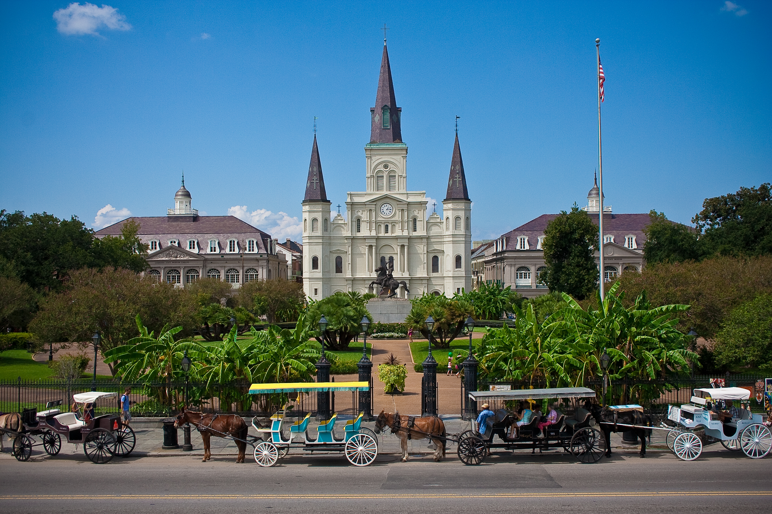
St. Louis Cathedral, New Orleans
Image Credits
Slide 1: jc.winkler, https://creativecommons.org/licenses/by/2.0/deed.en, Wikimedia Commons
Slide 2: Bluepoint951, https://creativecommons.org/licenses/by-sa/2.5/deed.en, Wikimedia Commons
Final Slide: Royalpt78, https://creativecommons.org/licenses/by-sa/3.0/deed.en, Wikimedia Commons
Return to Main Menu

