Slide 1
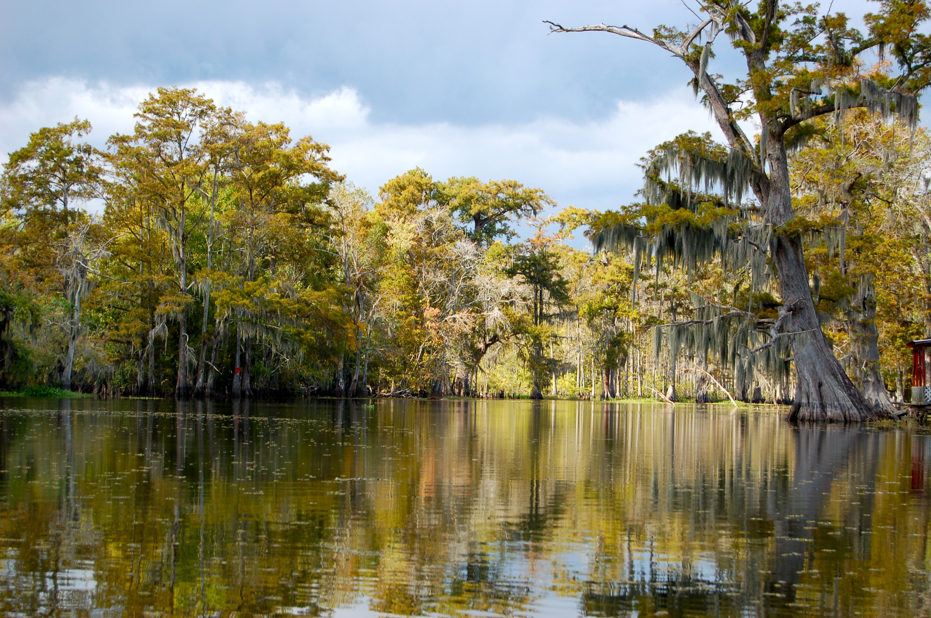
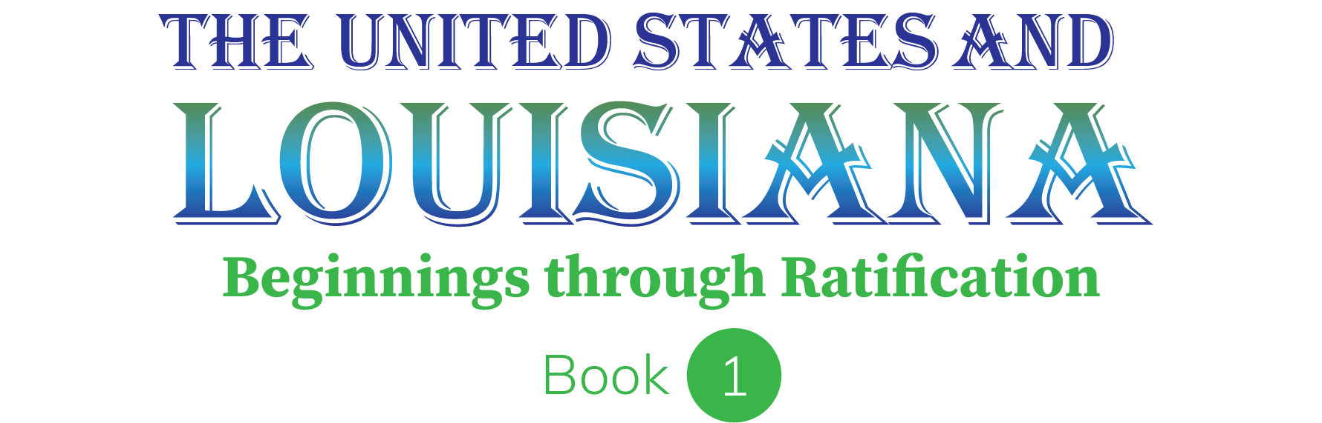
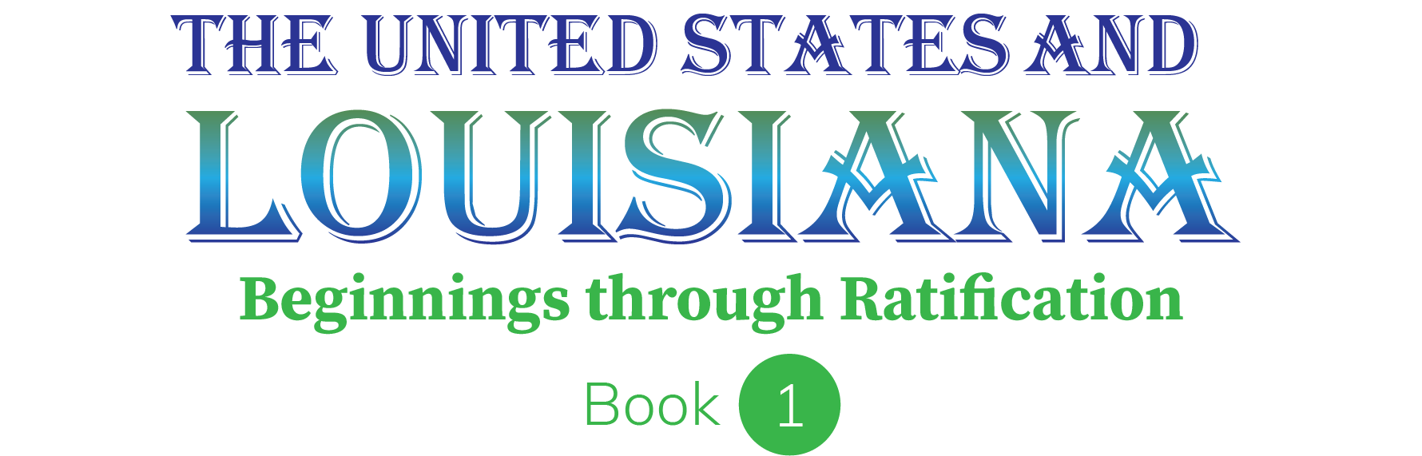
Chapter 10: The Road to Independence
STUDY PRESENTATION
© 2023 Clairmont Press

Slide 2
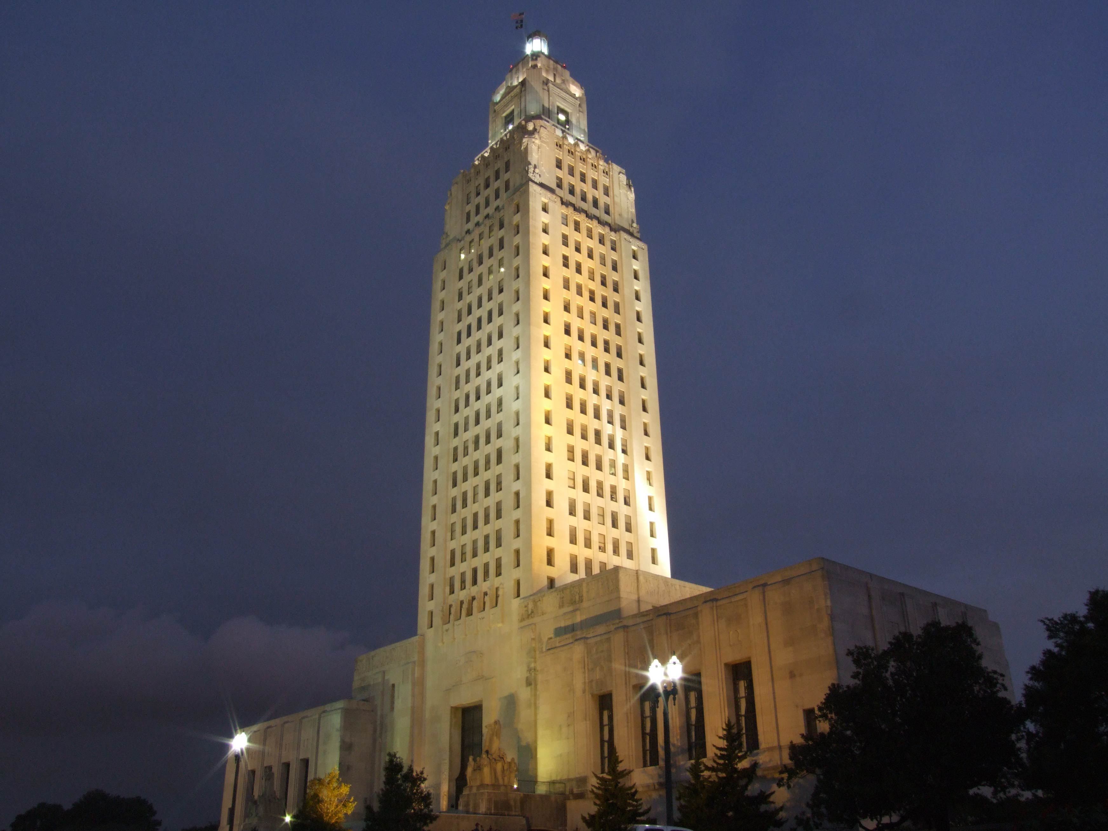
Louisiana State Capitol building, Baton Rouge
Section 2: The French and Indian War

Slide 3
Section 2: The French and Indian War
Essential Question
  What were the consequences of the French and Indian War?

Slide 4
Section 2: The French and Indian War
What terms do I need to know?
  Treaty of Paris of 1763
  Treaty of Fontainebleau

Slide 5
The French and Indian War
By the 1750s, over 2,000,000 colonists lived in Britain’s thirteen American colonies while just 60,000 French colonists lived to the north in Canada.
Farming in Canada’s cold climate likely limited the number of people who were willing to leave France and settle in Canada.
The valuable fur trade with Native Americans was the most profitable activity of the colonists in Canada.
This led to frequent conflict among Indian nations for greater control of the fur trade.

Slide 6
The French and Indian War Pt. 2
The Iroquois Wars began in 1640 and lasted into the next century.
The Iroquois Confederacy wanted more land for fur trading with the Dutch and British, but this provoked conflict with their Native American neighbors and their French allies.
France maintained good relations with many Indian groups despite the Iroquois' victory.
This proved important when disputes over land west of the Appalachian Mountains erupted in the 1750s between eager British colonists and the French.

Slide 7
Control of the Ohio River
No roads existed in the frontier, and while there were paths made by Indians and animals, travel by river was an easier and faster way to move people and supplies.
Control of rivers like the Ohio River, which flowed from Pennsylvania to the Gulf of Mexico, was important.
The point where the Allegheny and Monongahela Rivers form the Ohio River made an ideal location for a fort that could control the rivers and region.
This spot became the flash point for war between Great Britain, France, their Indian allies, and their colonists in the 1750s.

Slide 8
Young George Washington, Diplomat
Virginia’s Royal Governor Dinwiddie was alarmed by reports in 1753 that the French were building forts to secure the Ohio River.
Dinwiddie sent a young George Washington, a Virginia militia major, and a handful of men to order the French to leave.
The French politely welcomed Washington, read Dinwiddie’s demand for them to return to Canada, and then sent Washington back to Virginia with their refusal.
Both sides raced to seize and secure the land at the Ohio River.

Slide 9
The Battle of Fort Necessity
The next year, Washington, now a colonel, led a force of Virginia troops westward to secure the site.
He learned the French had already built their own Fort Duquesne, so he had his men build a small fort 50 miles away called Fort Necessity and waited for reinforcements.
Colonel Washington learned a party of potential French spies were encamped nearby, so he confronted them and ended up capturing or killing most in a few minutes.
This was Washington’s first military victory, but war had not been declared between Great Britain and France yet, which would be a problem.

Slide 10
The Battle of Fort Necessity Pt. 2
The French commander at Fort Duquesne was furious when he learned what happened.
He claiming his troops had been sent on a diplomatic mission to tell Washington leave French territory and had no intention of fighting.
Washington and his men found themselves in a desperate situation on July 3, 1754.
  They were outnumbered two-to-one by the French and their Indian allies
  They were stuck in their fort in an open field while the enemy was in the trees.
  They were stuck in heavy rain with damp gunpowder while the enemy continued to shoot at them from dry cover.

Slide 11
The Battle of Fort Necessity Pt. 3
The French asked for a truce just when it seemed Washington and his men would be defeated.
They allowed Washington and his men to march back to Virginia after he signed a surrender document pledging they would not return to the region for a year.
Since the document was written in French, Washington was shocked to learn later that it said he had assassinated a French diplomat in the small French force, that such actions were grounds for war, and that Washington’s admission was enough to blame the British for the conflict.
Washington argued that he didn’t know the document said anything about a French diplomat, and he would have never signed had he understood what it said.

Slide 12
The Battle of Fort Necessity Pt. 4
Washington’s reputation was damaged by these events, but most Virginians believed his explanation and supported him.
One year later, Washington joined General Edward Braddock and his troops in an expedition against Fort Duquesne.
Braddock’s army was nearly wiped out by a much smaller force of Indians allied with the French, and Braddock was killed, forcing a disgraceful return to Virginia.
By 1756, the conflict between France and Britain expanded into with fighting in Europe and much of the rest of the world.

Slide 13
The End of the War
British and colonial troops, as well as the navy, kept the pressure on France and eventually captured Fort Duquesne, Quebec, and Montreal from 1758 to 1760.
To avoid capture of their valuable Caribbean sugar colonies, France ended the war with the signing of the Treaty of Paris of 1763, which included the transfer of Canada to British rule.
France secretly transferred control of Louisiana to Spain, who had sided with France through the Treaty of Fontainebleau in 1762, to prevent the British from gaining possession of it.
Spain gained territory in this arrangement, but it lost valuable colonies in Cuba and the Philippines to Britain, so to regain control of those colonies, Spain surrendered Florida to the British.

Slide 14
War Debt Leads to New Colonial Policies
The end of the French and Indian War in 1763 should have been a good thing for Britain and her American colonies.
  The land Britain gained from the ordeal was enormous.
  The removal of France from North America reduced the threat of French or Indian attacks.
However, the war cost so much money to fund that British leaders had to borrow millions of English pounds, which left the government heavily in debt.
British leaders felt that the inhabitants of Great Britain already paid enough in taxes, so they turned to the colonies to relieve the debt.

Slide 15
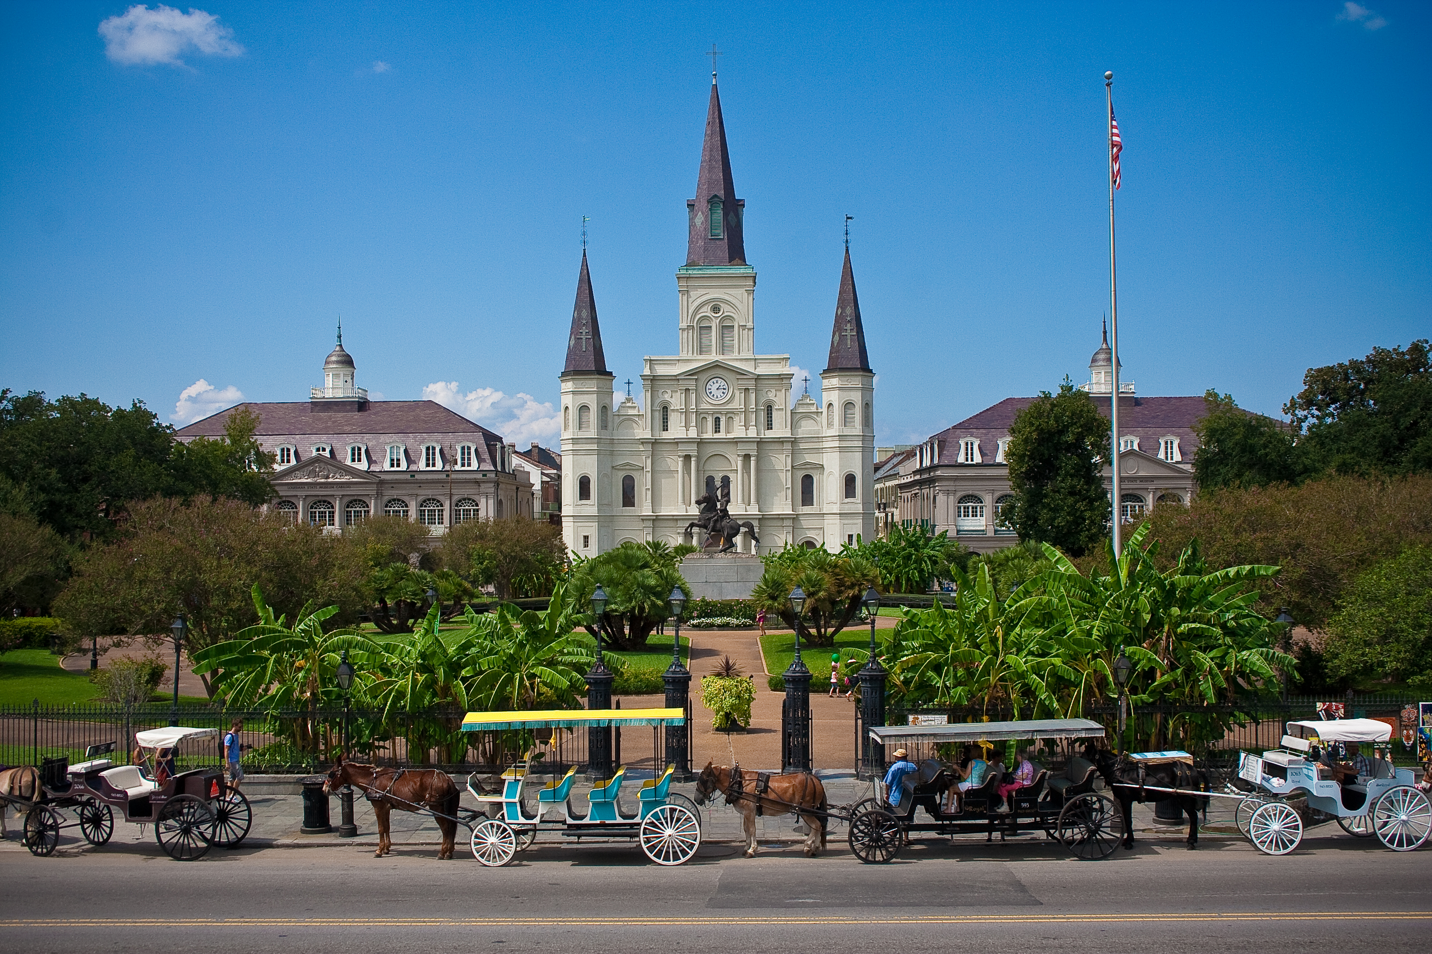
St. Louis Cathedral, New Orleans
Image Credits
Slide 1: jc.winkler, https://creativecommons.org/licenses/by/2.0/deed.en, Wikimedia Commons
Slide 2: Bluepoint951, https://creativecommons.org/licenses/by-sa/2.5/deed.en, Wikimedia Commons
Final Slide: Royalpt78, https://creativecommons.org/licenses/by-sa/3.0/deed.en, Wikimedia Commons
Return to Main Menu

