Slide 1



Chapter 10: The Road to Independence
STUDY PRESENTATION
© 2023 Clairmont Press

Slide 2
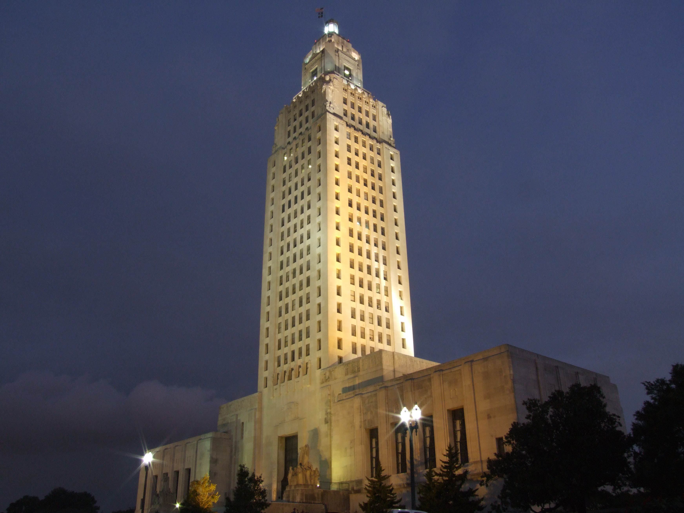
Louisiana State Capitol building, Baton Rouge
Section 4: Tensions Rise to a Breaking Point

Slide 3
Section 4: Tensions Rise to a Breaking Point
Essential Question
  Why did colonists opposed the Tea Act even though it might lower the price of tea?

Slide 4
Section 4: Tensions Rise to a Breaking Point
What terms do I need to know?
  Tea Act
  Committees of Correspondence
  Boston Tea Party
  blockade
  Coercive (Intolerable) Acts
  First Continental Congress

Slide 5
Tensions Rise to a Breaking Point
Repealing the Townshend Duties and removing British troops from Boston helped calm tensions between Britain and the colonies.
Although the tax on tea remained, most colonists resumed their purchase of boycotted goods except for tea.
Many colonists refused to buy British tea, others drank smuggled Dutch tea, and some stopped drinking tea.
The British East India Company soon found itself with a large supply of rotting.
It begged Parliament for help, and they passing a new law they hoped would convince the American colonists to drink the tea.

Slide 6
The Tea Act of 1773
The Tea Act was not designed to raise money from the colonies and was instead meant to help the East India Company, making them the only legal supplier of tea to the colonies.
The act also removed several trade regulations that increased the price of the tea.
Parliament believed the Tea Act would allow the East India Company to sell its tea to the colonists even cheaper than the smuggled Dutch tea and might convince the boycotting colonists to purchase it.

Slide 7
The Tea Act of 1773 Pt. 2
Many colonial leaders condemned the Tea Act, noting the tax on tea remained and lowering the price was just a way to trick colonists into buying the taxed tea.
Committees of Correspondence formed in most of the colonies, with the purpose to share information between the colonies through frequent letters and allow the colonies to coordinate their opposition to Parliament.
When large tea shipments were sent to the colonies in 1773, protesters in several cities prevented the tea from being unloaded, but they went a step further in Boston.

Slide 8
The Boston Tea Party
On December 16, 1773, a large crowd of Bostonians discussed what to do about three East India tea ships docked in the harbor, wanting to prevent it from being unloaded, sold, or consumed.
Fifty men disguised themselves as Indians and dumped over 300 chests of tea, worth over a million dollars today, into the ocean.
British officials were furious, and they demanded those involved be arrested and the tea be paid for.
Few in Boston cooperated, and only one person was identified and arrested for his involvement in the event known as the Boston Tea Party.

Slide 9
The Coercive (Intolerable) Acts
Parliament hit back in spring of 1774 with many laws punishing the whole colony of Massachusetts, especially Boston.
The Boston Port Act ordered the British navy to close blockade Boston’s port, meaning the use of naval forces to stop shipping.
Hundreds of people lost their jobs as a result, and the entire city suffered from the lack of trade.
The Massachusetts Government Act replaced the elected government official with a military general, Thomas Gage, who was free to rule the colony as he pleased.
The new military governor also sent accused criminals to England for trial instead, violating a long-held British principle of the right to be tried by a jury of one’s peers.

Slide 10
The Coercive (Intolerable) Acts Pt. 2
Thousands of British troops were sent in the summer of 1774 to enforce these laws.
The Quartering Act, which applied to all the colonies, required colonists to provide and pay for housing and food for British troops stationed there.
These laws were called the Coercive Acts in England, but in America, they were called the Intolerable Acts, with colonists saying these acts went to far and violated their rights.
Many colonists believed what happened at the Tea Party was too much, but they believed Parliament’s overreaction was even worse and couldn’t be ignored.

Slide 11
Reaction to the Intolerable Acts
Across the colonies, colonists met to discuss how to respond, wondering if they should try to help Massachusetts or stay out of the dispute?
Some colonists believed Parliament was right to punish Massachusetts, that they got what they deserved for being troublemakers, and the others should stay out of the dispute.
Other colonists countered, arguing the Intolerable Acts were unconstitutional and had to be opposed, because the alternative would be Parliament passing unconstitutional laws and oppressing every colony.

Slide 12
The First Continental Congress
Colonial leaders were summoned for a meeting in Philadelphia to discuss the matter further.
Every colonies but Georgia sent representatives to this First Continental Congress.
Those who arrived in September 1774 were some of the most important leaders in the colonies:
  Sam Adams, John Dickinson, and Patrick Henry were all known throughout the colonies for their opposition to Parliament.
  Other delegates like John Adams and George Washington would soon emerge as leaders.

Slide 13
The First Continental Congress Pt. 2
The delegates agreed that Parliament’s actions against Massachusetts were unconstitutional and illegal, but they disagreed on what to do about it.
Some believed written petitions to Parliament and King George III would be best, others argued the petitions they sent for earlier acts had little effect, but most agreed it was time to take more forceful actions.
Some wanted all the colonies to prepare their militias, but most thought such a proposal went too far as the idea of fighting against their own countrymen was too much for many to consider in 1774.

Slide 14
The First Continental Congress Pt. 3
The First Continental Congress voted to boycott nearly all British goods as long as the Intolerable Acts existed to pressure Parliament, pledging to stop selling goods to Britain if the acts were not repealed by September 1775.
This showed a lot of support for Massachusetts and was the opposite of what Parliament expected.
British leaders believed their harsh measures against Massachusetts would intimidate the other colonies to behave better, but it instead brought them closer together.
Many colonists saw Boston’s problem as their own and were willing to sacrifice their own comfort in order to help them.

Slide 15
Gunpowder and Arms
Colonial leaders hoped the boycott would convince Parliament to repeal its actions, but there were reports of more British troops sailing for Boston to join those already in the city.
Parliament also banned the shipment of gunpowder and musket to the colonies, suggesting Parliament hoped to disarm them to subdue the colonies by force.
Obtaining gunpowder and weapons, as well as forming and training militias, became the primary task across the colonies.

Slide 16
“Liberty or Death”
Patrick Henry declared, “Give me liberty or give me death!” at a meeting of Virginia’s leaders in spring of 1775, arguing there was no reason for Britain to send so many troops other than to subdue the colonists and that war with Great Britain could not be avoided.
Twelve years of disagreements between the Parliament and the colonies in America had now reached a breaking point, and events in Massachusetts three weeks after Henry’s speech would prove him correct.

Slide 17
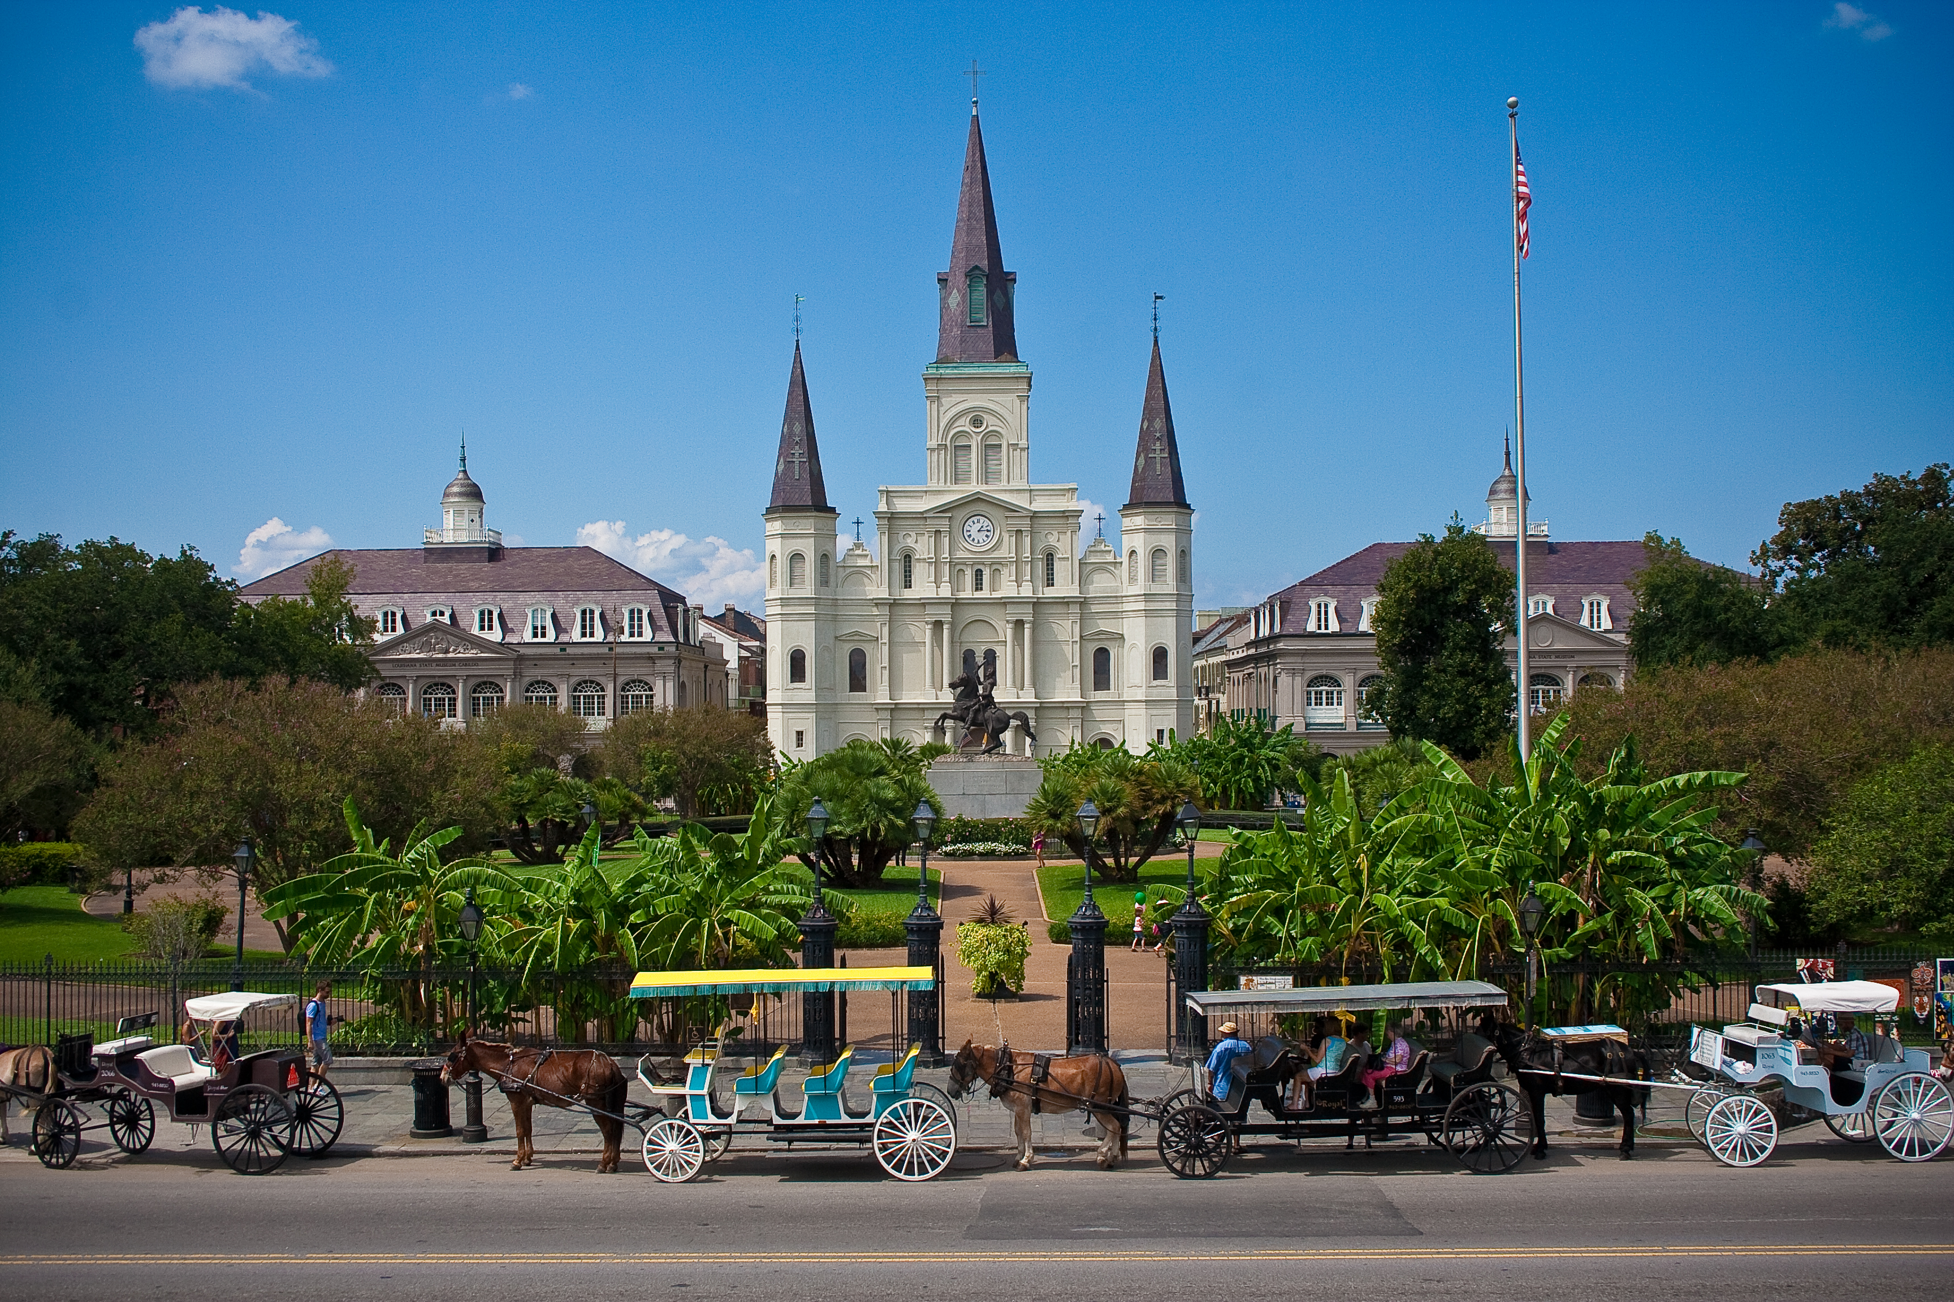
St. Louis Cathedral, New Orleans
Image Credits
Slide 1: jc.winkler, https://creativecommons.org/licenses/by/2.0/deed.en, Wikimedia Commons
Slide 2: Bluepoint951, https://creativecommons.org/licenses/by-sa/2.5/deed.en, Wikimedia Commons
Final Slide: Royalpt78, https://creativecommons.org/licenses/by-sa/3.0/deed.en, Wikimedia Commons
Return to Main Menu

