Slide 1
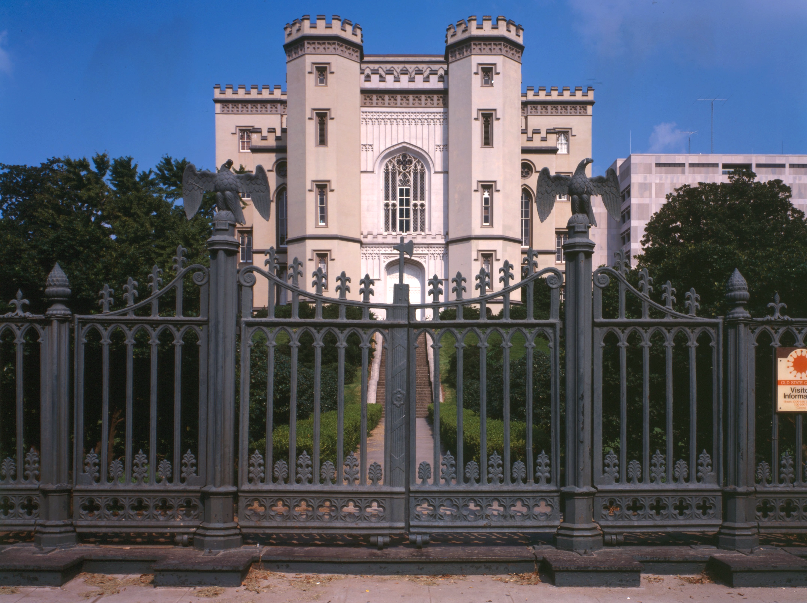

SMART SKILLS
Week 3 – Art & Artifacts 1
© 2023 Clairmont Press

Slide 2
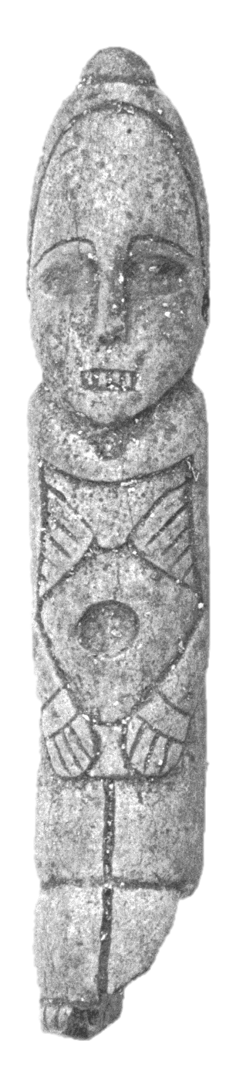
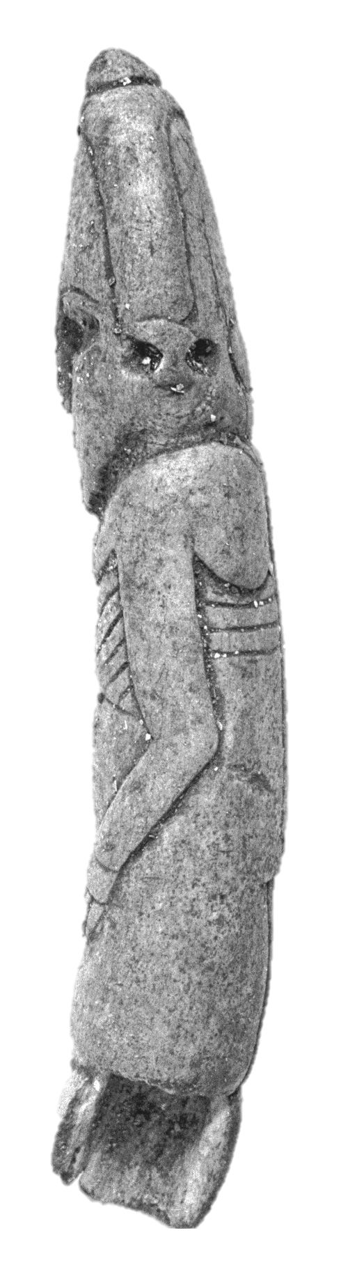
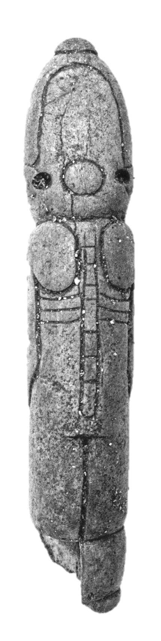
Monday
“The Morgan Effigy” from the
Coles Creek culture
  The object shown is an artifact or item of historical interest made by humans. What do you think this artifact is?
Notes:
A sculpture or model of a person.

Slide 3
Tuesday
“The Morgan Effigy” from the
Coles Creek culture
  An effigy artifact is a sculpture or model of a person.
  What reason could people have for making effigies in the past?
Notes:
Answers may vary, but usually it is done to respect someone or something

Slide 4
Wednesday
“The Morgan Effigy” from the
Coles Creek culture
  This effigy is made of deer antler found in a Native American mound on Pecan Island, Louisiana. What might this effigy represent or be related to?
Notes:
Answers may vary, but the effigy is believed to have been part of a burial, either representing a deceased high-ranking person or the embodiment of death itself.

Slide 5
Thursday
“The Morgan Effigy” from the
Coles Creek culture
  What might this effigy reveal about the civilization that created it?
Notes:
As civilizations develop and grow, more time can be made for art and expression. These people had the time, skill, and resources to create this work.

Slide 6
Friday
“The Morgan Effigy” from the
Coles Creek culture
  What judgements would you make about the ancient Coles Creek culture based on observing this effigy?
Notes:
Answers will vary

Slide 7
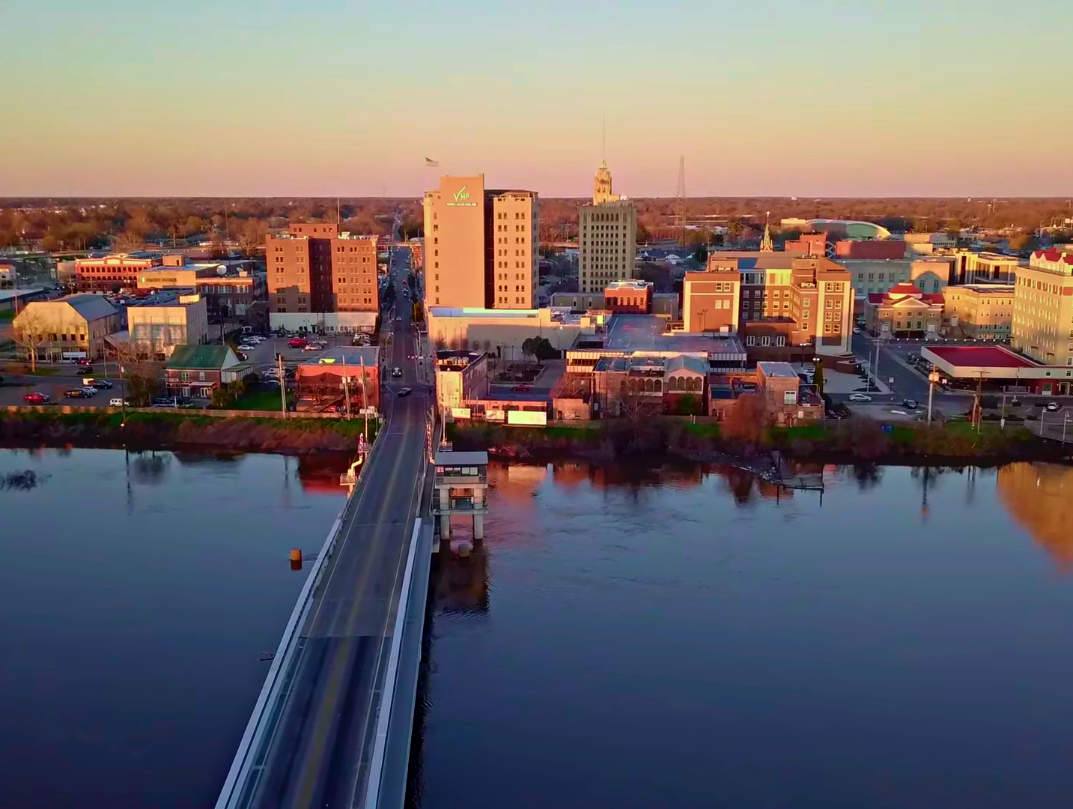
Image Credits
Title Slide: Old Louisiana State Capitol, Public Domain, Wikimedia Commons
Slides 2-6: The Morgan Effigy, http://vermilionhistorical.com/archives/features/topics/morgan_effigy.htm.
End Slide: Monroe, Louisiana skyline in 2021, by TheLionHasSeen, Uploaded 12 April 2021, Wikimedia Commons

