Slide 1
SMART SKILLS
Week 23 – Art & Artifacts 5
© 2023 Clairmont Press

Slide 2
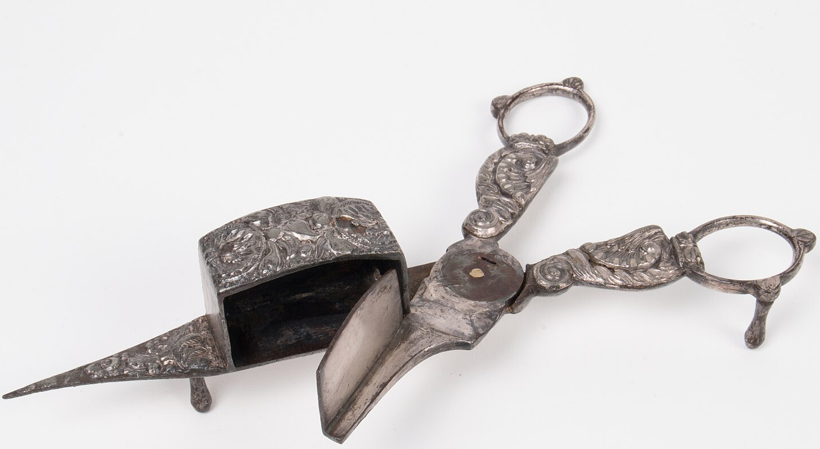
Monday
Study the image carefully.
Make a list of as many observations as you can.
Notes:
Answers will vary. Allow no more than two minutes for students to make their lists. In the class discussion, be sure to focus students’ responses on OBSERVATIONS only, not speculation about the subject of the image.
Students will use these observations on Tuesday.

Slide 3
Tuesday
Based on the observations from the previous day, what do you believe is shown in the image? What is the purpose of the image? Explain your thinking.
Notes:
Answers will vary.

Slide 4
Wednesday
This object is between 200 and 300 years old and about 6 inches long. This scissor-type candle snuffer was used to clip the burning wick of a candle to put out its flame. Why would this be useful? Are there other tools for this task? Would this have been a common household object? Explain your thinking.
Notes:
Answers will vary.

Slide 5
Thursday
The pointed end of the snuffer was used to lift a wick upward away from the candle. The burnt end was held to smolder in the box until extinguished. What clues are there that this is a luxury item?
Notes:
Answers will vary but may include the detailed carving, it is made of metal (silver?), it’s not something that a regular person could make at home – it would require a skilled craftsman, etc.

Slide 6
Friday
What modern-day devices have a similar use?
What examples can you give of luxury or expensive goods that work in the same way as simpler, cheaper goods?
Notes:
Answers will vary. Examples: light switch, remote controls, smartphones can be used to control lighting in a room, etc.
For the second question, there are many examples of luxury goods which cost more than cheaper versions which perform the same task.

Slide 7
Image Credits
Title Slide: Old Louisiana State Capitol, Public Domain, Wikimedia Commons
Slides 2-6: The Morgan Effigy, http://vermilionhistorical.com/archives/features/topics/morgan_effigy.htm.
End Slide: Monroe, Louisiana skyline in 2021, by TheLionHasSeen, Uploaded 12 April 2021, Wikimedia Commons

