Slide 1
SMART SKILLS
Week 30 – Cartoon 6
© 2023 Clairmont Press

Slide 2
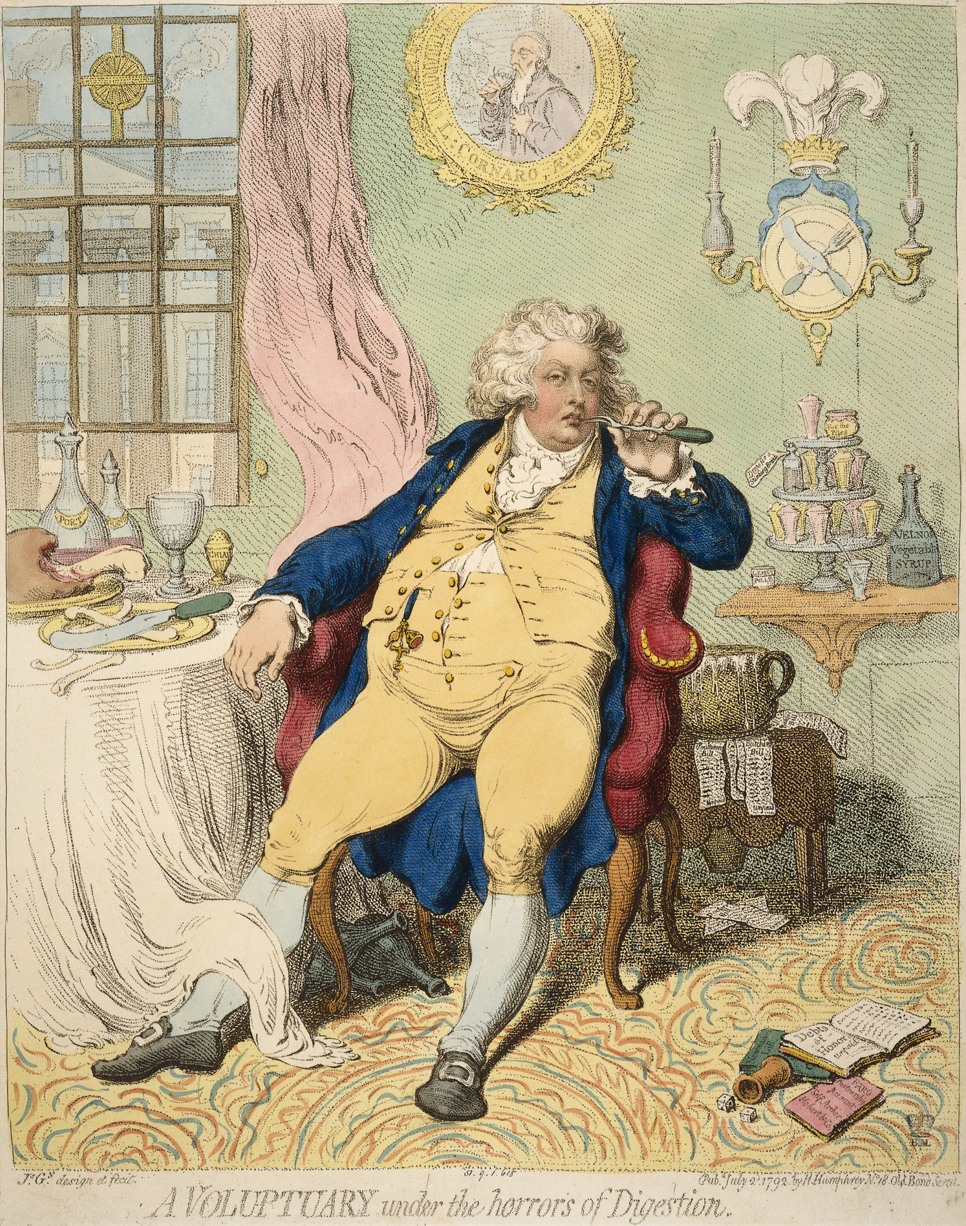
Monday
Study the political cartoon. Record things that you notice about it. What questions do you have?
Notes:
Answers will vary. Students should record OBSERVATIONS only.
Focus discussion on the observations and note the date (1792).

Slide 3
Tuesday
Who do you think is being represented in the cartoon?
What clues do you have to support your thinking?
Notes:
Allow discussion of students’ responses. This is a chance for students to make inferences based on their observations and prior knowledge.

Slide 4
Wednesday
Ostrich features on the right are a symbol of the Prince of Wales.
The man in the image is the Prince of Wales, the future King George IV, at age 20.
How does the cartoonist view the young prince? What evidence supports your thinking?
Notes:
Answers will vary. Sample ideas: The cartoonist thinks the prince overeats and gambles (dice and book of debts on the floor). The prince can barely button his vest from overeating, etc. His coat of arms is a plate with knife and fork, that shows he is making fun of the prince.

Slide 5
Thursday
A caricature is a picture of a person which exaggerates features. The exaggerations may poke fun at the person or make them identifiable.
Political cartoonists often make caricatures of people to get an emotional reaction.
What features of the prince do you think are exaggerated to make the caricature?
What other exaggerations are in the image?
Notes:
Answers will vary. Sample: The prince may not have been so overweight; his eyes look sleepy or lazy. He probably did not pick his teeth with a fork, eat huge meals, etc.

Slide 6
Friday
Understanding a political cartoon can be difficult. What information is needed to understand the full meaning of this image?
Notes:
Answers will vary. The word definition of the word “voluptuary” would be helpful. It was helpful to know that ostrich features symbolized the British Prince of Wales, etc.

Slide 7
Image Credits
Title Slide: Old Louisiana State Capitol, Public Domain, Wikimedia Commons
End Slide: Monroe, Louisiana skyline in 2021, by TheLionHasSeen, Uploaded 12 April 2021, Wikimedia Commons

